Slide 1
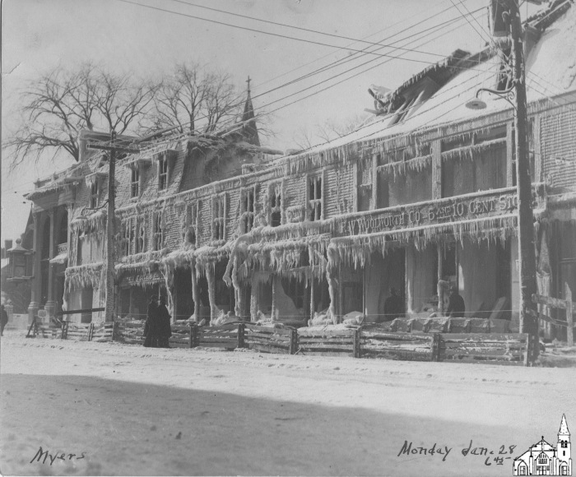
Folsom Block [Fire, 1935] (OBJ.A.2001.12)
Photo of the damage done to the Folsom Block by the Fire of January 1935, taken at 6:45pm of the day of the fire. The Woolworth storefront is still clearly visible. Signed by Myers.

Slide 2
Old Town Festival Chorus [1940] (OBJ.A.2001.51)
Flier for the Third Annual Concert by the Old Town Festival Chorus (with Mrs. Rita Silver as Guest Artist) on Monday Evening, April 29th, 1940. Lots of ads.

Slide 3
Preparedness Parade (Old Town)[1917] (OBJ.A.2001.65)
Postcard with a photo of the Old Town Preparedness Parade of April 14, 1917. Exact location unclear.

Slide 4
Universalist Church (Old Town) [XX Club, 1890s] (OBJ.A.2002.8)
Photo of three men and nine women. On the back, the man at the center is identified as Andrews, Universalist Minister. Others are identified as Helen Pratt, Susann Pratt, Nellie Chapman, Clara Cooper, Lida Brown, and William Waterhouse. Undoubtedly, Andrews refers to Frank C. Andrews, who was the Universalist minister in Old Town from 1891 to 1897. Thus the photo most likely dates from the 1890s, which is corroborated by fashion and hairdo. Most of the others mentioned by name are known to have been officers of the so-called (Universalist) XX Club. This club was responsible for the organization of a lot of social activities for younger people during the 1890s and early 1900s. Starting in 1895, members would proudly sport a double-X pin to identify them as a member. The organization seems to have faded away in the 1910s. This photo might be either a group portrait of all of the XX Club in its very early years or a portrait of just its officers. Since there are no pins, this owuld mean that the photo was taken in or before 1895.

Slide 5
View of Old Town from Milford [1870s] (OBJ.A.2003.10)
Stereographic card with view of Old Town as viewed from Milford (roughly from where the Miford Power Plant is now). Not marked as an Averill photo, but it has all the hallmarks of one. May be a later copy as the two sides are one photo, with one side depicting some damage but not actually being damaged itself.

Slide 6
T. Chapman Company [Flier, 1910s] (OBJ.A.2003.38)
Flier for Chapman's Gang Lathe Mill.

Slide 7
PCF [Photo, 1980s] (OBJ.A.2003.93)
Aerial color photo of the PCF plant in Great Works mounted on cardboard.

Slide 8
PCF [Photo, 1980s] (OBJ.A.2003.94)
Aerial color photo of the PCF plant in Great Works mounted on cardboard.

Slide 9
Old Town Junior High [Photo, 1930s] (OBJ.A.2004.33)
Photo of a group of middle-school-age, all female students in front of an unidentified building. Hard to date exactly.

Slide 10
Old Town Junior High School Orchestra [Photo, 1931-2] (OBJ.A.2004.37)
Photo of 11 members of the Old Town Junior High School Orchestra for the year 1931-2 along with their names. Maude Gould Powers is listed as the Director and Dorothy Burke as her Assistant (neither is depicted).

Slide 11
Redskins Game (Old Town) [Ticket [student), 1930-60] (OBJ.A.2004.5)
One student ticket for an Old Town Redskins Basketball game at the Helen Hunt High School.

Slide 12
H.W. Marsh House (Old Town) [1910s] (OBJ.A.2004.57b)
Photo of the house built on Center Street by H.W. March (1857-1940) in 1901. Marsh was a descendent of John Marsh and a lumberman by trade. He built a number of houses in Old Town (mainly on 4th Street and on Center Street). His second wife was Alice Eldora ("Dora") Oakes Marsh (1858-1950) and both hailed from Argyle.

Slide 13
Redskins Game (Old Town) [Ticket (adult), 1930-1960] (OBJ.A.2004.6)
One adult ticket for an Old Town Redskins Basketball game at the Helen Hunt High School.

Slide 14
Directors' Records for the Penobscot Development Company (Old Town/Boston, 1955-64] (OBJ.A.2005.18a)
Mostly minutes of meetings in Bangor and Boston.

Slide 15
Directors' Records for the Penobscot Development Company (Old Town/Boston)[1964-7] (OBJ.A.2005.18b)
Mostly minutes of meetings in Bangor and Boston.

Slide 16
Willey Log Scale Book [1896] (OBJ.A.2005.57a)
Log scale book kept by M. Willey (?-?) from May through August 1896 at the Pea Cove and Nebraska Booms.

Slide 17
Bailey Log Scale Book [1896] (OBJ.A.2005.57b)
Log scale book kept by F.A. Bailey (?-?) from May through August 1896 at the Argyle Boom.

Slide 18
Watters Log Scale Book [1896] (OBJ.A.2005.57c)
Log scale book kept by G.D. Watters (?-?) from May through August 1896 at the Argyle, Nebraska and Peabody Booms.

Slide 19
Quincy Log Scale Book [1894] (OBJ.A.2005.57d)
Log scale book kept by F.G. Quincy (?-?) from July through August 1894 at the Nebraska Boom.

Slide 20
Bartlett and Dudley Log Scale Book [1889] (OBJ.A.2005.57e)
Log scale book kept by J.B. Bartlett (?-?) and George Dudley (?-?) from May through August 1889 at the Argyle, Pea Cove, and Nebraska Booms.

Slide 21
Hatch Log Scale Book [1889] (OBJ.A.2005.57f)
Log scale book kept by Fremont Hatch (?-?) from May through August 1889 at the Argyle Boom.

Slide 22
Bagley Log Scale Book [1890] (OBJ.A.2005.57g)
Log scale book kept by James F. Bagley (?-?) from June through October 1890 at the Argyle, Pea Cove, and Nebraska Booms.

Slide 23
OTHS Graduation [Program, 1910] (OBJ.A.2005.74)
Program for the graduation exercises of Old Town High School for Friday, June 17, 1910. With the names of all of the students.

Slide 24
West Old Town Elementary School [Souvenir, 1899] (OBJ.A.2005.75)
Two page souvenir flier of the West Old Town Public School presented to Mabelle Smith (teacher) and Byron Porter (Director) with the names of thirteen pupils on it.

Slide 25
2nd Maine Infantry [Company G, 1917] (OBJ.A.2006.11)
Photo by A.F. Orr of Company G of the 2nd Maine Infantry. During August 1917, Orr was at Fort Keyes (August, ME) to photograph various Maine regiments as they were mobilizing. Therefore, it seems likely that this particular photo was taken there. The 2nd Maine Infantry was sent overseas in September 1917.

Slide 26
OTHS Graduation [Photo Collage, 1920] (OBJ.A.2010.11)
Composite photo with cabinet pictures of 44 members of the OTHS Class of 1920. Photo taken by the Perry Studio. A sheet of paper with most of the names typed on it is glued to the back of the photo.

Slide 27
Bangor, Old Town and Milford Railroad [Collage, 2008] (OBJ.A.2010.12)
Framed poster with several original items connected with the Bangor, Old Town, and Milford Railroad: photo of the Pioneer engine (cut out of original journal), first day cover for 100th anniversary of line, 2 Bangor, Old Town, and Milford Freight Tickets, Penobscot River Steamboat Ticket; Old Town & Lincoln Railroad Stock Certificate (blank), Old Town & Lincoln Railroad Proxy Ballot (blank)

Slide 28
Charlie Dow House [1890-1920] (OBJ.A.2010.14)
Duplicate of OBJ.O.2004.56.4

Slide 29
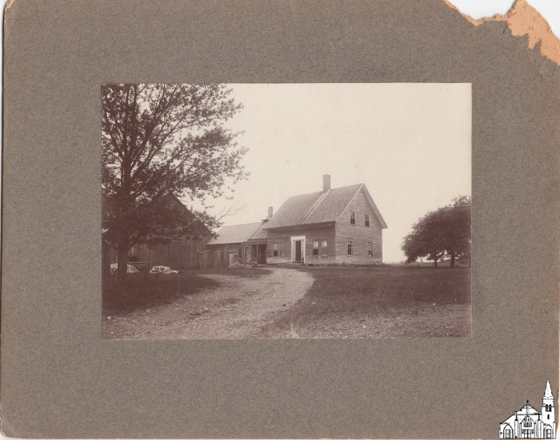
Farmhouse with Barn [1904-1921] (OBJ.A.2010.9)
Unknown farmhouse with barn at unknown location. According to stamp on the back, the image taken by A.F. Orr

Slide 30
Old Town High School Basketball Team [1913] (OBJ.A.2011.1)
Photo of the 1913 Old Town High School Basketball Team with six players (Lawrence Curran, Fred Hutchinson, Lewis Miller, Stanley Needham, Homer Orr, Linwood Rand), coach Frank West and principal James Hamlin. Embossed with the logo of A.F. Orr (Homer's father) in the left bottom corner of the margin.

Slide 31
OTJHS [Yearbook, 1969] (OBJ.A.2011.12a)
1969 Yearbook for the Old Town Junior High School.

Slide 32
OTJHS [Yearbook, 1970] (OBJ.A.2011.12b)
1970 Yearbook for the Old Town Junior High School.

Slide 33
Gleason's Pictorial Companion [1854] (OBJ.A.2011.16)
Framed original of p.312 of Vol.6 of Gleason's Pictorial Drawing-Room Companion with two engravings of Indian Island as seen from the ferry landing, sketched by a young Samuel Smith Kilburn (1831-1903) and engraved by A.B. (?) along with some (rather minimal) accompanying text. This page was part of No. 20 of that year, which issue was published on May 20, 1854. Kilburn went on to become a well-known illustrator. The American Antiquarian Society in Worchester (MA) still holds his sketchbooks from 1855 to 1860. No earlier sketchbooks appear to have survived.

Slide 34
International Bible Students Association [c1925] (OBJ.N.0000.1)
Framed photograph of a crowd in front of an IBSA Worship Hall, probably in Old Town. The exact date of the photo is unclear. However, the International Bible Students Association would become the Jehovah Witnesses in 1931, so the photo predates that year. Also, there is a reference in chalk to a lecture on Sunday, Aug. 19 next to the door. Given that the photo was clearly taken during the Interbellum period, that would put the year the photo was taken at either 1923 or 1928. An odd feature of the photo is a tent with an (improvised) sign "Old Town Casket Company, Old Town, Me". No casket company by that name is known to have existed. The photo is signed, but the signature is illegible.

Slide 35
Codman House (Old Town) [Guest Book, 1885] (OBJ.N.0000.12)
Last guestbook for the Codman House right before it burned down on June 12, 1885. The first entry is for May 23, 1885 and the final entry is from June 11. The next day is marked in the book, but there are no entries. For a report on the fire that started early in the morning and the assistance that the Stillwater and Bangor Fire Departments provided in extinguishing it, see the Bangor Daily Whig and Courier of June 13, 1885, p.3.

Slide 36
Dual Alarm Clock [H. H. Herrick branded] (OBJ.N.0000.13)
Steel alarm clock patented Mar. 15, 1898, Jan 29, 1901, Feb 12, 1901, Jan 29, 1907. Branded H. H. Herrick, Jeweler, Old Town, ME.

Slide 37
Police Department [1923] (OBJ.N.0000.3)
Original photograph of Old Town Police Department in modern matting. According to the accompanying label, the photo was taken on May 30, 1923. Depicted are on the front row (f.l.t.r): Corny McCarthy Charthy - Charles Willett's son - Charles Willett - Merritt Towle, with on the back row (f.l.t.r): Lewis Cyr - Dana Whidden - Ben Fortier - Fred L. Curneil.

Slide 38
Old Town Police Department [1923] (OBJ.N.0000.3a)
Modern copy of OBJ.N.0000.3.

Slide 39
Old Town Police Department [c.1977] (OBJ.N.0000.4)
Copy of a photo of the Old Town Police Department taken during the tenure of Chief Palo. Depicted are (front row, f.l.t.r.) Jack Palo (chief), Pat Cotter, Francine Cyr, Don Smart, Marcella Morin, Dale Gauthier, (second row) Lloyd Oliver, Forrest McKenney, Alan Stormann, Paul McManus, Pat Murray, , Steve Martell, (third row) Steve Hatch, Larry McLaughlin, Donald Rhodes, Paul Paradis, Blaine Demont, Arden Jones . The original photo was taken by Steve Martell (who had a background in photography). Photo is pristine, but some scratches are showing in the right-top corner that must have been on the original.

Slide 40
Hellenbrand and Company (Old Town) [c.1920] (OBJ.N.0000.6)
Photo mounted on paperboard of the interior of a store with two people in the back. Below the photo is written "Hellenbrand and Company Old Town Me". No further information available.

Slide 41
Old Town at a Glance [c.1982] (OBJ.N.0000.7)
Binder-style photo album illustrating the revitalization of Old Town from 1978 through 1981. Contains many contemporary photographs of various companies, but some are missing.

Slide 42
Old Town Fire Department [1919] (OBJ.N.0000.8)
Photo of the Old Town Fire Department taken by A.F. Orr on May 30, 1919. In pretty poor shape with sign of worm, water damage, and tears. The original frame had the names of the officers on labels glued onto the glass cover, but the glass broke in 2019. The names of the officers were as follows. Row 1: Cliff Rand, George Boyle, Walter Hurd, Percy Hurd, Alley Gross, Roy Flanders; Row 2: François Bouchard, Meritt Towle, Jake Snow, Andy Applebee, Moses Brissette, Clod Mitchell, Freeman Martin, William Davis, John Richards; Row 3: Red Broadway, Ralph Daigle, Eddie Savoy, Levi Snow, Archie Richard, Charles Parsons, William Violette, Beacher Tagett, Frank Bouchard; Row 4: Harry Tourtillotte, Merle Mitchell, Frank Spruce, Charles Miller, Joseph Dubay.

Slide 43
Old Town Police [Annual Arrest Statistics, 1930-1956] (OBJ.N.1976.1)
Full set of compilations of annual Old Town arrest statistics from 1930 to 1956, partly on standard forms (although often not the right one), partly fully typewritten. Each report covers the period from April 1 to March 31 of the next year.

Slide 44
Sam Harris [Barber, 1900-1920] (OBJ.N.1976.3)
Photo of the inside of Sam Harris' Barber Shop. Harris' collection of shaving mugs is clearly visible in the back. Most likely the barber depicted is Sam Harris.

Slide 45
Donald Commeau [Old Town Water District, 1993] (OBJ.N.1976.4)
Photo of Donald Commeau, Superintendent and Manager of the Old Town Water District, "inspecting" machinery at the old pumping station. He is looking the same and wearing the exact same clothes as in a Penobscot TImes article of May 13, 1993. Probably the photo was taken for possible inclusion in this article.

Slide 46
Interior of Old Town Pumping Station [1954] (OBJ.N.1976.5)
Original of a photo published in the Penobscot Times of Sept. 30, 1954 on p.5. Along with machinery, Bill Jenkins and Lawrence Miller are depicted as well.

Slide 47
Interior of Old Town Pumping Station [1950s] (OBJ.N.1976.6)
Photo of the interior of the pumping station, showing what looks like three reservoirs next to each other. Given the general cleanliness, the station probably was still in use then.

Slide 48
Old Town Pumping Station [Photo, 1929] (OBJ.N.1976.7)
A photo of the construction of the pumping station in progress taken by Frank H. Myers in the morning of Aug 7, 1929.

Slide 49
Old Town Pumping Station [Photo, 1929] (OBJ.N.1976.8)
A photo of the construction of the pumping station in progress taken by Frank H. Myers in the morning of Aug 7, 1929.

Slide 50
Helen Hunt School Gym [Scan/Photo, 1990s] (OBJ.N.1977.19a)
Framed copy of OBJ.O.1977.19

Slide 51
Three men in a bateau [Photo, 1930-1950] (OBJ.N.1977.27a)
Modern photo from an original negative/photo at the Northern Archives for Folklore and Oral History (now at Library of Congress, see links) depicting three men in a bateau moving logs with pick poles. Clothing suggests the time around WWII.

Slide 52
Men on Headworks [Photo, 1900-1930] (OBJ.N.1977.27b)
Modern photo from an original negative/photo at the Northeast Archives for Folklore and Oral History (now at Library of Congress) depicting three men winding on headworks. Note that the Patten Museum owns a photo with virtually the same scene, but taken from a slightly different angle.

Slide 53
Six Men at a Sluice-way [Photo, 1930-1950] (OBJ.N.1977.27c)
Modern photo from an original negative/photo at the Northeast Archives for Folklore and Oral History (now part of Special Collections at Fogler Library) depicting six men standing at the bottom of a sluice-way, prodding logs with pick poles. The original negative/photo has not been located.

Slide 54
Costigan Wharf [1917] (OBJ.N.1977.27d)
Modern photo from an original negative/photo at the Northeast Archives for Folklore and Oral History (now part of Special Collections at Fogler Library) depicting a running crew at the Costigan Wharf. Also depicted in Ives' Argyle Boom, p.71. The original in NAFOH is a little wider and has a clearer view of the three steamers in the background. According to information on at least two other copies of the same photo, the shot was taken in 1917 and depicts Isaiah ("Ide") W. Buzzell (1852-1935) and his crew. The man appearing in charge certainly resembles known depictions of Buzzell, but seems to be somewhat younger than Buzzell would have been in 1917.

Slide 55
Costigan "Bean Hour" [1917] (OBJ.N.1977.27e)
Modern photo from an original negative/photo at the Northeast Archives for Folklore and Oral History (now part of Special Collections at Fogler Library) depicting what looks like a bean hole with a metal structure on top of it and a two men who might have been camp cooks. The photo might have been taken at or around Costigan's Wharf and possibly the men were part of Burr's 1917 crew. The original is wider and depicts two more men.

Slide 56
Logging Crew [1910s] (OBJ.N.1977.27f)
Modern photo from an original negative/photo at the Northeast Archives for Folklore and Oral History (now part of Special Collections at Fogler Library) depicting a logging crew around a Lombard Steam Hauler. Original at NAFOH as not been located.

Slide 57
Argyle Boom Rafting Ground [c1905] (OBJ.N.1977.27g)
Modern photo of a negative/photo at the Northeast Archives for Folklore and Oral History (now at the Library of Congress) depicting the rafting ground at the Argyle Boom looking north from the south end of No Name Island (formerly White Squaw Island). Original taken from Defebaugh, History of the Lumber Industry in America (Chicago, 1906), opposite p.54. See also p.41 (and cover) of Ives' Argyle Boom. None of the photos are of great quality.

Slide 58
North Lincoln Sorting Gap [1900s] (OBJ.N.1977.27h)
Modern photo of a negative/photo at the Northeast Archives for Folklore and Oral History (now at the Library of Congress) depicting the North Lincoln Sorting Gap.

Slide 59
Log Jam on Stillwater River [1923] (OBJ.N.1977.27i)
Modern photo of a negative/photo at the Northeast Archives for Folklore and Oral History (now at the Library of Congress) depicting a log jam, probably on the Stillwater River, possibly during the flood of early May 1923

Slide 60
Pea Cove Boom House [c.1900s] (OBJ.N.1977.27j)
Modern photo of a negative/photo at the Northeast Archives for Folklore and Oral History (now at the Library of Congress) depicting the buildings of the Pea Cove Boom House as seen from the north. See also p.105 of Ives' Argyle Boom.

Slide 61
Argyle Boom Holding Area [1910-1930] (OBJ.N.1977.27k)
Modern photo of a negative/photo at the Northeast Archives for Folklore and Oral History (now at the Library of Congress) depicting the holding area at the Argyle Boom looking north from the north end of No Name Island (formerly White Squaw Island). Photo quality suggests 1910s or 1920s. See also p. 29 of Ives' Argyle Boom.

Slide 62
Log Jam at Black Island Train Bridge [1940-1960] (OBJ.N.1977.27l)
Modern photo of a negative/photo at the Northeast Archives for Folklore and Oral History (now at the Library of Congress) depicting a log jam at the Black Island Train Bridge. Photo quality suggests 1940s or 1950s (possibly 1960s). It is not clear when the bridge was removed.

Slide 63
Argyle Boom Sorting Gap [c1905] (OBJ.N.1977.27m)
Modern photo of a negative/photo at the Northeast Archives for Folklore and Oral History (now at the Library of Congress) depicting the sorting gap at the Argyle Boom looking south from the north end of No Name Island (formerly White Squaw Island) with the rafting grounds in the background and No Name Island on the left. See also p.31 of Ives' Argyle Boom. Likely taken around the same time as OBJ.N.1977.27g (the Argyle Rafting Area)

Slide 64
Pea Cove Boom House [c.1900s] (OBJ.N.1977.27n)
Modern photo made by Charles Buck of a photo at the Old Town Public Library depicting the buildings of the Pea Cove Boom House as seen from the north. See also p.105 of Ives' Argyle Boom.

Slide 65
Pea Cove Boom Piers [c.1900s] (OBJ.N.1977.27o)
Modern photo of a photo at the Old Town Public Library depicting the Pea Cove Boom Piers as seen from the Boom House (ie from the north).

Slide 66
Photograph of Men and Boats on the Penobscot (OBJ.N.1978.55)
A sepia photograph of the Penobscot and several men and rowboats along its bank. Date of creation thought to be 1900-1910. Connection to Old Town unclear.

Slide 67
Joe Duplissie's Home [Photo, 1950s] (OBJ.N.1980.25)
Photo of Joe Duplissie's home on the County Road in Milford.

Slide 68
Hearing Aid (OBJ.N.1980.30)
Hearing aid, black and brown. Hard plastic and rubber tubing. Connection to Old Town unclear.

Slide 69
Dr. Martin C. Madden [Photograph] (OBJ.N.1981.11)
A sepia portrait by Smith Photo Co., 27 Monument Sq., Portland, ME. The subject is Dr. Martin Crowell Madden, taken for Bowdoin Medical School's class of 1901. Dr. Madden ran his medical practice in Old Town, ME from 1902 until his death in 1952. His son erected a memorial at the family home on Center Street May 18, 2008, which may still be seen.

Slide 70
Harriet Louise Norton [Letter, 1861] (OBJ.N.1982.1)
Envelope with letter dated May 9, 1861 from Harriet Louise Norton (1842-1870), married to George Norton since March 1861, in Old Town to her step-mother Francis Huse in Portland. Mostly about George having enlisted, her illnesses and her getting used to the plank sidewalks. Both letter and envelope sport the American flag.

Slide 71
Scrapbook [1920-1960] (OBJ.N.1982.29)
Scrapbook kept by Myrtis Bradline Tourtillotte (1899-1978) with many loose sheets. Contains mostly newspaper clippings and school paraphernalia pertinent to herself and various relatives.

Slide 72
GAR [Convocation, 1894] (OBJ.N.1982.29a)
Postcard announcement of a meeting of the local GAR division on July 27, 1894. Signed: O.B. Fernandez. Removed from OBJ.O.1982.29. Eugene W. Bradeen, the recipient, was Myrtis' father.

Slide 73
OTHS Alumni Association [Name Tag, 1957] (OBJ.N.1982.29b)
OTHS Alumni Association name tag for a 1957 event (full date not legible) for Myrtis (Bradeen) Tourtellotte, Class of 1918. Removed from OBJ.O.1982.29.

Slide 74
Stillwater Covered Bridge [Toll Receipts, 1857] (OBJ.N.1984.1)
Two acknowledgements of receipts from Orimel Rogers for use of the Stillwater toll bridge in 1857 for the periods June 16th to July 16th and Oct 16 to Nov. 16. Signed by W.C Waterton (?).

Slide 75
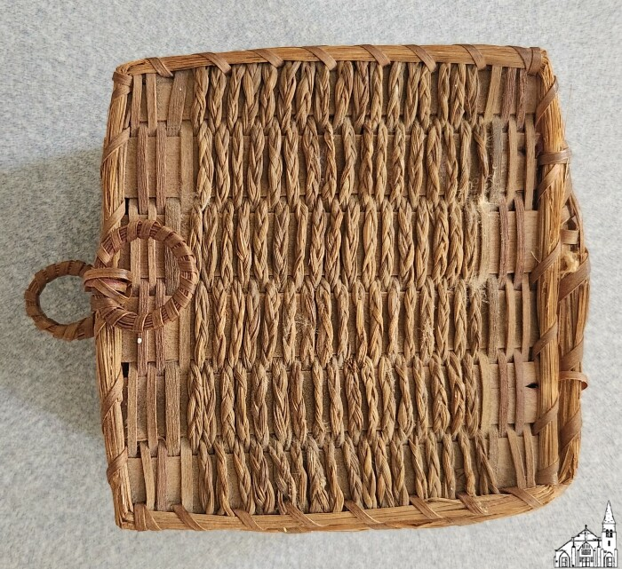
Small Native American-made basket with lid (OBJ.N.1984.250)
Small, square basket with lid attached by a single piece of ash. It has two small circles, one on the lid, and one attached to the basket directly below the first. May possibly be a needle case.

Slide 76
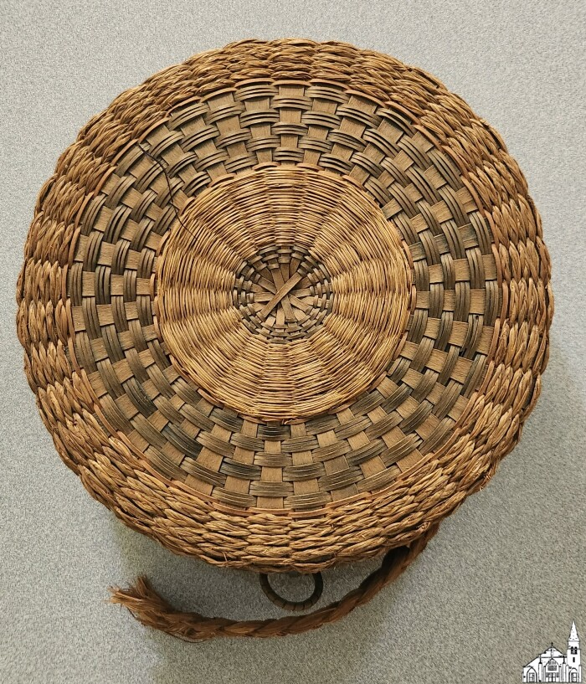
Native American-made fancy flat basket (OBJ.N.1984.251)
Round, sweetgrass fancy flat basket. Has a handle on one side that has been damaged. One circle is attached on the side with the handle, and two circles interlock on the other side. Colors consist of brown, orange, and blue.

Slide 77
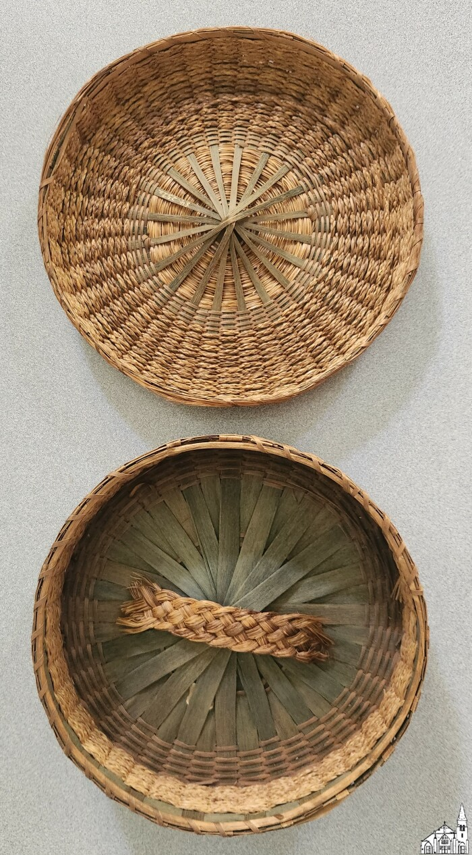
Native American-made fancy flat basket (OBJ.N.1984.252)
Green and brown, round, fancy flat basket with a broken handle that is stored inside.

Slide 78
Tôle Ware Tin Box (OBJ.N.1984.255)
A small tin trunk painted with a green leaf and red circle design. Age and connection to Old Town unclear.

Slide 79
Tôle Ware Tin Box (OBJ.N.1984.256)
Small tin trunk, painted with a green and orange leaf design. Age and connection to Old Town unclear.

Slide 80
Novelty Dresser Box with Mirror (OBJ.N.1984.31)
Plywood box decorated with seashells and mirror. Connection to Old Town unclear.

Slide 81
Celluloid Fancy Comb (OBJ.N.1984.32)
An amber comb, apparently of celluloid plastic, decorated with nine glass "rhinetones." Date of origin estimated early-mid 20th century. Connection to Old Town unclear.

Slide 82
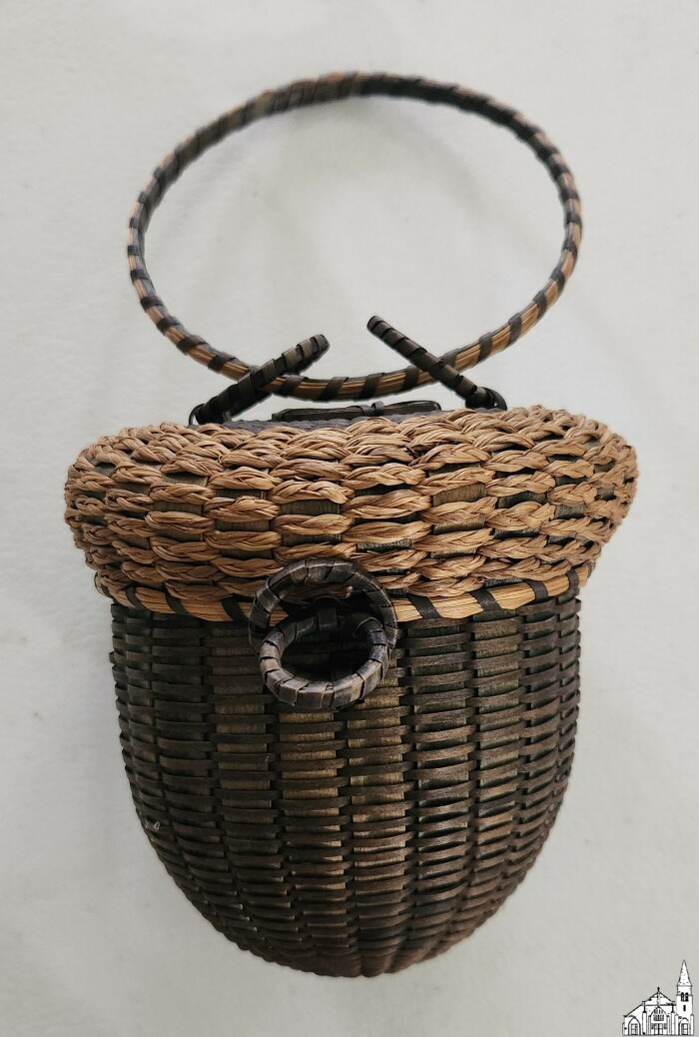
Native American-made acorn knitting basket (OBJ.N.1984.41)
Acorn-shaped knitting basket, green in color, with a ring on top to hold on the arm, and a rounded bottom.

Slide 83
The Penobscot Times' List of Tax Assessments (OBJ.N.1984.8)
A newspaper insert titled "The Penobscot Times' List of Tax Assessments," subtitled "Complete Report of Assessors Published for First Time," and introduced thus: "The object of publishing this tax list is to encourage more equitable valuations on Old Town property. It is NOT a list of delinquent taxes, but all tax levies, paid or unpaid. Names of property owners are followed by the address of the property valued, and valuation. The last figure is the total tax levied. The letter 'P' stands for Personal Property. Attention is called to the fact many pieces of property, including several large industries, are owned by non-residents. These may be found in a separate list on the last page." Unfortunately, the insert is not dated. Though the Penobscot Times dates to 1888, it has undergone several name changes and was only named "The Penobscot Times" beginning in 1941, which likely dates this paper to the period 1941-1979 when it held that name. Based on the dollar amounts listed as property values and tax levies, "e.g. $1200; tax $66" this first issue came out earlier in that time range. Under the Non-Resident list of property owners is an advertisement that reads, "Mail a Copy to Your Friends: Extra copies of this List of Assessments are available at the TIMES office. Mail a copy to your out-of-town friends who may be interested in the tax conditions in Old Town -- 25c per copy."

Slide 84
Oakes House [Photo, 1980s] (OBJ.N.1985.1)
Photo from the 1980s of the house on the lot owned by Samuel G. Oakes (1811-1861) up to 1842, when he defaulted on a mortgage and then later by his brother Hiram (1818-1851), who sold the lot to Isaac and Winslow Staples (1816-1898) in 1844. At that point, the lot had buildings on it. Probably the house was built by Samuel in the early 1830s. Later on, Samuel owned a house on S. Main Street which is depicted on the 1855 Woodford map of Old Town. Dr. Daniel Perley (1797-1878) is supposed to have lived in the first Oakes house at some point, but there is no hard evidence of that. However, when Staples left for WI in 1854, he sold the lot to Oren Clark, Perley's son in law.

Slide 85
Ellis House [Photo, 1980s] (OBJ.N.1985.10)
Photo from the 1980s of the house at the corner of Franklin and Free Streets in Stillwater. From 1838 to 1875 the lot belonged to Dea. William Ellis (1802-1884) who bought it from William Jamison's Orono Company. Based on the architectural features of the house, it was probably built soon after Ellis acquired the lot.

Slide 86
Spencer House [Photo, 1980s] (OBJ.N.1985.11)
Photo from the 1980s of the farm house next to the Newbegin house on Main Street in Milford. Henry Spencer acquired the lot in 1847 as the first local owner and he may have built the house before he sold the lot in 1854. Also owned by William McPhetres and George William H. Brown. Replaced with an apartment complex in 1989.

Slide 87
Decorative Comb (OBJ.N.1985.119)
A plastic comb with four long teeth and an elaborate molded design of curved lines and flowers. Tortoiseshell coloring. Manufactuerer and date of origin unknown, but likely mid-20th century. Connection to Old Town unclear.

Slide 88
Hall House [Photo, 1980s] (OBJ.N.1985.12)
Photo from the 1980s of the house on Main Street opposite Penobscot Street in Milford. From 1835 to 1851, Peleg Hall (1810-1857) gradually acquired the whole lot on which the house sits from his business partner William Howard (1802-1869). Probably, either Hall or Howard built the house during this time. The house is also depicted on the 1855 map. The Howard & Hall store was located two lots North of the house.

Slide 89
Dudley House [Photo, 1980s] (OBJ.N.1985.13)
Photo from the 1980s of the house on Main Street opposite Mill Street in Milford. This house was built as a tavern stand by Arad Dudley (1809-1876) between 1842 and 1846, even though Dudley did not own the lot. A deed for the lot from 1842 (Cony to Willey & Hathorn) does not mention any structures, but two later deeds from 1846 (Willy & Hathorn to Hathorn) and 1848 (Hathorn to Pratt) do. Hathorn tried to evict Dudley in 1847. Dudley would only acquire the lot through an agreement with Samuel Pratt (his brother-in-law), although this would result in a lawsuit with a later owner when he goes bankrupt in 1866. However, the 1875 Comstock map calls the house the A. Dudley House, so Arad may still have had at least some ownership at that point.

Slide 90
Old Town Pumping Station [Copy, 1950s] (OBJ.N.1985.14)
Copy of a photo of the finished pumping station. Since any vegetation around the building is missing, the original photo was probably taken shortly after the building was completed.

Slide 91
Davis House [Photo, 1980s] (OBJ.N.1985.2)
Photo from the 1980s of the house on the corner of Stillwater Av. and 4th Street. It is located of the lot once owned by John Tabor Davis (1805-1878), son of Jackson Smith and brother of Asa Smith. John was a blacksmith and longtime ferryman to Indian Island. The house is not shown on the Comstock map of 1875. Probably it was built by Davis' heirs soon after his death.

Slide 92
Eastman House [Photo, 1980s] (OBJ.N.1985.3)
Photo from the 1980s of the house on Center Street known as "Three Gates". Built for lumberman Ira Eastman (1869-1919), it was completed in late 1906.

Slide 93
White House [Photo, 1980s] (OBJ.N.1985.4)
Photo from the 1980s of the house on the corner of High and Middle Streets. Built by Charles M. White (1840-1906) as his residence in 1891. Dr. Landry bought the house in 1902 (right before his wedding). In the 1950s, Dr. Gaetani lived in the house.

Slide 94
J.L. Smith House [Photo, 1980s] (OBJ.N.1985.5)
Photo from the 1980s of the house on the corner of Brunswick Street and Stillwater Avenue. Built by Joseph L. Smith (1817-1902) shortly after his marriage in 1837. Extensively renovated over time. Note the similarity to the E.B. Pierce House (which was built around the same time). One of Smith's daughters later lived in the house.

Slide 95
Fagan House [Photo, 1980s] (OBJ.N.1985.6)
Photo from the 1980s of the house on the corner of Davis and Fourth Streets. Built in 1902 by contractor W.C. Loud for James Fagan on land sold to Fagan by his employer, the American Woolen Company. From Dec. 1911 to 1922, Bertha Quinn ran the Old Town Emergency Hospital at this address.

Slide 96
Broad House [Photo, 1980s] (OBJ.N.1985.7)
Photo from the 1980s of the house on the corner of Willow and Main Streets. The lot it is on is listed as lot #7 on the Eben Steward map of 1832, at which point the lot was owned by one Benjamin L. Gilpatrick. In 1835, it is owned by Henry R. Soper, who sold it to Horace Broad on May 29, 1835. Broad subsequently sells half the lot to the Bangor, Piscataquis Canal and Rail Road on April 7, 1836 and then sells the other half on May 17 to Samuel D. Hasty. Since there is no mention of buildings in the deed when Broad acquired the lot and there is when he sold it, it seems likely that Broad erected the brick house to turn a quick buck. This matches with what little else we know about his life: Horace Broad (1807-1858) was born in Albion where he also married his wife Maria(h). They then lived in Old Town in the 1830s (where three of their children were born). From 1836 through 1837, Broad and his family lived in Forksville (aka The Forks), now Haynesville along the military road from Bangor to Houlton. By 1838 until at least 1840, they lived in Houlton. By 1847, the family lived in Portland, at which time Broad was listed in the City Directory as a mason. By the time of his death, he was living in Dedham, MA, where he worked as a contractor.

Slide 97
Newbegin House [Photo, 1980s] (OBJ.N.1985.8)
Photo from the 1980s of the house on the corner of Main and Penobscot Streets in Milford. The first local owner was John Newbegin (c.1818-1900), who acquired the lot in 1848 and then sold it in 1853. Newbegin may never have lived on the lot as he is said to have returned to Pownal in 1848 or shortly afterwards and to have built a home there. Later on, he moved to Gray, where he allegedly also constructed a home. This does suggest that he may have built the house on the photo as well.

Slide 98
Sewall House [Photo, 1980s] (OBJ.N.1985.9)
Photo from the 1980s of the house located where Center and Stillwater Streets merge. Built for George P. Sewall in the 1830s, it was later turned by 90 degrees.

Slide 99
Paper Box [Japanese] (OBJ.N.1986.105)
Cardstock box, made in Japan. Connection to Old Town unclear. Contents: fiber floral decoration.

Slide 100
Higgins Company [Display Case, 1920-1940] (OBJ.N.1986.117)
Wooden display cabinet with the Higgins logo on the door.

Slide 101
Surgeon Appointment Certificate for Jerome Elkins [1864] (OBJ.N.1986.120)
Appointment certificate for Jerome Bonaparte Elkins (Old Town, 1831 - Old Town, 1882) as Surgeon to the First Heavy Artillery of Maine. A graduate of Bowdoin's Medical School, he practiced medicine in Ashland before the Civil War. After the war until his death, he practiced in Old Town.

Slide 102
Assistant-Surgeon Appointment Certificate for Jerome Elkins [1862] (OBJ.N.1986.121)
Appointment certificate for Jerome Bonaparte Elkins (Old Town, 1831 - Old Town, 1882) as Assistant Surgeon to the 18th Regiment of Infantry of Maine. A graduate of Bowdoin's Medical School, he practiced medicine in Ashland before the Civil War. After the war until his death, he practiced in Old Town.

Slide 103
Volunteer Testimonial for Jerome Elkins [1868] (OBJ.N.1986.122)
Volunteer Service Testimonial for Jerome Bonaparte Elkins (Old Town, 1831 - Old Town, 1882). A graduate of Bowdoin's Medical School, he practiced medicine in Ashland before the Civil War. After the war until his death, he practiced in Old Town.

Slide 104
Black Box [Japanese] (OBJ.N.1986.58)
Black wooden box, made in Japan. Connection to Old Town unclear. Contents: beaded bracelet, wartime savings stamp.

Slide 105
Turquoise Beaded Necklace (OBJ.N.1986.59)
A length of turquoise beads strung in Czechoslovakia. Gift to the museum by Mary E. Blethen, who was given them by "Miss Pickering" around 1905-1910. Connection to Old Town unclear.

Slide 106
Old Town Woolen Company [Group Photo, 1919] (OBJ.N.1987.3)
Panoramic group photo of Old Town Woolen Company personnel in front of the factory building. Signed by A.F. Orr.

Slide 107
John F. Young [Photograph] (OBJ.N.1987.7)
A photograph taken 1923-1927 in Old Town, ME. The subject is John S. Young, a mustachioed man who, in the picture, wears a brimmed hat and heavy, belted trench coat but no gloves. There is snow on the ground and roof of a house in the background. In his right hand, he is carrying a parcel or sheaf of paper. The donor of the photograph, Ruth Ross, shared that Mr. Young would sell is poems around Old Town. Mr. Young wrote the poems "Steamer Empress of Ireland Sunk" and "The Great Bangor Fire."

Slide 108
Mesh Purse (OBJ.N.1987.91)
A chain mesh coin purse. Belonged to the donor, Anna Wareing's, mother in 1900. Connection to Old Town unclear.

Slide 109
Bed Warmer Ash Tray (OBJ.N.1988.144)
An ash tray shaped like a bed warmer, brass with a wooden handle. Age and connection to Old Town unclear.

Slide 110
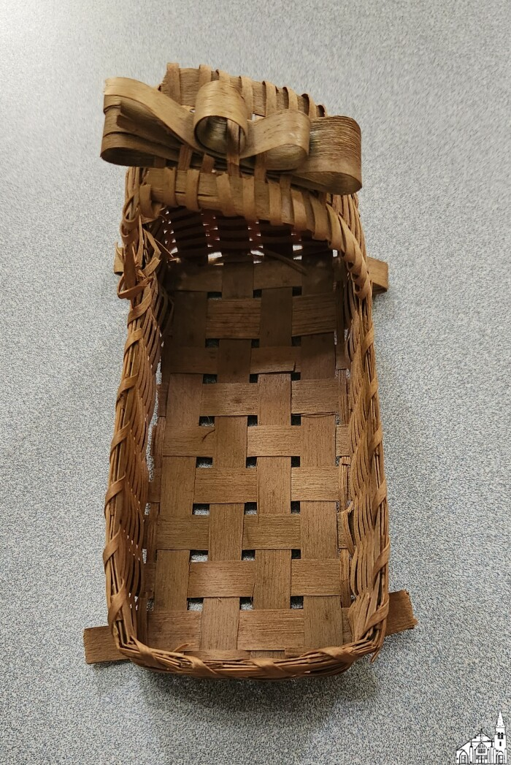
Native American-made doll cradle basket (OBJ.N.1988.148)
Small, doll-sized cradle shaped basket made from black ash.

Slide 111
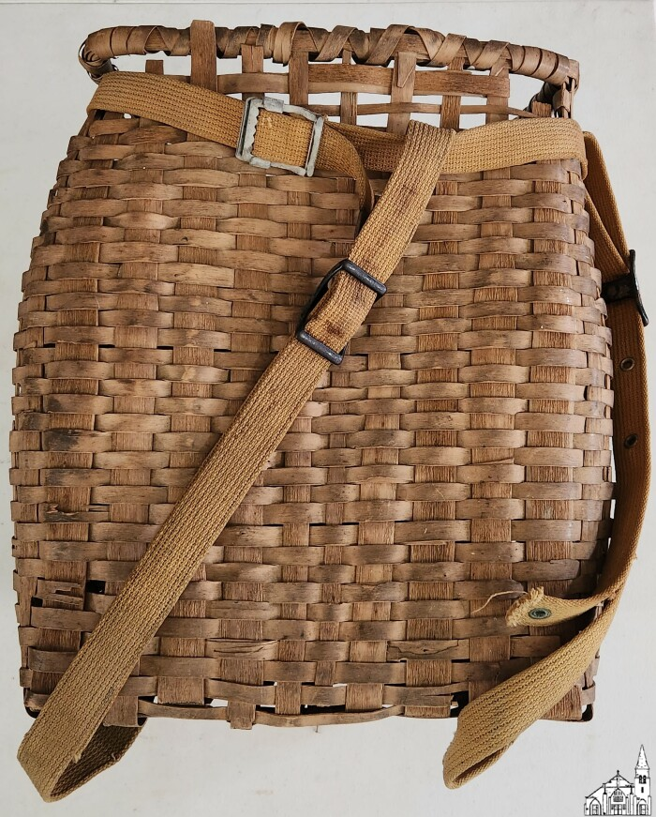
Native American-made pack basket (OBJ.N.1989.142)
Pack basket made by Penobscot Indians, brown ash splint, about 100 yrs. old at the time of acquisition. Made for packing over-the-woods trails, strapping probably replaced. The basket originated in Herbert Wright's family (Enid's husband).

Slide 112
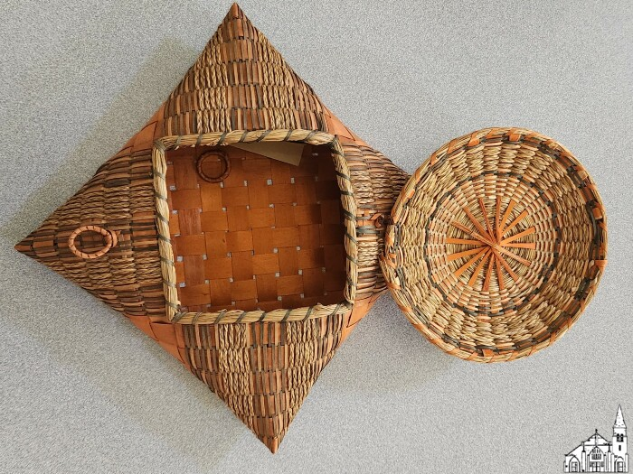
Native American made handkerchief basket (OBJ.N.1989.143)
Handkerchief basket made by Penobscot Indians, bought about 1930, from an Indian store on N. Main St., Old Town. One loop is broken and is now stored in the basket. Donated by B. Betts, Ma., 1989.

Slide 113
Lenfests? [Photo Postcard] (OBJ.N.1989.147)
A postcard, unaddressed. The black-and-white photograph on the front features a two story building with white siding surrounded by trees in leaf. In the foreground a man in a bowler hat stands between two girls in late 19th or early 20th century clothing. Names written on the back of this postcard are not fully legible, but may read "Capt. Lenfest - Beulah + Jeunelle." Connection to Old Town unclear.

Slide 114
Two Lenfest? women [Photograph] (OBJ.N.1989.148)
A 3/4 studio portrait in black and white by Nelson, Anoka, Minn. The subjects are two women in fur coats. On the back of the photo they are identified as Beulah Lenfest and Laura Lenfest. The date they were photographed, written in the same hand as their names, is X'mas 1911. Connection to Old Town unclear.

Slide 115
Group of 4 Men, 14 Women and 1 Male Child [c.1900] (OBJ.N.1989.149)
Group photo with, 14 women of varying age and one early (male) teen taken in a tent or another temporary construction. Connection to Old Town unclear.

Slide 116
Camp Moosehours? [Group Photograph] (OBJ.N.1989.150)
A sepia photograph of three women and two men seated in a rowboat at the edge of a lake. The boat is named Vivien and sports two flags -- an old-fashioned American flag with the stars arranged in a circle and a dark flag with part of a kerned letter visible, perhaps for a club, camp, or university. Notes on the back in semi-legible script indicate the picture was taken in 1904 at Camp Moose[hours? horus?]. Three names, likely identifying the depicted women but not indicating who is who, are also found on the back. Those names appear to be Edith Longley Sleeper, Belle Longley, and Minnie (or Winnie) Louchester (or Couchester?). Connection to Old Town unclear.

Slide 117
Dunphy House [Photograph] (OBJ.N.1989.151)
An apparent copy of a sepia photograph. Depicted is a two story house with unpainted wood siding and one chimney. A horse-drawn carriage is partially out of frame on the left and an outbuilding can be seen in the distance. In front of the house a woman sits in a rocking chair and two young children, a boy and girl presumed by their dress and hair length, stand side-by-side. Writing on the back indicates that this is a picture of the Dunphy house in Milford, ME. The year it was taken is unknown, though sometime in the late 19th or very early 20th centuries seems probable.

Slide 118
Patrons of Husbandry [Membership Card, 1970] (OBJ.N.1989.179)
50 Year Membership Card presented by the Maine State Grange to Bertha Flanders (Note: in same box as OBJ.O.1989.176).

Slide 119
Charles W. Sleeper [Photograph] (OBJ.N.1989.180)
A 1/2 portrait taken by Perry Studio, with locations in Bangor, Old Town, and Millinocket, Maine, likely around the turn of the 20th century. The subject is identified as C. W. Sleeper by an inset, printed card and the picture signed "Sincerely Charles." This is likely a graduation photo, based on the age of the subject and quality of the inset card's paper. Several Charles W. Sleepers are recorded to have lived in the area; this photo may have been taken as late as 1928-30 if this is actually the C. W. S. born in 1910. Regardless, the man in the photo wears a suit and striped necktie. He is cleanshaven with his hair combed back.

Slide 120
Lena Longley [Photograph] (OBJ.N.1989.181)
A 3/4 portrait taken by A. F. Orr of Old Town, ME, likely around the turn of the 20th century. The subject is Lena Longley, "Willis' 2nd wife" as written on the back. She's wearing a dark skirt and light blouse as well as an outer garment with long, loose sleeves. Her hair is pinned up; visible accessories include a locket, bracelet, and wedding ring.

Slide 121
Willis Longley [Photograph] (OBJ.N.1989.182)
A 1/2 portrait taken by Manhattan Studio, 29 1/2 Tremont St., "opp. Boston Museum," likely around the turn of the 20th century. The subject is identified as Willis Longley. He wears a three piece suit with enamel lapel pin, diamond-point bowtie, and high, stiff collar. He is cleanshaven and his hair severely parted and combed. This may be Willis Leroy Longley of Milford, ME, born 1873, though that might place the date of the photograph around the late 19th rather than early 20th century.

Slide 122
Helen Spruce [Photograph] (OBJ.N.1989.184)
A black and white studio portrait by an unknown photographer, likely taken in the early 20th century. The subject is Helen Spruce as a young child. She is shown seated on a cushion, wearing a period-typical gown, necklace with medallion, and black leather shoes over tights. Connection to Old Town unclear.

Slide 123
Beulah and Laura Lenfest [Photograph July, 1904] (OBJ.N.1989.185)
A large copy of a black and white photograph by Nelson of Anoka, Minn. The subjects are identified as Beulah and Laura Lenfest as young girls. The date July, 1904 is written on the back with their names. They're standing beside two plank swings, each grasping a rope in one hand. Each wears a light-colored dress with dark tights and shoes and a distinctive dark jacket and hat. There are two unidentified houses in the background. Connection to Old Town unclear.

Slide 124
Old Town Woolen Company [Group Photo, 1919] (OBJ.N.1991.1)
Panoramic group photo of Old Town Woolen Company personnel in front of the factory building. Signed by A.F. Orr.

Slide 125
At Maine [OTHS Cast, 1909] (OBJ.N.1991.25a)
Flier for the Old Town High School Play, At Maine, on Friday, March 19, 1909 (no specific time indicated). Lots of ads. No further information as the Old Town Enterprise for 1909 is missing.

Slide 126
OTHS Minstrel Show [Pamphlet, 1908] (OBJ.N.1991.25b)
Flier for an Old Town High School Minstrel Show on December 16, 1908 (no specific time indicated). Lots of ads. No further information as the Old Town Enterprise for 1908 is missing.

Slide 127
Blank Bill [Old Town Water District, 1980s] (OBJ.N.1991.64f)
A blank mailing form for Old Town Water District bills.

Slide 128
Old Town Post Office [1914] (OBJ.N.1992.133)
Small photo of the Old Town Post Office under construction.

Slide 129
School Outing (?) [1907] (OBJ.N.1992.151)
Oval bluish photo, probably a cyanotype. The back says the photo was taken in front of Herbert Gray's Cottage, Pushaw. Looks like a group of six adult females and perhaps one male and eight younger kids. Could this be a group of teachers with their pupils? According to the text on the back, Ellen Davis (Sturgeon's aunt) is among the children. Frame might read "O.T.'07.8.5", as in "Old Town, August 5, 1907."

Slide 130
Speech to City Council [1906? 1913?] (OBJ.N.1992.152)
An eight page speech addressed to Old Town City Council, attributed to "Mayor Davis." Charles G. Davis was mayor of Old Town in 1906 and 1913, and as the speech outlines the city's debt in terms of bonds coming due in 1908 and later and "notes outstanding" that had been due in 1904 and 05, it's likely that this address was made during Davis' first term.The typewritten pages include penciled-in notes and addenda, as well as a few typos. Beyond bonded debt, topics covered include infrastructure improvements and the town Water Supply.

Slide 131
Ladies' Eyeglasses With Case (OBJ.N.1992.58)
Decoratively embellished metal pince-nez glasses on a chain. Accompanied by leather box lined in blue velvet. From the estate of Florence M. Latno, who passed away in Orono, ME in 1990. Date of manufacture unknown, likely early-mid 20th century.

Slide 132
Kukunsook Club Stock Certificate (OBJ.N.1992.71)
A blank stock certificate for shares in the Kukunsook Club of Old Town, Maine, established 1893. The Kukunsook Club is a coalition of property owners around Pushaw Lake.

Slide 133
Center Street (Old Town) [1928] (OBJ.N.1992.75)
Photo of road work on Center Street. Back of the photo has a form stamp by the Portland Cement Association (33 West Grand Avenue, Chicago) with date 7/11/1928.

Slide 134
Sterling Silver Hand Mirror (OBJ.N.1992.87)
Silver-backed hand mirror from 1870. Owned by Geneviève Violette, a resident of Milford.

Slide 135
St. Joseph's Church (Old Town) [1910s] (OBJ.N.1993.104a)
Postcard of the "New Catholic Church". The rectory is partially visible as well.

Slide 136
Silver Nail File (OBJ.N.1993.63)
A sterling silver nail file, 1888. Owned by Geneviève Violette's mother and grandmother, residents of Milford.

Slide 137
Fountain Pen (OBJ.N.1994.52)
An Imperial brand fountain pen, 1940s. Case of opalescent red and grey. Connection to Old Town unclear.

Slide 138
Old Town Grange [Field Day, 1924] (OBJ.N.1995.26)
Photo (by Myers) of the Old Town Grange (#522) Field Day of July 27, 1924 at the store of Mr. and Mrs Lund on Pushaw Lake. A report on the day can be found in the Old Town Enterprise (July 31, 1924, p.3). The names of many participants are listed on the back and include Gladys Preble and her mother and sister, George Young, Lillian Stormann, Pauline Sibley, Tom Dalaw (?), Charles Hunt, Mrs. Hunt, Mrs. Guerin, Caroline Guerin, Mrs Laura Weymouth, Liv Coiley, Mr. Rand (Cora Paradis' grandfather), Mr. Rand's son, Mrs Severance, Eeta Weymouth, Mina Stormann, Chester Littlefield, Julia Littlefield, Georgia Littlefield, Tom Potter, Mrs. Potter, Leila Folsom, Gertrude Young, Earl Douglas, Mr. Folsom. It also says that George and Linwood Stormann did not get to the meeting for the picture because they were haying and they tipped the load of hay.

Slide 139
Langlais [Sketch, 1940] (OBJ.N.1995.51)
A pencil sketch of Albert L. Morin by Bernard Langlais. Framed and Matted.

Slide 140
Foldable Lorgnette Eyeglasses (OBJ.N.1996.1)
One pair of eyeglasses which fold into a compact metal holder which includes the lorgnette handle. Lorgnette glasses, meant to be held to the eyes rather than worn on the face, were assistive sight technology from the late 1700s and popular fashion accessories in the 19th and early-mid 20th centuries. Though the age and manufactuerer of these glasses is unknown, they appear to be for fashion more than vision, as the case features elaborate, realistic embossed flowers and the lenses are unshaped glass. Connection to Old Town unclear.

Slide 141
Envelope [1936] (OBJ.N.1996.118)
Envelope send from Old Town and addressed to Mr. and Mrs. Frank Meyers. No content.

Slide 142
Strand Theater Interior [ Scan, 2008] (OBJ.N.1996.125a)
Scan of OBJ.O.1996.125, probably made by Bill Osborne (see accompanying email)

Slide 143
Strand Theater Interior [Scan, 2008] (OBJ.N.1996.125b)
Scan of OBJ.O.1996.125, probably made by Bill Osborne (see email accompanying OBJ.O.1996.125)

Slide 144
Waid Harvey Miles [Photograph] (OBJ.N.1996.128)
A sepia photograph taken around 1880 by T. W. Merger, Photographer, Racine, Ohio. The subject is Waid Harvey Miles, a child in full formal suit and oversized bowtie, posed with his legs crossed and right hand in his coat pocket. Merger's studio is made to look like a camp, with forest backdrop and wooden props. Written on the back of the photo are the notes "This is natural and good," and "Uncle Harvey as a boy."

Slide 145
W. Harvey and Ethel Miles [Photograph] (OBJ.N.1996.129)
A black and white photograph taken around 1880 in the studio of G. E. Mercer, "The Popular Photographer," 137 Second St., Gallipolis, OH. The subjects are two children identified as Waid Harvey Miles and Ethel Miles. W. Harvey is seated on a bicycle in a collared suit with oversized bowtie, right hand on the handlebars and left hand in lap. Ethel stands beside him with her right hand on the other handlebar; she is wearing a long white dress.

Slide 146
Review of 76th Division at Camp Devens, MA [1918] (OBJ.N.1996.139)
Photo by Geo. Russell (Lowell, MA) of the final review of the 76th Division on June 17, 1918. The 76th was composed of National Army drafts from the five New England states.

Slide 147
OTHS Graduation [Group Photo, 1921] (OBJ.N.1996.14)
Composition photo by the Perry Studio of the OTHS class of 1921, depicting 23 students. The 4th person in the second row is Virgil W. Comstock (1904-1976, UMaine '25).

Slide 148
Main Street, Old Town, Maine [Postcard, 1936] (OBJ.N.1996.150)
A black and white postcard depicting Old Town's Main Street around 1936. The card's back identifies it as a Silvercraft, made by Dexter Press, Pearl River, N. Y. The photo print front has the number 4738 apparently handwritten on the original in its lower right corner. Dexter Press was founded by Thomas Dexter in 1920 and produced postcards through the thirties, so this postcard probably dates to the year depicted.

Slide 149
The Last of Maine's Old Native Pines [Poem by O. W. Severance] (OBJ.N.1996.26)
A single page photocopy taken from an unknown publication. The page contains the apparently complete text of a ten stanza poem titled "The Last of Maine's Old Native Pines." The poet is identified as O. W. Severance of Old Town, Maine. The poem is an elegy for Maine's old growth trees and a tribute to the "Penobscot lumber-men" who, in the bygone "days of lumbering" cut them down. Some "lumber kings" mentioned by name include, "Jordan, McNulty, Isaac Terrell, McLean, McLeod, Ed Spencer, Cunningham, and Murphy." Date of composition or original publication not known.

Slide 150
Leather Pouch (OBJ.N.1996.4)
A tan leather pouch with round base and drawstring closure. Used in the early 1900s to hold men's collars. Connection to Old Town unclear.

Slide 151
St. Mary's Church (Old Town) [1940-1960[ (OBJ.N.1996.76)
Small photograph of St. Mary's Church in Old Town.

Slide 152
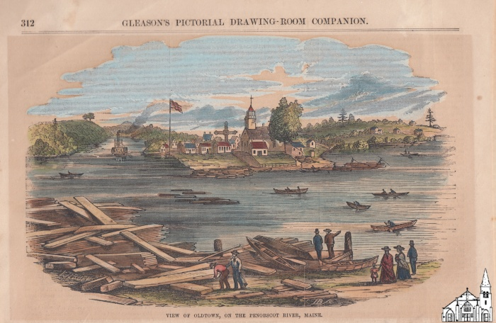
View on Indian Island [Gleason, 1854] (OBJ.N.1997.41)
Framed, matted and colorized cutout of the engraving with a view on Indian Island as printed on p.312 of volume 20 of Gleason's Pictorial Drawing-Room Companion, published in 1854.

Slide 153
Blueprint of the Old Town Post Office [1914] (OBJ.N.1997.47)
An original blueprint for the construction of the Old Town Post Office "showing proposed location of Screen Doors." Annotated "(See letter of Supt. dated July 9, 1914)." Blueprint created July 16, 1914 and approved July 20, 1914. Donated by Old Town Post Office.

Slide 154
Blueprint of the Old Town Post Office Vault [1914] (OBJ.N.1997.48)
The original blueprint for the construction of the Old Town Post Office vault. Created by Watson Manufacturing Company of Jamestown, NY on August 8, 1914.

Slide 155
Patch of Post Office Department United States of America (OBJ.N.1997.53)
A circular patch made of Scotchlite Reflective Sheeting. Displays in white-on-red the words Post Office Department United States of America around the central figure of a galloping Pony Express rider. Date of origin unknown; donated by the Old Town Post Office.

Slide 156
Patch of Post Office Department United States of America (OBJ.N.1997.54)
A circular patch made of Scotchlite Reflective Sheeting. Displays in white-on-red the words Post Office Department United States of America around the central figure of a galloping Pony Express rider. Date of origin unknown; donated by the Old Town Post Office.

Slide 157
Register of Postal Savings Certificates Issued at Old Town, Maine [Jul. 3, 1911-Sept. 1918] (OBJ.N.1997.55)
A record of postal savings certificates issued 1911-1918 at the Old Town, ME post office. Hardcover off-white notebook with handwritten accounts.

Slide 158
Postmasters' Account and Record Book [Oct. 1918-Sept. 1921] (OBJ.N.1997.56)
Account book kept by James W. Sewall, Postmaster for Old Town, ME.

Slide 159
Postmasters' Account and Record Book [Oct. 1915-Sept. 1918] (OBJ.N.1997.57)
Account book kept by James W. Sewall, Postmaster for Old Town, ME.

Slide 160
Postmasters' Account and Record Book [Oct. 1927-Sept. 1930] (OBJ.N.1997.58)
Account book kept by Homer M. Orr, Postmaster for Old Town, ME.

Slide 161
Postmasters' Account and Record Book [Oct. 1921-Sept. 1924] (OBJ.N.1997.59)
Account book kept by James W. Sewall, Postmaster for Old Town, ME.

Slide 162
Postmasters' Account and Record Book [Oct. 1930-Sept. 1933] (OBJ.N.1997.60)
Account book kept by Homer M. Orr, Postmaster for Old Town, ME.

Slide 163
Old Town, Maine Post Office Building Record [1914-1923] (OBJ.N.1997.61)
Four successive postmasters kept this custodial record of the building maintenance costs for the new Old Town, ME post office. Record keepers are written on the front page as: "-1914- Frank L. Averill - Custodian - 1915 James W. Sewall. Custodian George H. Hunt. Apr. 9 - 1922 to Custodian A. B. Rand. July 24/1923 Custodian" These signatures belonged to Frank L. Averill, Postmaster beginning 12/09/1902; James W. Sewall, Postmaster beginning 03/03/1915; George H. Hunt, Acting Postmaster beginning 04/08/1922; and Arthur B. Rand, Acting Postmaster beginning 07/13/1923. During this timespan Eddy A. Conant also served as Postmaster beginning 03/01/1923 but did not sign his name to this custodial record. The book records expenses in maintaining the building rather than postal services. Categories of expenditures are listed on the page following the above signatures as "Electric Current, Water, Coal, Wood, Ice, Laundry, and Ashes and Rubbish." Enclosed in the notebook are further notes on Office of the Custodian (Treasury Department Custodian Service) letterhead and a letter addressed to the Custodians of U.S. Public Buildings regarding operating supplies. The letter is dated December 9, 1914 and is typewritten on "Office of Supervising Architect" letterhead stationery. Its first page reads: "Sirs: There is inclosed herewith an electric and gas service data card which you are requested to fill in, in accordance with the instructions inclosed, and return to this office. The information necessary to answer questions regarding the character of gas and electric service available in the city should be obtained from the various local public service companies. If none of the employees under your charge is competent to furnish you with the information requested in reference to the motor equipment, it is probable that the local service company now supplying electric current to the building in your custody will be so courteous as to give you the assistance of one of its employees familiar with the electrical machinery. Respectfully, H. G. Sherwood. Acting Executive Officer." The second page of this letter is a typewritten set of instructions for filling out the data card, which is not found in the record book.

Slide 164
Postmasters' Account and Record Book [Oct. 1924-Sept. 1927] (OBJ.N.1997.62)
Account book kept by Homer M. Orr, Postmaster for Old Town, ME.

Slide 165
Register of Postal Savings Certificates Paid at Old Town, Maine [Jul. 3, 1911-Sept. 1918] (OBJ.N.1997.63)
A record of postal savings certificates paid 1911-1918 at the Old Town, ME post office. Hardcover off-white notebook with handwritten accounts.

Slide 166
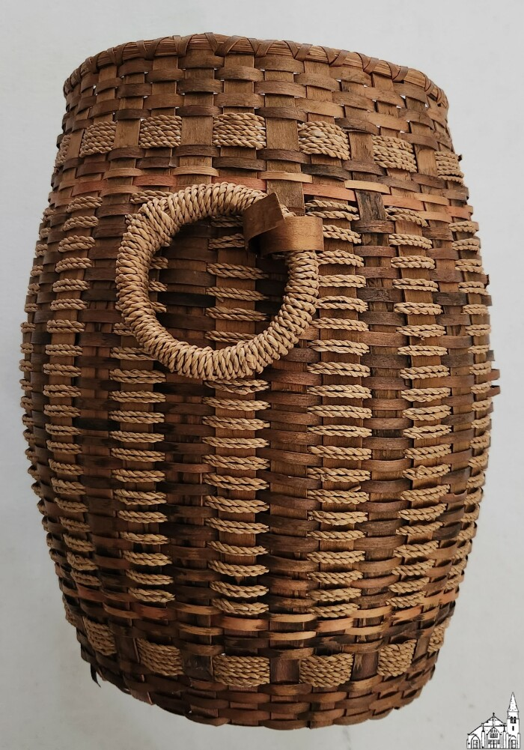
Native American-made basket (OBJ.N.1997.72)
Native American-made basket made of black ash and sweetgrass. It has two rings, one on either side, and has some brown and pink trim.

Slide 167
Rogers Receipts [1857] (OBJ.N.1998.1)
Two acknowledgements of receipt to Orimel Rogers. One dated Sept 7th, 1857 for bridge toll, the other dated Oct. 27, 1857 for the purchase of a cow.

Slide 168
Broken Stick: a Legend [by Harry S. Dalton] (OBJ.N.2001.67)
A short, illustrated booklet published in 1989 by Regis Publishing Co., Stillwater, ME. Harry S. Dalton was a resident of Milford. The booklet, written in the style of a children's picture book, tells the story of a Mic Mac boy named Broken Stick for his use of braces and crutches to walk.

Slide 169
Bickmore Truck [c.1920] (OBJ.N.2002.1)
Copy of an original photograph of a Bickmore truck of the 1920s with four men in front.

Slide 170
OTHS Class of 1933 [Photo] (OBJ.N.2002.15)
Framed class photo for the Old Town High School Class of '33.

Slide 171
Bickmore Team [1900-1920] (OBJ.N.2002.2)
Copy of a photograph of an original photo of a Bickmore team. Note the "Federal Business College" in the window on the second floor. Since the only business colleges by this name were Canadian and Brantford Roofing (as seen in the ground floor window) was a Canadian company, the picture was probably taken in Canada.

Slide 172
Ballard's Golden Oil [1940-1960] (OBJ.N.2002.22)
2 fl oz bottle of Ballard's Oil with metal screw cap and trademark yellow-red label. Produced by the Bangor Candy Company.

Slide 173
Ballard's Golden Oil [1960s] (OBJ.N.2002.23)
A glass bottle with plastic cap, once containing Ballard's Wonderful Golden Oil. This bottle was "prepared by the Bangor Candy Co., Bangor, Maine" sometime in the later 20th century, though the Ballard's Golden Oil Co. began in Old Town. The ad blotter wrapping the bottle reads, "Ballard's Wonderful Golden Oil has been on the market since 1902. An 'old stand-by' in homes, shops, factories and with lumbermen. Especially economical. Physicians endorse it, mothers appreciate it, thousands praise it. Being made from pure gums and oils, this Golden Oil contains no harmful ingredients." Ingredients listed as follows: Camphor, Oil Wintergreen, Oil Peppermint, Oil Sassafras, Oil Origanum, Oil Hemlock, LInseed Oil.

Slide 174
Ballard's Golden Oil [1930s] (OBJ.N.2002.24)
2 fl oz bottle of Ballard's Oil with cork stopper and trademark yellow-red label. Produced by the Ballard Golden Oil Co. in Old Town.

Slide 175
Bickmore Team [1900-1920] (OBJ.N.2002.3)
Copy of an original photograph depicting a Bickmore team. Exact year and location unknown.

Slide 176
Bickmore Team [c. 1900] (OBJ.N.2002.4)
Copy of an original matted photograph depicting a Bickmore team along the Penobscot River facing Milford. According to the label on OBJ.N.2002.5, the two gentleman on the carriage are George Gray and Abiel Bickmore. Some water damage on the left of the original matting and photo with possibly the left bottom corner missing.

Slide 177
Bickmore Team [c.1900] (OBJ.N.2002.5)
Framed, cropped copy of the same original photograph as OBJ.N.2002.4 or possibly a copy of the latter. Matting has been cropped, but the water damage to the photo is still visible.

Slide 178
Emile Leveille [Cabinet Photograph] (OBJ.N.2002.50)
A sepia photograph by an unknown photographer, taken around the late 19th or turn of the 20th century. The subject is identified as Emile Leveille (1856-1918). The Leveille family lived at 47 Bradbury St. in Old Town, ME. Emile was father to Victor Leveille, Rudolph "Duffy" Leveille, Virgil Leveille, Lillian Leveille Snell, Delcina Leveille Deering, and Evelyn Leveille LaForge.

Slide 179
Mamie Rossignol Leveille [Two Photo Proofs, 1925] (OBJ.N.2002.51)
Two photo proofs made in 1925 by Perry Studio of Bangor, Maine. The subject is identified as Mamie Rossignol Leveille. The proofs are soft-focus sepia, showing Mamie in two slightly different poses, both smiling. Her hair is bobbed and set in a wave; she wears no visible jewelry.

Slide 180
Old Town Train Station [1870-1880] (OBJ.N.2002.6)
Copy of a photo depicting the Old Town Rail Station with locomotive and European and North American car 101. As the E. & N.A. extension from Bangor to Vanceboro was leased by Maine Central Railroad in 1882, the original photo probably predates that year. As the line did not open until 1868, the photo postdates that year. Furthermore, the locomotive depicted seems to be virtually identical to the (original) "Countess of Dufferin", the first steam engine to run on the Northern Pacific Line. That locomotive was built by Baldwin Locomotive Works in 1872 and shared a chimney design with the locomotive on the photo that does not seem to have been used for very long (Note that the restored locomotive in Winnipeg and the picture on the Canadian stamp have a different chimney). This corroborates that the photo was taken in the 1870s (give or take a few years).

Slide 181
Old Town Train Station [1870-1880] (OBJ.N.2002.7)
Copy of a photograph of the Old Town Train Station with a Pullman Parlor Car. The design of the parlor car seems consistent with the 1870s, so the orignal photo might have been taken around the same time as the original of OBJ.N.2002.6.

Slide 182
Old Town Train Station [1870-1880] (OBJ.N.2002.8)
Copy of a photograph of Old Town Station with the old Catholic Church in the background. Probably from the same decade (or same even same photo shoot) as the other photos in the lot.

Slide 183
Old Town Train Station [1870-1880] (OBJ.N.2002.9)
Copy of photo depicting the Old Town Train Station or Depot with a locomotive virtually identical to the one on OBJ.N.2002.6 (the front pressure valve is slightly different and and the sign on the side of the cabin seems to have a different shape; there is no skirt either) hauling wood. Original probably taken in the 1870s as well.

Slide 184
OTHS Graduation [Program, 1933] (OBJ.N.2003.35)
Program for the graduation exercises of Old Town High School on June 7 and 8, 1933. Slight damage to bottom-left corner.

Slide 185
Hairbrush (OBJ.N.2003.72a)
Pyralin hairbrush and mirror set, made in the U.S.A. by Dupont. Belonged to Ruth Littlefield, 1920s approx.

Slide 186
Hand Mirror (OBJ.N.2003.72b)
Pyralin hand mirror with hairbrush made in the U.S.A. by Dupont. Belonged to Ruth Littlefield.

Slide 187
War Ration Books [1942/3] (OBJ.N.2003.73)
Three War Ration Books No. 3 in a war ration book holder in the names of Gerald R. Woodsum, Marcia S. Woodsum, and Harriet E. Woodsum---all of Old Town. Since Harriet is listed as 17 years old and she was born in November 1925, these booklets were used in 1942 or 1943.

Slide 188
Button Hook (OBJ.N.2003.90)
A steel button hook with plastic handle of black Bakelite or celluloid. Used to button up ladies' boots from the mid-19th to the early 20th century. Connetion to Old Town unclear.

Slide 189
Brunswick Street Grammar School [c1910] (OBJ.N.2004.42)
Group photo with students, teachers and other adults. Possibly a graduation photo. The building in the background appears to be the Brunswick Street Grammar School.

Slide 190
Young Girl [Photo in Convex Glass] (OBJ.N.2004.57c)
A sepia photograph of a young girl, taken by an unknown photographer in the very late 19th or very early 20th century. The photograph has been affixed to convex glass for display; the glass is cracked and a small piece of the lower right edge of the picture has broken off. The girl wears a long white gown with ruffled shoulders and stands with her hand placed on a tassled cushion. Identifying information on the back is not clearly legible, but includes the name Olive. Connection to Old Town unclear.

Slide 191
2nd Maine Infantry, Company I [1917] (OBJ.N.2004.63)
Photo by A.F. Orr of Company I of the 2nd Maine Infantry. During August 1917, Orr was at Fort Keyes (August, ME) to photograph various Maine regiments as they were mobilizing. Therefore, it seems likely that this particular photo was taken there. The 2nd Maine Infantry was sent overseas in September 1917.

Slide 192
Milford Fire [Photo Collage, 1905] (OBJ.N.2004.64)
Collage of 19 photos of the April 29, 1905 Milford Fire by A.F. Orr.

Slide 193
Concert of Nations [Benefit, 1905] (OBJ.N.2004.65)
Photo of the cast of Concert of Nations, a musical fundraiser for the Methodist Church of Milford that took place on February 22, 1905. Names are written all over the matting.

Slide 194
Milford Fife and Drum Corps [photo, 1900-10] (OBJ.N.2004.66)
Photo of the Milford Fife and Drum Corps under the leadership of Albert L Pierce (c.1878, Abbott - ?) who is depicted along with 11 members (including a young boy Benny, who may have been Pierce's son). Photo taken by A.F. Orr.

Slide 195
Boston & Maine Locomotive [c.1900] (OBJ.N.2004.67)
Photo of six men in front of a Boston & Maine RR branded locomotive, presumably taken in Milford or Old Town. The back has some long multiplications on it as well as the name Herbert O'Connell.

Slide 196
Milford Baseball Team [1910-1920] (OBJ.N.2004.68)
Photo of the 9 members of the Milford Baseball Team along with eight of their names. Several people appear on OBJ.N.2004.66 as well, but are about ten years younger there.

Slide 197
Group Photo [1910-1920] (OBJ.N.2004.69)
Group photo of 11 males and two women, possibly a family portrait, with Orr's logo is on the matting. On the back it says "Mrs Fitzgerald."

Slide 198
Independent Order of Foresters [Committee on Anniversary Services, 1906] (OBJ.N.2004.70)
Group portrait of the 14 members of the IOF Committee on Anniversary Services for Old Town. Printed caption with names and date glued below the photograph.

Slide 199
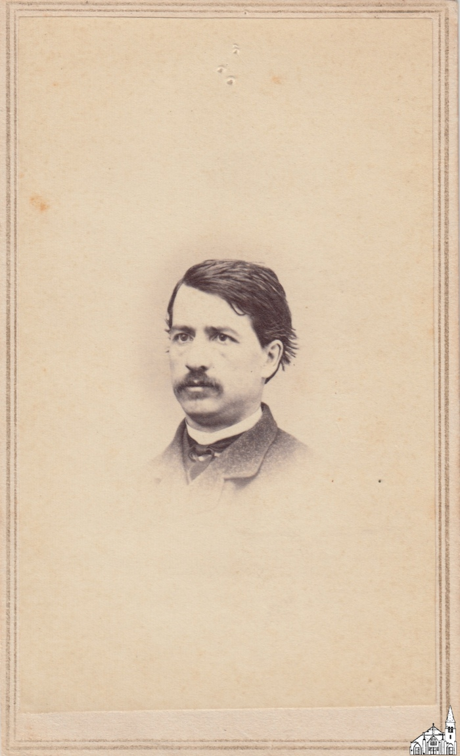
Melville M. Folsom [CdV, c.1870] (OBJ.N.2005.70)
A Carte de Visite for Melville M. Folsom as indicated on the back. Photo taken by M.L. Averill of Old Town, who was active in the late 1860s and early 1870s.

Slide 200
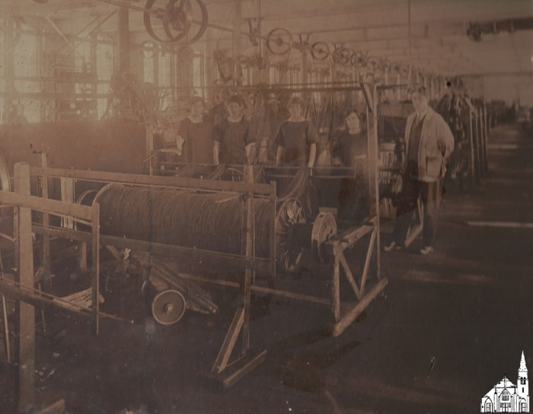
Interior American Woolen Mill [c.1910] (OBJ.N.2006.1)
Original Photo of Interior of Ounegan Mill with four female workers and one male foreman. On the back is a note by Bill Osborne indicating that this was a gift of Beverly Therrian.

Slide 201
OTHS Graduation [Program, 1919] (OBJ.N.2007.2)
Program for the Old Town High School Graduation Exercises of 1919.

Slide 202
Stillwater [Aerial View, c.1950] (OBJ.N.2007.4)
Aerial view of Stillwater showing mostly the Marsh Island part of the village, the bridge and Jameson's Island. Good view of College Avenue, Stillwater Avenue and Old Mill Road. The bridge is still covered, so the photo predates 1952. Based on other visible structures, the photo postdates 1949.

Slide 203
Stillwater [Aerial View, c.1950] (OBJ.N.2007.5)
Aerial view of Stillwater showing mostly the Orono side of the village. Good view of Bennoch road, and Stillwater Avenue. The bridge is still covered, so the photo predates 1952. Given that the photo was probably taken at the same time as OBJ.N.2007.4, it most likely postdates 1949.

Slide 204
Icepick [1910s] (OBJ.N.2010.28)
Ice pick with flat metal handle. The inscription on one side says "Old Town & Milford Ice Co. Ice saves food". The inscription on the other side says "In Need of Ice, call Striar's Coal Yard". Striar's was bought out by the Old Town Fuel Company in 1924.

Slide 205
United Methodist Church of Old Town Bicentennial Plate [1994] (OBJ.N.2010.29)
A decorative plate created in 1994 by the United Methodist Church of Old Town for the bicentennial of Rev. Jesse Lee, an itinerant preacher, establishing the faith in what was then called Kenduskeag Plantation in 1794. The front features a central medallion that reads, "The United Methodist Church of Old Town, Old Town, Maine, 200 Years," and four surrounding images of the church building as it existed in 1854 (the first permanent church), 1905, 1970, and the current building, constructed in 1993 after a fire destroyed its predecessor. The plate's back features a timeline detailing some of this 200 year history, up to the April 24, 1994 Bicentennial Service and May 15, 1994 Consecration Service held by Bishop F. Herbert Skeete and Rev. Dr. George E. Curtis III.

Slide 206
Edwin M. White [Photograph] (OBJ.N.2011.21)
A posed studio photograph by The International Photo Co., R. M. Howe, No. 113 Main Street, Old Town, Maine. R. M. Howe was a photographer from Old Town active in the 1890s and early decades of the 20th century; this photo is presumed taken then. The subject is identified as Edwin M. White. This may be the same Edwin White who founded E. M. White Canoe Company, a significant producer of wood and canvas canoes from the 1880s through the 1940s, eventually opening a shop in Old Town in 1896. The Edwin M. White shown in the picture has a dark mustache and wears a light-colored trilby, longsleeved shirt with geometric design printed or sewn on the chest, black slacks, leather shoes, and holds a bicycle in the foreground. The apparent sweatshirt may date this photo to the mid-1920s, when they first became popular sportswear.

Slide 207
Pants' Hanger [c. 1910] (OBJ.N.2011.22)
Pants' hanger branded "W.E. Hellenbrand & Co.. Mens Outfitters Old Town ME. Patented August 18 1908"

Slide 208
Maine National Guard, 2nd Infantry [1917] (OBJ.N.2011.4)
Very wide photo of an encampment of the Second Infantry of the Maine National Guard, probably at Camp Keyes. This photo was most likely taken during an exercise. After mobilization in 1916, Orr is known to have spent time at Camp Keyes to take photographs of the mobilization effort (Old Town Enterprise, August 18, 1917, p.4 & August 18, 1917, p.1).

Slide 209
Maine National Guard, 2nd Infantry [Marching Band, 1917] (OBJ.N.2011.5)
Very wide photo of the Marching Band of the Second Infantry of the Maine National Guard, probably at Camp Keyes. This photo was most likely taken during an exercise. After mobilization in 1916, Orr is known to have spent time at Camp Keyes to take photographs of the mobilization effort (Old Town Enterprise, August 18, 1917, p.4 & August 25, 1917, p.1).

Slide 210
OTHS [Graduation Photos, 1928] (OBJ.N.2012.1)
Graduation photos lined with matting in individual covers for eight students in the OTHS Class of 1928. Names of the students on the back of the cover. Emblem of the Perry Studio on the matting. Photos identical to corresponding photos in the 1928 Sachem or probably done in the same session, with the exception of Lilian Sucy's and Janice Curran's.

Slide 211
Concert Program [1941] (OBJ.N.2012.2)
Program for a Concert by the Old Town Festival Chorus at City Hall on March 31, 1941. Guest artists were Constance M. King of Bangor and noted tenor James G. Selwood of New York.

Slide 212
Desjardins [Adding Machine, 1912-24] (OBJ.N.2013.1)
All mechanical American Adding Machine, Model V made by the American Can Company in Chicago, IL. Serial Number tag on the bottom reads 43254. Was used by the Desjardins Saddlery Store. In reasonably good shape.

Slide 213
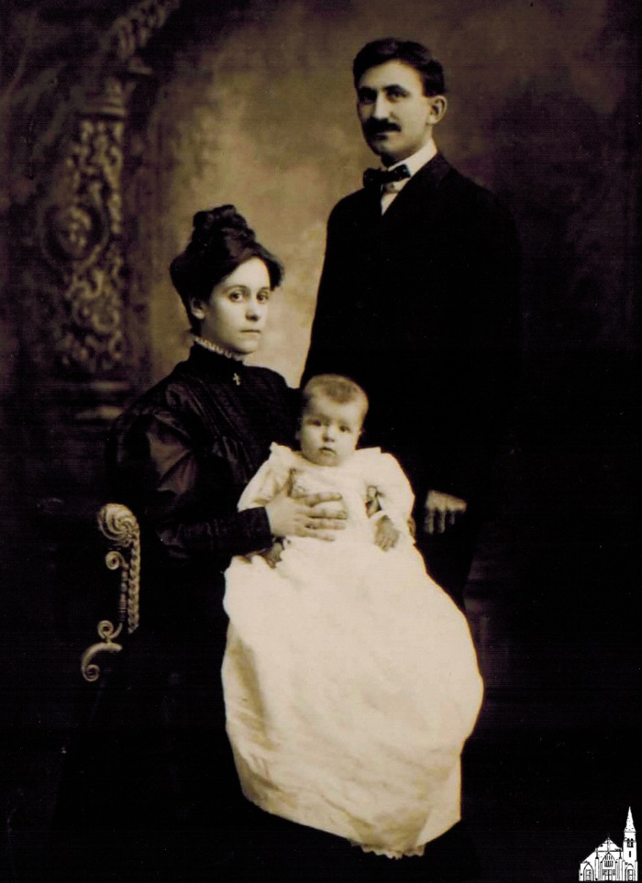
Desjardins [Family, 1906] (OBJ.N.2013.10)
Copy of a photo made in 1906 depicting George Roy Desjardins (1871-1957), his wife Rose Lisotte Desjardins (c1881-1964) and their oldest child Rose Esther (1905-1962). The date on the back of the copy suggests that it was developed on 7/22/13.

Slide 214
How Company [Metal Spool, 1900-1915] (OBJ.N.2013.11)
A metal spool to hold a How-Ko typewriter ribbon made by The How Company, Manufacturers, Old Town, Maine, USA with offices in New York (142 Fulton Street) and Boston (28 School Street) and branch offices in large cities.

Slide 215
How Company [Metal Box, 1900-1915] (OBJ.N.2013.12)
A square metal box to hold a How-Ko typewriter ribbon made by The How Company, Manufacturers, Old Town, Maine, USA with offices in New York (142 Fulton Street) and Boston (28 School Street) and branch offices in large cities.

Slide 216
Leather Purse [1930-1950] (OBJ.N.2013.13)
Small leather purse with the image of a canoeing Native-American on one side. Underneath the image it says "Old Town, Maine". Clearly sold as a souvenir.

Slide 217
Spruce Gum Box [Burnham, 1920-1940] (OBJ.N.2013.14)
Blue, matchbox-sized container for "warranted one-half ounce pure spruce gum" labelled "H.M. Burnham Druggist, Old Town, Maine". On the lid it says "Manufactured by Whitney & Co., Box Makers, Leominster, Mass". Dried-out gum still inside.

Slide 218
Membership Share 125th Anniversary of Old Town [1965] (OBJ.N.2013.15)
One membership share of the Old Town 125th Anniversary Celebration, Inc issued to Clyde Campbell on April 9, 1965

Slide 219
Desjardins [Saddlery Store, 1900-1910] (OBJ.N.2013.2)
Copies on glossy paper of two photos of the inside of Desjardins Harness & Saddlery store on Center Street, OT. Both photos appear to have been taken from a printed source. The man on the right in the two pictures is said to be George Roi Desjardins.

Slide 220
OTHS [Graduation Photos, 1927] (OBJ.N.2013.3)
Photo album with 59 photographs of students of the OTHS Class of 1927. Photos in inserts with two on each page and the name of each student written in the right bottom corner. With softleather cover imprinted "O.T.H.S. 1927" and leather strap holding the pages together. In frail condition.

Slide 221
Letters from Ira D. Eastman to Edith M. Bussell (OBJ.N.2013.4)
A collection of 10 letters to Edith Bussell from Ira D. Eastman (1868-1929), mostly written on various business trips. Eastman was boarding with Bussell's parents around the turn of the century (see 1900 Census). It is not immediately clear where he was living when the letters were written, but based on their content, he and Bussell may have been romantically involved at that time. Around the same time, Eastman had a house on Center Street built where he lived with his parents and a servant. He died a bachelor.

Slide 222
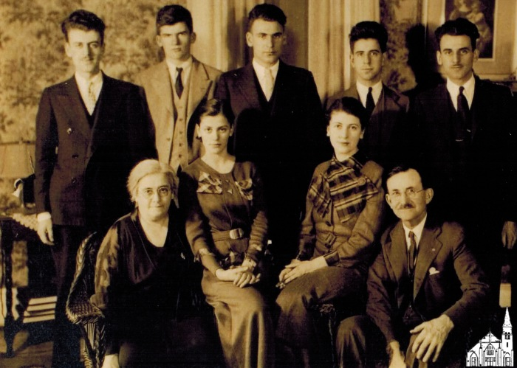
Desjardins [Family, 1933] (OBJ.N.2013.6)
Copy of a photograph taken in 1933 depicting George Roy D. (1871-1957) with his wife Rose Lizzotte (c.1881-1964) and their daughters, Rose Esther (1905-1962) and Ruth (1919-2001), and their sons (l to r.): Adrian Trudel (1913-1990), Maurice Benedict (1916-1989), Jules (1910-1996), Lionel Louis (1911-??), George Eloi (1907-1998). The date on the back of the copy suggests that it was developed on 7/22/13.

Slide 223
LaForge - A Heart Can Cry [Sheet Music] (OBJ.N.2013.7)
"A Heart Can Cry" sheet music, with lyrics by Pauline LaForge and music by Len Tobin.

Slide 224
LaForge - A Heart Can Cry [Sheet Music] (OBJ.N.2013.8)
"A Heart Can Cry" sheet music, with lyrics by Pauline LaForge and music by Len Tobin.

Slide 225
LaForge - A Heart Can Cry [Copyright Registration] (OBJ.N.2013.9)
Certificate of Copyright Registration issued to Pauline LaForge of Old Town for "A Heart Can Cry".

Slide 226
Postcard "A Panoramic View of Old Town, Me." [1911] (OBJ.N.2014.1)
A postcard postmarked 1911 bearing, on the front, a collage image: a photograph of Old Town, Maine captioned, "A Panoramic View of Old Town, Me." superimposed on a colorized image of lemons growing on a tree branch. It was used by a V. Jones to correspond with Miss Dugas of 42 Coburn St., East Lynn, Mass. Jones wrote from Greenfield Maine that, "We arrived here yesterday. The courntry is lovely all around. The boys are enjoyig their farm life," and signed with kindest regards to all, "yours affectionately."

Slide 227
Order of the Eastern Star, Katahdin Lodge #121 [Yearbook 1988-89] (OBJ.N.2014.15)
Yearbook for the Old Town Masonic Lodge for the yer 1988-89.

Slide 228
Order of the Eastern Star, Katahdin Lodge #121 [By-Laws, 1982] (OBJ.N.2014.16)
By-Laws for the Old Town Masonic Lodge as last revised in 1982.

Slide 229
Order of the Eastern Star, Katahdin Lodge #121 [Lifetime Membership, 1996] (OBJ.N.2014.17)
Certificate of lifetime membership of the Old Town Masonic Lodge for Lyle Campbell, issued on September 3, 1996.

Slide 230
Order of the Eastern Star [Plate] (OBJ.N.2014.19)
Generic plate with the paraphernalia of the Order of the Eastern Star. Made by the Sanders Manufacturing Co. in Nashville, TN.

Slide 231
Young People's Forum, United Baptist Church [1927-1937] (OBJ.N.2014.2)
A notebook of ruled paper with a black fabric spine and brown covers. The front cover reads "Compositions" in Gothic lettering inside an embossed title box. The inside front page identifies the contents as notes for, "Young People's Forum, United Baptist Church, Old Town, Maine." Additional notes on the first page read: - Forum organized Nov. 6th, 1927. All members of the Intermediate and Senior Depts. of the Church School are members of the Forum. - Forum meets each Sunday at 6 p.m. for one hour service. First 15 mts. devotional. Last 15 mts. discussion period. The bottom left corner of the first page is signed M. R. Brown--this may be the creator of the notebook. Typical entries list forum officers (president, vice president, committee chairs) and committee members (e.g. the Social Committee) or list discussion questions posed by the Discussion Committee, such as 'Why do we give gifts at Christmas?" or "What is sacrilege?" The first entry is for November 6, 1927 and the last entry lists "Guild" officers elected on May 13, 1936 for the year of 1936-7.

Slide 232
Omega Club [Charm] (OBJ.N.2014.20)
Round charm with Omega Club printed on one side and Lyly on the other side. Date unclear.

Slide 233
Maine Federation of Women's Clubs [Pendant] (OBJ.N.2014.21)
Small pendant in the form of a rhombus with a blue background and MFWC in silver lettering around a stylized pine tree.

Slide 234
Maine Order of the Eastern Star [Pin, 1982] (OBJ.N.2014.22)
Pin in the form of the State of Maine with a green background and a border in gold with the paraphernalia of the OES in the center. Above, it says 50 years in gold lettering. Since the Maine OES was established in its current form in 1932, the pin likely dates to 1982.

Slide 235
OTHS 1935 [Coasters] (OBJ.N.2014.23)
Set of 4 identical tapestry crochet coasters with white lettering and border on a green background. The text reads "OTHS 1935" across the diagonals. According to the accession form, they were made on the occasion of the 60th reunion of the OTHS Class of '35.

Slide 236
OTHS 1935 [Bookmarks] (OBJ.N.2014.24)
Set of 2 identical tapestry crochet bookmarks with white lettering and border on a green background. The text reads "OTHS 1935". According to the accession form, they were made on the occasion of the 60th reunion of the OTHS Class of '35.

Slide 237
Stillwater Covered Bridge [screen print, c.1950] (OBJ.N.2014.25)
Screen print of the Stillwater Covered Bridge in red on greenish paper, signed Francis E. Hamabe. Likely, this is an original print by the Maine artist Francis Emritz Hamabe (1917-2002), who lived and worked in the area when the covered bridge was still standing. Conceivably, this print could also have been created at a later time, but the print seems to match his earlier work.

Slide 238
OTHS Basketball Team [1934] (OBJ.N.2014.28)
Photo of the five members of Old Town High School Basketball team for the year 1933-34, their substitutes and their coaches.. The names of the students and coaches depicted are on the back.

Slide 239
Dedication of the New Town Hall, Milford [1908] (OBJ.N.2014.4)
A concert program for the dedication of the new town hall in Milford, Maine on February 14, 1908. On that Friday evening, Pullen's Orchestra performed the following musical arrangements: - March, Admiral Farragut, by Losey - Overture, The Red MIll, by Herbert - A clarinet solo performed by "Mr. Cosmey" (5th Air Varie by Brepsant) - Malena, by Ellis - Selection, The Time, The Place, and The Girl, by Howard - Down South, by Myddleton The concert committee included G. W. Harthorn, J. H. Jordan, and H. C. Burr. J. H. McNaughton is credited as "builder."

Slide 240
Phi Eta Kappa Fraternity Certificate for Edward Merle Hildreth [1931] (OBJ.N.2014.5)
A certificate of initiation into the Phi Eta Kappa fraternity at the University of Maine awarded to Edward Merle Hildreth on November 2, 1931. E. Merle Hildreth was a member of the class of '34 and was active with the Boy Scouts of America in Milford, Maine during the decade he graduated.

Slide 241
Boy Scouts of America Troop 1, Old Town, ME [Photo Album, 1926-27] (OBJ.N.2014.6)
A photograph album containing snapshots, most related to camping, of Old Town's Troop 1. This Boy Scout troop was organized in 1925 at the United Baptist Church by Rev. W. F. Brown and later chartered as Troop 70. The shots were taken by Merle Hildreth, a resident of Milford, ME who was one of the Charter members of Troop 1 and would become scoutmaster of Troop 70. The album's photographs were taken in 1926-27.

Slide 242
Scoutmaster's Scrapbook [1931] (OBJ.N.2014.7)
A scrapbook of news clippings and other scouting-related papers started by E. Merle Hildreth in 1931 for Old Town, Maine's Troop 70.

Slide 243
Milford Grammar School Graduation Program [1925] (OBJ.N.2014.8)
A formally printed, thread-bound event program for the June 12, 1925 graduation ceremony at Milford Grammar School. The front cover features a stylized green fern and green detailing; the thread is also green. The inside pages list the event details and all class members' names. Class roll: Hilda Johnson, Irene Willett, Durward Buchanan, Ara Costigan, John Costigan, Alden Davis, Theodore Lanfest, Barbara Burr, Doris Harris, Richard Evans, William Lanfest, Dora Lanfest, Mary Alward, Marguerite Vandez, Walter Dunn, Charles Sleeper, Margaret Dunn, Merle Hildreth, Alice Reed, Mildred Smith.

Slide 244
Old Town High School Graduation Program [1929] (OBJ.N.2014.9)
A folded event program for the graduation of the class of 1929 from Old Town High School. The inner pages list musical interludes, speeches and speakers. The back page lists the 77 graduates in that class.

Slide 245
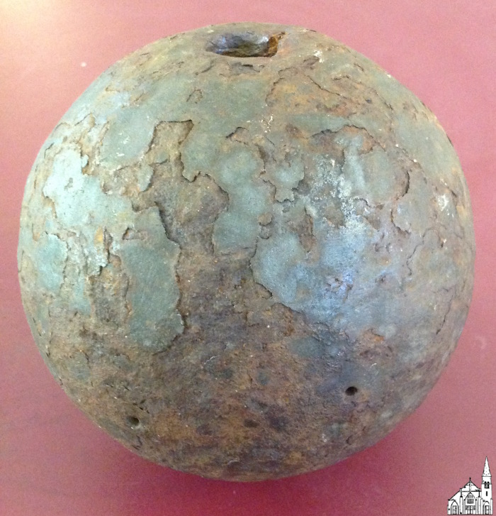
Cannon Ball [1861-5] (OBJ.N.2015.1)
A cast-iron cannon ball, probably dating from the civil war era.

Slide 246
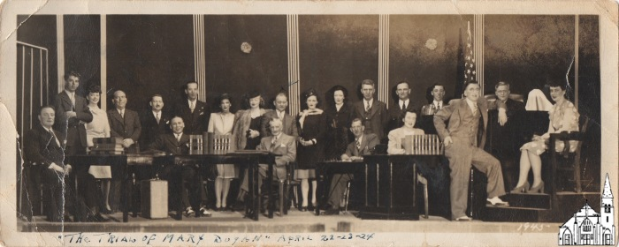
The Trial of Mary Dugan [Cast, 1945] (OBJ.N.2015.2)
Photograph of the cast of a 1945 performance of the 1927 play "The Trial of Mary Dugan" by Bayard Veiller. The play was performed in the Old Town City Hall on April 22, 23, and 24 and was directed by Verne Hardy, who also played the role of District Attorney. The high school teacher Miriam Grover starred as Mary Dugan. The name of the play, the performance dates and the year are on the front of the photograph, with the names of the complete cast on the back.

Slide 247
How Company [Metal Canister, 1900-1915] (OBJ.N.2015.3)
A metal canister to hold a How-Ko ribbon for a duplicating machine made by The How Company, Manufacturers, Old Town, Maine, USA with offices in New York (142 Fulton Street) and Boston (28 School Street) and branch offices in large cities.

Slide 248
Aerial Photographs [Old Town, 1946] (OBJ.N.2015.4)
Set of 23 aerial photographs of Old Town by Robinson Standard Aerial Surveys, Inc of 418-426 Central Avenue, Newark, New Jersey. The name of the company is stamped on the back with the date and a code "OT - ME - #" at the top of each photograph. The set is incomplete with four duplicates (31, 32, 33, and 47). Photos 31 through 35 cover the Penobscot river from Great Works up to Orson Island, while photos 38 through 40 cover the same river from just north of the mouth of Sunkhaze Stream up to White Squaw Island (just South of Argyle Road). Photos 41-48 and 67-69 cover Pushaw Lake and its immediate surroundings.

Slide 249
Aerial Photographs [Old Town, 1947] (OBJ.N.2015.5)
Set of 7 aerial photographs of Old Town by Fairchild Aerial Surveys of 21-21 41st Avenue, Long Island City 1, N. Y., together with an index to exposures. The name of the company is stamped on the back with the date and a code "8722 - #" at the top of each photograph. The index of exposures (in duplicate) is a map showing the overlay of the photos. The set is incomplete, as it only contains photos 3, 4, 5, 10, 11, 12, 14. Together these photos do cover Old Town (village), Great Works, French Island, and part of Indian Island. Most likely part of a Tax Valuation Project commissioned by the City of Old Town in 1947 (see Penobscot Times, September 24, 1948, p.1).

Slide 250
Aerial Photographs [Old Town, 1947] (OBJ.N.2015.6)
Set of 16 aerial photographs of Old Town by Fairchild Aerial Surveys of 21-21 41st Avenue, Long Island City 1, N. Y., together with an index to exposures. The name of the company is stamped on the back with the date and a code "8722-#-#" at the right side of each photograph. The index of exposures (in duplicate) is a map showing the overlay of the photos. The set is incomplete, as it only contains photos 6-5, 6-6, 7-4, 7-5,7-6 (covering the Stillwater river from the University to Stillwater), photos 3-1, 4-1, 4-2, 5-2, 5-3 (covering Old Town (village), French Island, Indian Island, and parts of Orson Island), and photos 3-12, 3-13, 3-14, 3-15, 4-11, 4-12 (showing Mud Pond and parts of Pushaw Lake). Most likely part of a Tax Valuation Project commissioned by the City of Old Town in 1947 (see Penobscot Times, September 24, 1948, p.1).

Slide 251
St. Mary's 25th anniversary plate [1953] (OBJ.N.2015.7)
Commemorative plate on the occasion of the 25th anniversary of St. Mary's Catholic Church in 1953.

Slide 252
Lewis-Stairs School Recipe Book [Great Works, 1970s] (OBJ.N.2016.1)
Typed and handwritten recipe book put together by the PTC of Lewis-Stairs Elementary School in Great Works.

Slide 253
Old Town Trust Still Bank [1910s] (OBJ.N.2016.14)
Adware. Old Town Trust Company branded "Wealthometer" (= still bank) by the Automatic Recording Safe Co" of Chicago. Key missing.

Slide 254
Old Town Trust Co [Directors, c.1910] (OBJ.N.2016.15)
Early 20th-century photograph of the board of directors of the Old Town Trust Company in front of the original company building (corner Main & Center Street).

Slide 255
Fire Hose Nozzle (OBJ.N.2016.16)
Large copper on brass fire hose nozzle. No apparent connection to Old Town.

Slide 256
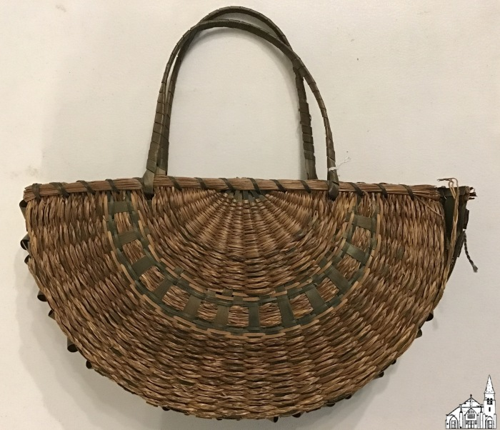
Native-American made basket (OBJ.N.2016.20)
Native-American, fan-shaped basket with green trim and curls on side. Exact provenance unknown. Some damage is visible on one side in the form of tearing from the bottom and one side. Tear extends about 3 inches.

Slide 257
Box with Blank Baby Book [1913] (OBJ.N.2016.3)
Blank "Our Baby" baby book with original receipt of May 27, 1913. In a box with loosely bound sheets with information about baby as well as 6 photographs.

Slide 258
Old Town Canoe Catalog [1958] (OBJ.N.2017.2)
Old Town Canoe catalog for 1958

Slide 259
St. Anne's Church [1910s] (OBJ.N.2017.3)
Postcard of St. Anne Church on Indian Island. Photo probably taken in the 1910s.

Slide 260
Old Town Brochure [1950s] (OBJ.N.2017.4)
Advertisement for Old Town ("Gateway of Northern Maine") in the form of an 8-page flier. Lists 1950 census population and shows the bridge to Indian Island (opened 1951), a Hunter's breakfast (started in 1951 as well) and the new high school (opened 1953). Uses the same map of Maine as OBJ.N.2023.54.

Slide 261
Tarratine Lodge [Constitution and By-Laws, 1900-1910] (OBJ.N.2018.1)
Constitution and By-Laws for Tarratine Lodge no. 27 (Old Town) with initiation form for Theran Reed signed February 13, 1909

Slide 262
Membership Certificate [Tarratine Lodge, 1913] (OBJ.N.2018.10)
Membership Certificate Tarratine Lodge, Independent Order of Odd Fellows for Charles H. Gray, dated Dec. 31, 1913. signed by C.D. Kennedy (?) (Noble Grand) and S.W. Libbey (Secretary)

Slide 263
Business District [Old Town, 1973] (OBJ.N.2018.11)
8mm film reel in plastic can labelled "Old Town Business District 1973". Origin unknown. Mostly contains shots from various places in Old Town (Main Street, Indian Island, French Island, High School, Middle School, Fire Station). For its full contents see https://www.youtube.com/watch?v=U9jahwrOQio.

Slide 264
Lumbering [1910s] (OBJ.N.2018.2)
Postcard with photo of Jordan Lumber Company crew hauling logs. Original photo in collection as well.

Slide 265
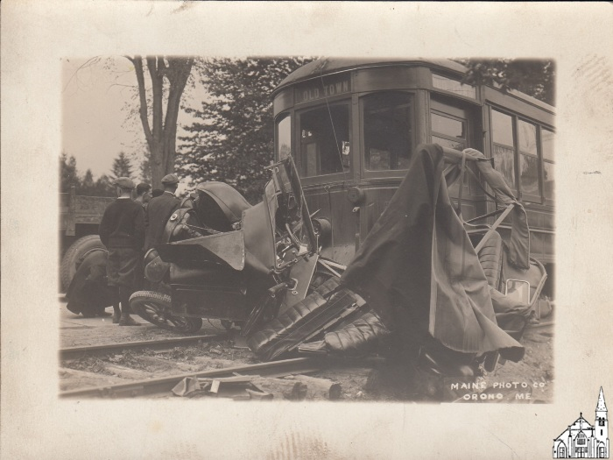
Old Town Trolley and Automobile Collision - Front (OBJ.N.2018.4)
Photo of the damage after a collision between the Old Town Trolley and an automobile showing the trolley car from the front. Left bottom corner says Maine Photo Co, Orono, ME. The accident depicted probably took place on June 5, 1924 when an automobile coming from Hamlin Street in Orono collided on Main Street with the Old Town Trolley going down toward Bangor. The driver later sued Bangor Hydro Electric Company for $30,000 in damages.

Slide 266
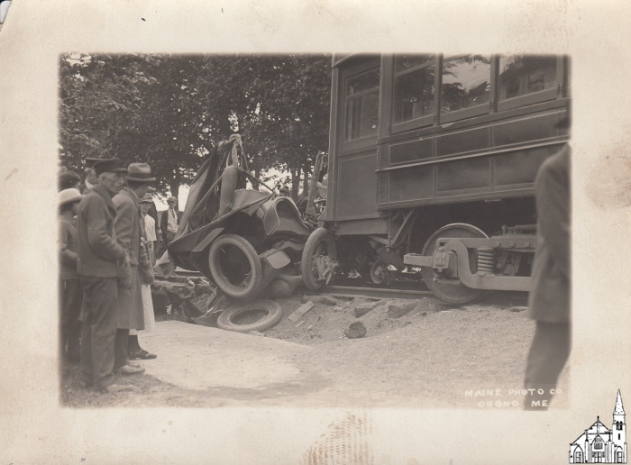
Old Town Trolley and Automobile Collision - Side (OBJ.N.2018.5)
Photo of the damage after a collision between the Old Town Trolley and an automobile showing the trolley car from the side. Left bottom corner says Maine Photo Co, Orono, ME. The accident depicted probably took place on June 5, 1924 when an automobile coming from Hamlin Street in Orono collided on Main Street with the Old Town Trolley going down toward Bangor. The driver later sued Bangor Hydro Electric Company for $30,000 in damages.

Slide 267
Myrtle Rebekah Degree Lodge [Constitution] (OBJ.N.2018.6)
Booklet (22 pp, printed by Smith & Sale in Portland) entitled: Constitution, By-Laws and Rules of Order of Myrtle Rebekah Degree Lodge, Number Fourteen of the Independent Order of Odd Fellows, Oldtown, ME. Instituted January 31, 1888. Also contains a list of female and male members.

Slide 268
Jordan Lumber Mill [1910s] (OBJ.N.2018.7)
Postcard with photo of the Jordan Lumber Company factory building. Postmarked Nov. 12, 1914 (with caption identifying the building as Jordon's Mill, Oldtown, ME)

Slide 269
PCF Mill [Great Works, 1910] (OBJ.N.2018.8)
Postcard with view from the river of the Great Works paper mill. Postmarked April 6, 1910.

Slide 270
Aerial View [Pea Cove Pentecostal Campground, 1980s] (OBJ.N.2018.9)
Undated postcard with on back the caption: Camp Ground. New England District of the United Pentecostal Church, Inc. Located in Old Town, Maine on Route 16. Sender of the card mentions that he and his father served as cooks for the camp over the summer.

Slide 271
Gilman Falls [1993] (OBJ.N.2019.10)
Single photo of Gilman Falls

Slide 272
N. Brunswick Street [1900] (OBJ.N.2019.11)
Matted photo with a view of the McKinley School and the Methodist Church.

Slide 273
View of Indian Island [1900] (OBJ.N.2019.12)
Postcard with a view of the Penobscot River and Indian Island

Slide 274
Course of Study [OTHS, 1890] (OBJ.N.2019.13)
Brochure "Course of Study and Rules and Regulations of the Public Schools of Old Town, ME" (Old Town: Enterprise Press, 1890).

Slide 275
St. Anne Catholic Church [1996] (OBJ.N.2019.14)
Flier for the St. Ann Catholic Church dated May 5, 1996 with a Mass schedule and other announcements. Probably part of a weekly publication.

Slide 276
Pictures for Little Hands [1903] (OBJ.N.2019.15)
Drawing Book for girls courtesy of Scott & Bowne, makers of Scott's Emulsion. 1903 calendar on back as well as the localization "for sale by C.A. Lowe Drug Co, Main Street, Old Town ME". Front has "Alice Johnston" written in a childish hand, which probably refers to Mary Alice Johnston (1892-1965).

Slide 277
Annual Report [Old Town, 1891] (OBJ.N.2019.16)
Mayor's Address and Annual Report of the City Government for the Municipal Year 1891.

Slide 278
Folsom Block from North [Averill, 1870s] (OBJ.N.2019.17)
Stereoview card of the Folsom Block looking South. Several stores clearly identifiable. Old St. James Episcopal Church in the background. Note the planking instead of a sidewalk. M.L. Averill's name is on the back, printed in landscape. The name of Averill's wife (Albra Averill) was also written on the back, but has been partially erased. There may have been a label with number.

Slide 279
Folsom Block from South [Averill, 1870s] (OBJ.N.2019.18)
Stereoview card of the Folsom Block looking South. Several stores clearly identifiable. Note the planking instead of a sidewalk. M.L. Averill's name is on the back, printed in landscape.

Slide 280
Memorial Day [1928] (OBJ.N.2019.2)
Matted photo of the Old Town Fire Department on Memorial Day 1928. Depicted are, according to the information on the back of the photo, (from l. to r.) the 1885 Button Team, the 1917 Garford Pumper, a 1904 horse-drawn hose wagon, a 1923 American LaFrance Pumper and a c. 1904 horse-drawn hook-and-ladder wagon. Holding the reins for the second team is John Richards, while M. Gilman is behind the wheel of the LaFrance Pumper, with Rex Sibley standing next to him. O. Brown holds the reins for the third team. Based on the embossment on the matting, the Perry Studio (i.e. Walther Erb or one of his assistants) took the photo.

Slide 281
Memorial Day [1928] (OBJ.N.2019.2.1)
Enlarged copy of OBJ.N.2019.2 with some additional information about the Old Town Fire Department. Lists the year the original photo was taken incorrectly as 1925.

Slide 282
Ounegan Block from North [Averill, 1870s] (OBJ.N.2019.20)
Stereoview card of the Ounegan Block looking South. At least one store is clearly identifiable. Averill's name is on the back, printed in landscape.

Slide 283
View of Old Town from Indian Island [Averill, 1870s] (OBJ.N.2019.21)
Stereoview card with a view of Old Town from Indian Island. The structure in front is what was left of the Veazie Block, a set of saw mills at the same height as the Milford Mill. The building on the right is G. C. Dillingham's Outfitter store. The white building on the left is the Wadleigh House (which burned to the ground in 1874). Averill's name is printed on the back in portrait.

Slide 284
Our Neighborhood Club [Members, 2019] (OBJ.N.2019.22)
Printouts of two collages of photos of Our Neighborhood Club members--with their names.

Slide 285
Stillwater Covered Bridge (OBJ.N.2019.23)
Set of 4 copies or facsimiles of postcards of the Stillwater covered bridge with related writing (by Carole Spruce) on back.

Slide 286
Stillwater Covered Bridge [1940s] (OBJ.N.2019.24)
Two b/w photos of the covered bridge, one of the Marsh Island side entrance, the other of the upstream side (check the shape of the support in the middle and the number of peek holes on each side of the support).

Slide 287
Stillwater Covered Bridge (OBJ.N.2019.25)
Four photos (two identical) of the Stillwater covered bridge, along with negatives for three of them plus a fourth negative.

Slide 288
Stillwater Covered Bridge [1910s] (OBJ.N.2019.26)
Postcard with a view of the Marsh Island side of the Stillwater covered bridge.

Slide 289
Covered Bridge between Old Town and French Island (OBJ.N.2019.27)
Postcard with a view of the covered bridge from Old Town

Slide 290
Flood [Chapman Building, 1923] (OBJ.N.2019.28)
Postcard of the flooded Chapman building during the Flood of 1923. View from the end of Center Street.

Slide 291
Flood [1923] (OBJ.N.2019.29)
Set of four photos of the Flood of 1923, one with a view of the pie plate (paper products), one with a view of Sawyer's Livery, one of the bridge to French Island, and one depicting an unidentified location. The photo of the pie plate has a picture of a car glued on the back.

Slide 292
The Birth of a Nation [Movie Handbill, 1915] (OBJ.N.2019.3)
Handbill for the program at New Central Theatre for the week of December 6, 1915. The only show on the program is "The Birth of a Nation" (which premiered on March 21, 1915). Printing done by Star Printing Company of Old Town. Note that the flier only says "Week of December 6". From the Penobscot TImes it is clear that for New Central Theatre the week started on a Monday and December 6, 2015 was a Monday.

Slide 293
Stillwater Covered Bridge [Toll Receipt] (OBJ.N.2019.30)
Handwritten acknowledgement of receipt of one dollar from Orimel Rogers for use of the Stillwater toll bridge from July 16h to August 16th, 1857. Signed W.C. Waterson (?).

Slide 294
Penobscot Times Printing Blocks (OBJ.N.2019.31)
A collection of engraved printing press blocks used by the Penobscot Times. The collection includes letter blocks, signature blocks, icons, and a rubber stamp for creating a "Penobscot Times Photo" label. Founded as "The Old Town Enterprise" in 1888 and printing weekly under that name until 1934, when it became 'The Penobscot Times and Old Town Enterprise,' the paper became "The Penobscot Times" in 1941. In 1979, under new ownership the paper became "Old Town-Orono Times Penobscot Times" until 1992, when the name again shortened to "The Penobscot Times," which it remains today despite their acquisition by Bangor Media Group and closure of the paper's Old Town office in 2019. These blocks, and stamp, may date to the 38 years when the paper first carried the name The Penobscot Times, though exact date of origin is not known.

Slide 295
Jack's Five Basketball Tickets [1963-1964] (OBJ.N.2019.32)
Ten tickets for admission to a Jack's Five Basketball game in Old Town, Maine, no date printed. Jack's Five were a semi-pro ball team assembled in 1963 by Old Town restaurateur Jack Cashman from some of the finest college and high school basketball players in the area. Cashman wrote a restrospective essay for Old Town Museum about the team's composition and two years playing together, accessible online in the museum's digitized newsletters. The essay is found in Volume 17, Number 1 on page 3.

Slide 296
Sewall Company (Old Town) [c1955] (OBJ.N.2019.33)
[Copy of] original photograph of the Sewall Company's building on Center Street in the 1950s.

Slide 297
Elgin Adware [c.1920] (OBJ.N.2019.4)
Adware for Elgin railroad watches customized for Sancton Jewelry Co. "Elgineers" of 165 Main Street, watch inspector for the Bangor & Aroostook and the Maine Central Rail Lines.

Slide 298
Diamond Corporation Softball Uniform [c.1975] (OBJ.N.2019.5)
Softball uniform used by the Diamond Corporation Team. Blue with vertical white stripes. Size XL.

Slide 299
L.C. Chase Carriage Robe (OBJ.N.2019.6)
L.C. Chase carriage robe which originally belonged to the Eastman family of LaGrange, ME. It came into the Cousins family of Old Town when Madeline Eastman (Old Town, 1899- Bangor, 1993) married Edgar Fuller Cousins (Westbrook, 1888- Bangor, 1983) on January 7, 1950, mayor of Old Town from 1935 to 1946, Penobscot Chemical Fiber Company employee from 1912 to 1958, and grandfather (by previous marriage) of John C. Cousins, III. Lucius C. Chase and Company of Cambridge, MA was the foremost manufacturer of carriage robes in New England during the second half of the 19th century.

Slide 300
Aerial Photo [Great Works] (OBJ.N.2019.7)
Aerial photo of Great Works and the PCF plant. According to the text on the frame (discarded) the photo was taken in the Spring of 1950. The text on the back also mentions that the bill should go the the City and that a cut of the photo with dimensions 12.5''x6.75'' should go to the Penobscot Times. That cut clearly is the source of the image of the plant printed on p.12 of June 12, 1950 issue of the Penobscot Times. There, the photo is attributed to the James W. Sewall Company.

Slide 301
Higgins Display Case (OBJ.N.2019.8)
Wooden display cabinet with the Higgins logo on the door. The cabinet came into the country store collection of Dr. George Nutter, owner of the Rexall Drug Store of Salmon Falls, NH about 1910 to his death in 1939, then to his daughter Dorothy Nutter Green of Salmon Falls until the Rexall Store was sold in the 60’s and became Care Pharmacy. Then the cabinet was taken to Willimantic Ct by Faith Green Kenton, and used as a cabinet for sewing notions.

Slide 302
Methodist Church Fire [1993] (OBJ.N.2019.9)
Single photo of the Stillwater Av. Methodist Church after its sanctuary was gutted by fire on June 26, 1993

Slide 303
Old Town Slides (OBJ.N.2020.1)
Batch of 14 slides with scenes from Old Town, including several of the A & P Food Store on North Main Street and of the Masonic Building (between the Post office and the Eastern Trust and Banking Company) shortly after it was gutted in the morning of June 13, 1962.

Slide 304
Dancing Mothers [Movie Handbill, 1926] (OBJ.N.2020.10)
Movie Handbill for the Paramount movie "Dancing Mothers" showing at New Central Theatre on Aug.20-21, 1926.

Slide 305
The Light of the Western Stars [Movie Handbill, 1925] (OBJ.N.2020.11)
Movie Handbill for the Paramount movie "The Light of the Western Stars" showing at New Central Theatre on Aug.20-21, 1925.

Slide 306
The Vanishing American [Movie Handbill, 1926] (OBJ.N.2020.12)
Movie Handbill for the Paramount movie "The Vanishing American" showing at New Central Theatre on Aug.30-31, 1926.

Slide 307
Everybody's Acting [Movie Handbill, 1926] (OBJ.N.2020.13)
Movie Handbill for the Paramount movie "Everybody's Acting" showing at New Central Theatre on Dec.17-18, 1926.

Slide 308
Aloma of the South Seas [Movie Handbill, 1926] (OBJ.N.2020.14)
Movie Handbill for the Paramount movie "Aloma of the South Seas" showing at New Central Theatre on Sep.3-4, 1926.

Slide 309
Mannequin [Movie Handbill, 1926] (OBJ.N.2020.15)
Movie Handbill for the Paramount movie "Mannequin" showing at New Central Theatre on Mar.13, 1926.

Slide 310
Dr. Jack [Movie Handbill, 1922] (OBJ.N.2020.16)
Movie Handbill for the Pathépicture movie "Dr. Jack" showing at Strand Theatre on Aug.14, 1922.

Slide 311
The Old Homestead [Movie Handbill, 1922] (OBJ.N.2020.17)
Movie Handbill for the Paramount movie "The Old Homestead" showing at Strand Theatre on Nov.3-4, 1922.

Slide 312
To Have & To Hold [Movie Handbill, 1922] (OBJ.N.2020.18)
Movie Handbill for the Paramount movie "To Have & To Hold" showing at Strand Theatre on Dec.8-9, 1922.

Slide 313
The Keeper of the Bees [Movie Handbill, 1925] (OBJ.N.2020.19)
Movie Handbill for the J.P. Kennedy movie "The Keeper of the Bees" showing at Strand Theatre on Dec.5, 1925.

Slide 314
2nd Maine Infantry, Company I (1917) (OBJ.N.2020.2)
Orr photo of Company I taken in Augusta, ME

Slide 315
Brown of Harvard [Movie Handbill, 1925] (OBJ.N.2020.20)
Movie Handbill for the Metro-GM movie "Brown of Harvard" showing at Strand Theatre on Oct.9, 1925.

Slide 316
Old Ironsides [Movie Handbill, 1926] (OBJ.N.2020.21)
Movie Handbill for the Paramount movie "Old Ironsides" showing at Strand Theatre on Jun.7-8, 1926.

Slide 317
My Boy [Movie Handbill, 1921] (OBJ.N.2020.22)
Movie Handbill for the Sol Lesser movie "My Boy" showing at Strand Theatre on April 1, 1921. NOT COMPLETE!!!

Slide 318
The Son of the Sheik [Movie Handbill, 1926] (OBJ.N.2020.23)
Movie Handbill for the United Artist movie "The Son of the Sheik" showing at Strand Theatre on Dec.18, 1926.

Slide 319
Oliver Twist [Movie Handbill, 1922] (OBJ.N.2020.24)
Movie Handbill for the Sol Lesser movie "Oliver Twist" showing at Strand Theatre on Jan.12-13, 1923.

Slide 320
One Minute to Play [Movie Handbill, 1922] (OBJ.N.2020.25)
Movie Handbill for the J.P. Kennedy movie "One Minute to Play" showing at Strand Theatre on Jan.28, 1927.

Slide 321
My Own Pal [Movie Handbill, 1926] (OBJ.N.2020.26)
Movie Handbill for William Fox' "My Own Pal" shown at Strand Theatre on April 21, 1926

Slide 322
The Sea Beast [Movie Handbill, 1926] (OBJ.N.2020.27)
Movie Handbill for Warner Brother's "The Sea Beast" shown at Strand Theatre on July 31, 1926.

Slide 323
The Eternal Flame [Movie Handbill, 1922] (OBJ.N.2020.28)
Movie Handbill for Joseph Scheck's "The Eternal Flame" shown at The Strand Theatre on Nov.24-25, 1922.

Slide 324
Lightning [Movie Handbill, 1926] (OBJ.N.2020.29)
Movie Handbill for William Fox' "Lightning" shown at Strand Theatre on Feb.26, 1926.

Slide 325
Margaret Chase Smith to Louis Leverone (1949) (OBJ.N.2020.3)
Letter dated MArch 3, 1949 by Sen. M.C. Smith to Louis Leverone in his capacity of president of the Old Town Chamber of Commerce. With original envelope and a draft response by Leverone.

Slide 326
Deadwood Coach [Movie Handbill, 1925] (OBJ.N.2020.30)
Movie Handbill for William Fox' "Deadwood Coach" shown at Strand Theatre on Aug.24, 1925.

Slide 327
Jack and the Bean Stock [1920s, Ticket] (OBJ.N.2020.31)
Ticket for admission to Prof. Mardox Jack and the Bean Stock [sic!] as performed on City Hall on "Wednesday, Next". Date and location are stamped, the rest of the ticket is printed. This most likely was a traveling children's show, but no further information could be found.

Slide 328
Two Piano Recitals [1924, Invitation] (OBJ.N.2020.32)
Invitation for two piano recitals---one at Helen Hunt Auditorium on 7/9/24 and one in Bangor the day after---by the students of Mrs Irene Tracy, Teacher of Piano in Bangor, Orono, and Old Town. Program and list of students for the academic year 1923-24 included. Underlinings in pencil and annotation "I went" on the front.

Slide 329
Junior High Glee Club [1925, Program] (OBJ.N.2020.33)
Program for a joint Old Town and Orono Junior High musical performance on Thursday, April 30, 1925

Slide 330
Stop Thief [1924, Program] (OBJ.N.2020.34)
Program booklet for "Stop Thief. A Comedy in Three Acts" directed by J. Dal Luther under the auspices of PCFAA (?) from April 24 through April 26, 1924. Contains a lot more ads than actual program information.

Slide 331
Anne What's Her Name [Cast, 1926] (OBJ.N.2020.35)
Program sheet for the play "Anne What's her Name" by the senior class of Brewer High School performed at the Old Town City Hall on March 10, 1926.

Slide 332
Vacation [OTJH Cast, 1925] (OBJ.N.2020.36)
Typed Program sheet for the play "Vacation" by the Old Town Junior High School at Helen Hunt Auditorium on Feb. 5, 1925.

Slide 333
Wilson Memorial [1924] (OBJ.N.2020.37)
Flier with announcement of a Woodrow Wilson Memorial Service at the Helen Hunt Auditorium on Sunday, February 17, 1924 at 7:30pm.

Slide 334
Our Neighborhood Club [Expenses, 1934-1953] (OBJ.N.2020.38a)
Ledger with expenses from 1934 to 1953. Some Treasurer Reports included as well.

Slide 335
Our Neighborhood Club [Expenses, 1953-1971] (OBJ.N.2020.38b)
Ledger with expenses from 1953 to 1971. Some Treasurer Reports and Budgets included as well.

Slide 336
Our Neighborhood Club [Expenses, 1970-1998] (OBJ.N.2020.38c)
Ledger with expenses from 1970 to 1998.

Slide 337
Our Neighborhood Club [Expenses, 1998-2007] (OBJ.N.2020.38d)
Ledger with expenses from 1998 to 2007.

Slide 338
Our Neighborhood Club [correspondence, 1995-2007] (OBJ.N.2020.39)
Folder with correspondence of Our Neighborhood Club, mostly related to donations.

Slide 339
Curran Ledger/Scrapbook (OBJ.N.2020.4)
Ledger kept by an unidentified company (or possibly a post office), later used as a scrapbook. Contains many memorabilia and effusions pertinent to the life of Janice Curran as a teenager growing up in Old Town. A number of theater cards and other fliers have been removed and are catalogued individually.

Slide 340
Our Neighborhood Club [finances, 2002-2007] (OBJ.N.2020.40)
Folder with various budgets and treasurer's reports from 2002 to 2007.

Slide 341
Our Neighborhood Club [varia] (OBJ.N.2020.41)
Folder with various items, including a short history of Our Neighborhood Club, a photo of a visit to the new Old Town Elementary School on Feb.5, 2004, several fliers, and a set of poems by Vivian D. Spruce (1914-2002).

Slide 342
Old Town Brochure [2010] (OBJ.N.2020.42)
Set of 3 identical brochures about Old Town.

Slide 343
Myrtle Rebekah Degree Lodge [Constitution] (OBJ.N.2020.43)
Booklet (32 pp, printed by Smith & Sale in Portland) entitled: Constitution, By-Laws and Rules of Order of Myrtle Rebekah Degree Lodge, Number Fourteen of the Independent Order of Odd Fellows, Oldtown, ME. Instituted January 31, 1888. With revisions dated December 22, 1931 and July 3, 1934.

Slide 344
Tarratine Lodge [Constitution] (OBJ.N.2020.44)
Booklet (53 pp, printed by Smith & Sale in Portland) entitled: Constitution and By-Laws of Tarratine Lodge. Number 27. Independent Order of Odd Fellows, Old Town, ME. Instituted May 23, 1845. Most recent change listed is of October 24, 1926. Contains several erasures and corrections in pen. The membership certification note in the front is filled out to the name of Robert Forsythe Abbott, initiated on April 8, 1949.

Slide 345
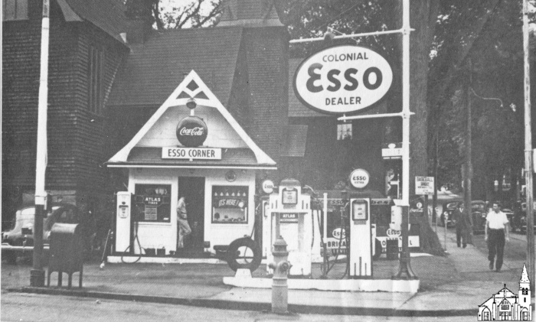
Esso Corner [ca.1950] (OBJ.N.2020.46)
Photo of a photo of Al's Esso Corner in front of St. James Church. The original was used for an ad in the Penobscot Times of November 8, 1951 (p.5). The photo of the photo was probably taken in the 1990s or later.

Slide 346
The Pony Express [Movie Handbill, 1925] (OBJ.N.2020.5)
Movie Handbill for the Paramount movie "The Pony Express" showing at New Central Theater on Dec.4-5, 1925.

Slide 347
The Coast of Folly [Movie Handbill, 1925] (OBJ.N.2020.6)
Movie Handbill for the Paramount movie "The Coast of Folly" showing at New Central Theatre on Oct.30-31, 1925.

Slide 348
The American Venus [Movie Handbill, 1926] (OBJ.N.2020.7)
Movie Handbill for the Paramount movie "The American Venus" showing at New Central Theatre on Feb.27, 1926.

Slide 349
Kid Boots [Movie Handbill, 1926] (OBJ.N.2020.8)
Movie Handbill for the Paramount movie "Kid Boots" showing at New Central Theatre on Nov.19-20, 1926.

Slide 350
It's the Old Army Game [Movie Handbill, 1926] (OBJ.N.2020.9)
Movie Handbill for the Paramount movie "It's the Old Army Game" showing at New Central Theatre on Oct.8-9, 1926.

Slide 351
Ladies Man [Move Handbill, 1931] (OBJ.N.2021.1)
Movie Handbill for the Paramount movie "Ladies Man" shown at Strand Theatre on May 25, 1931

Slide 352
Dick Tracy Certificates [1938] (OBJ.N.2021.10)
Two Dick Tracy Secret Service Patrol certificates---one for Alice Madeline Bradford and one for Leslie Bradford, siblings from Argyle.

Slide 353
Little Women [Flier/OTHS Cast, 1936] (OBJ.N.2021.11)
Very low budget flier for the 1936 Old Town High School Play based on "Little Women" on Friday, November 20, 1936. The photo on the flier is the same as published in the Penobscot Times.

Slide 354
Indian Island [1910s] (OBJ.N.2021.12)
Set of two hand-colored postcards with a view of Indian Island roughly from the foot of the bridge to Indian Island. It would appear that in both cases the artist added a lot more trees than were really there.

Slide 355
Sawdust Trail to Indian Island (OBJ.N.2021.13)
(Modern) photo of OBJ.N.1979.55. Poor quality.

Slide 356
Stillwater Covered Bridge [Demolition, 1951] (OBJ.N.2021.15)
Photo of the demolished Stillwater covered bridge with the temporary bridge upstream from it. High-quality print of the photo published in the Penobscot Times.

Slide 357
Rural Carrier [Receipt, 1938] (OBJ.N.2021.16)
Acknowledgment of receipt by a rural carrier (name illegible) of the amount of $6.42 from S.C. Dow of Argyle. The receipt fell out of one of the Argyle books.

Slide 358
Ira Eastman [Envelope, 1913] (OBJ.N.2021.17)
Envelope with printed return address for Ira Eastman of Old Town and addressed to Ms. E.M. Bussell. Provenance of item unknown.

Slide 359
Cutler Trading Stamps [1950s] (OBJ.N.2021.18)
A total of 15 cash discount stamps issued by Cutler's of Old Town. Since Cutler only advertised their "red stamps" in the Penobscot Times in the 1950s, these 15 stamps probably date from that period. Provenance unknown.

Slide 360
WWII Honor Roll [1946] (OBJ.N.2021.19)
Lined composition book with the handwritten list of names of Old Town citizens who served in WWII in alphabetical order. On the back of the front cover, it says that the count on May 14, 1946 was 1093. Possibly this was the source of the names on the temporary War Memorial between the Post Office and Masonic Hall.

Slide 361
Greenhalgh Binder (OBJ.N.2021.2)
A binder containing 13 photographs of plate molding machinery (5 dated 11/7/1960, 5 dated 12/12/1967, and 3 undated), one aerial view of the Pulp Products plant from the early 1960s, one publicity photo for Repel!, and an extract from Cy's writings. The aerial photo gives a good view of North Main Street and shows all houses and businesses from the YMCA to the Old Town Body Shop, including the Old Town Hardware Store, Goldsmith's Furniture, Blanchard Fuel, the North End Café and the Beaulieu Brother's Market.

Slide 362
Group Photo with Mostly Young Men [c.1938] (OBJ.N.2021.20)
Group Photo with mostly young man. The back of the photo lists the names of the men on the front row with a location for most of them. A number of them graduated from Old Town High School in 1934 and most of the others look like they might be in their early twenties. Some do not seem to have a connection to Old Town at all. Old Town names include Charles Higgins (1916-1983. OTHS '34), Alex Sapiel (1915-1944, OTHS '34), and Vincent LaFlamme (1918-2010). The photo has a stamp "Parlin Pharmacy, Corner Main & Center Streets, Old Town, Maine" on the back. There might be a connection with the Civilian Conservation Corps or the American Legion.

Slide 363
Group Photo with Mostly Young Men [c.1938] (OBJ.N.2021.21)
Group Photo in front of the the Old Town Post Office with mostly young men. The back of the photo lists the names of all of the men, along with the name of a town in Penobscot Co. All of them seem to be around the same age; some do not seem to have a connection to Old Town at all. Old Town names include Harry Goslin (1917-1985, W. Old Town/Gerry), Raymond Roy (1916-1981), Fred Martin (OTHS '34), Arthur Neptune (Indian Island, 1918-1999), Listed as absent are Lionel Marquis (1916-1983) of Old Town and Alfred Oakes (1918-2008) of Milford. There might be a connection with the Civilian Conservation Corps or the American Legion.

Slide 364
Reward Cards [Elementary School, c. 1900] (OBJ.N.2021.22)
A collection of three elementary school reward cards signed by Old Town teachers for one Harry White. Probably this was Harry Williamson White (1889/90-1936), one of the two Old Town men to first enlist for WW1 and whose early death was related to the injuries he sustained.

Slide 365
American Woolen Mill [Interior, c.1910] (OBJ.N.2021.23)
Interior of the American Woolen Mill in Old town

Slide 366
Herbert Gray School [1938 OTHS Cohort] (OBJ.N.2021.24)
Scans of end-of-the-year class photos for all five years of those of the OTHS 1938 cohort who attended the Herbert Gray School, starting elementary school in 1926. The 1931 photo has all the names. Notable members of this cohort were George Barker Cunningham (1919-2003), author of Ten Houses in Old Town:1865-1940, and (minus its last year) Joseph Sewall (1921-2011), president/CEO of the Sewall Company from 1946 to 1996. Together with classmate (and cousin) Deane Benson Gray (1920-1993), Sewall did his last year of high school at Holderness School, Plymouth, NH

Slide 367
Hunting Scene [Original Photograph] (OBJ.N.2021.25)
An original black-and-white photo, probably taken 1890-1920, of a hunter. He is looking down at a deceased deer on the ground. Before them is a log campfire, unlit. Behind them are a tent made of pale tarps and a bark canoe with paddle. The back of the photograph identifies the hunter as Bert Freese. Connection to Old Town unclear.

Slide 368
Argyle Boom Crew [Photograph] (OBJ.N.2021.27)
An apparently original photograph taken at the Argyle Boom during its years of operation (approx. 1900-1930). Twenty-five men stand in a posed group in front of the boom house, several standing on planks for a riser effect at the back. Two men carry buckets; many wear hats. An open window and open door ventilate the house in this apparently summer scene.

Slide 369
Black Island Train Bridge [Photo Reproduction] (OBJ.N.2021.28)
A copy, likely made in the 1950s, of a mid-19th century photo. Labeled Black Island Train Bridge, it probably depicts a bridge on the Bangor and Pistaquis Railroad in the 1860s. Besides the crossbeam bridge in the background, the photo shows the river, an L-shaped plank pier, and trees bare of leaves.

Slide 370
Argyle Boom House and Group [Photo Reproduction] (OBJ.N.2021.29)
A reproduction (1950s?) photograph of the Argyle Boom House, in operation roughly 1900-1930. The shot is taken at a distance. A group of men cluster around its entrance, which along with two upstairs windows is open. One man stands far off to the side.

Slide 371
Steam Engine and Loggers [Photo Reproduction] (OBJ.N.2021.31)
An apparent photocopy (1990s?) of a picture of loggers posed around and on a steam hauler trailing cars stacked with logs in the snow. Eight men perch on the front of the engine, two peer out from the cab, and four stand in the snow with various logging implements. Perhaps taken 1900-1920, if the engine is a Lombard steam hauler.

Slide 372
Ice Harvest Photographs [3] (OBJ.N.2021.32)
Three black and white photographs labled Jan 23. Each shows three workers around a horsedrawn cart in various poses. in one, the cart is attached to one horse, in another a worker backs a second horse into harness, and in the third both horses are in place, indicating candid shots taken in succession. On the cart are white rectangular blocks of ice. Photos' year of origin and connection to Old Town unclear.

Slide 373
Unidentified Farm [1880s-1890s] (OBJ.N.2021.33)
A likely original photograph of a late 19th century farm and barn. In the foreground a man and horse stand behind a split-log fence. Behind them an empty buggy with large wheels typical of the 1880s-90s stands on the grass, and midframe on the horizon is the single-chimneyed house with four people in front of it--two women and two men, apparently. Connection to Old Town unclear.

Slide 374
Group in Winter [Photograph] (OBJ.N.2021.34)
An apparently original photograph taken approximately 1890-1910. Eight men in winter dress stand in a line, some holding tools. They may be at the Argyle Boom House, though the building in the background is not clear. Appears to be the same group shown in OBJ.N.2021.36

Slide 375
Hay Baling [Photograph] (OBJ.N.2021.35)
An apparently original photograph of workers posed with hay bales. Four men sit on an elevated cart-bed and one stands below holding a bale. Likely taken 1900-1920, connection to Old Town unclear.

Slide 376
Unidentified Group of 8 Men in Winter II [1896-1904] (OBJ.N.2021.36)
Eight men in different poses in front of a building hanging with icicles. Connection to Old Town unclear, but style reminiscent of Rhodes.

Slide 377
Cabinet Photographs of M. S. Buker [1880s approx.] (OBJ.N.2021.37a)
Series of six cabinet photographs by Old Town, ME photographer M. S. Buker. Buker opened his Old Town studio in 1884, so these pictures are estimated to have been taken in the 1880s. Their subjects are unidentified. In brief, the pictures are of: 1) A baby on a cloth-draped chair, wearing a period-typical child's gown. 2) A 1/4 headshot of a woman looking to her left. Her hair is pulled back but not obviously styled; she wears no jewelry or accessories. 3) A 1/4 headshot of a woman looking to her left. Her hair is pulled back in a bun. She is wearing a lace collared dress, pearl stud earrings and pearl(?) brooch. 4) A 1/2 headshot of a man looking to his right. He is cleanshaven with severely parted hair and is wearing a three-piece suit with tie, pocket watch, and pocket handkerchief. 5) A 1/2 headshot of a man looking to his right. He has a mustache and sideburns as well as a severe part. He is wearing a double-breasted coat and striped bowtie. 6) A full body portrait of a formally dressed woman in the same studio forest setting. She rests her right hand on a fake tree with the left at her side, wedding ring visible. Her dress features asymmetrical lace and fabric layers slanted diagonally down the skirt and a bodice with small buttons in front. Other accessories include a pocket watch, pin or brooch, and earrings.

Slide 378
Mary Lowell [Photograph May 1886] (OBJ.N.2021.37b)
A cabinet photograph by M. S. Buker of Old Town, ME. The subject is identified as Mary Lowell. The picture was taken in May, 1886. Mary appears as a young girl in white dress with sash, black tights, and black leather shoes. She is posed leaning on a haybale against a mock forest backdrop with fake tree. She wears a ring on the third finger of her right hand and what appears to be a pin or brooch.

Slide 379
Cabinet Photographs of A. B. Carr [1880s approx.] (OBJ.N.2021.38a)
Series of six cabinet photographs by Old Town, ME photographer A. B. Carr.Carr was listed in the 1877-78 Maine register as a photographer based in Old Town, so while these pictures may date to the late 1870s, they're estimated to have been taken in the 1880s. Subjects are unidentified but briefly decribed as follows: 1) A 1/4 headshot of a woman with her hair in a top knot bun looking to her left. She wears a lace collar and ribbon around her neck. 2) A 1/2 portrait of a woman looking to her left. Her hair is braided and coiled on her head and she wears a large lace collar, necklace, and pin or brooch. 3) A 1/4 headshot of a woman looking left. Her hair is severely parted, twisted, and held back. She wears a lace collar and ribbon around her neck. 4) A 1/2 portrait of a man with thinning, parted hair and large mustache. He looks directly ahead and is wearing a suit and bowtie. 5) A 1/2 portrait of a man with severely parted, pomaded hair. He is cleanshaven and looks directly ahead. He is wearing a three-piece suit with high collared shirt and skinny cravat tied in a loose bow. 6) A large 1/4 headshot of a man looking slightly to his left and surrounded by an oval feather gradient. His hair is parted and combed back and he wears a suit and bowtie.

Slide 380
Hattie B. Leighton [Photograph, 1880s approx.] (OBJ.N.2021.38b)
A black and white headshot taken by Old Town, ME photographer A. B. Carr around the 1880s. The subject is identified as Hattie B. Leighton. She wears an elaborately tied sheer (silk?) scarf and dangling earrings. Her hair is pulled up and back, leaving tightly curled bangs.

Slide 381
Cabinet Photographs of M. G. Gilmore [1890-1910 approx.] (OBJ.N.2021.39)
Two sepia photographs by Old Town photographer M. G. Gilmore, taken approximately 1890-1910. The subjects are two unidentified girls with sausage ringlets and teased bangs. In one, the girl looks to her right; in the other the girl looks directly at the camera. The girl looking right wears a striped dress with puffed sleeves and a lace bodice. The girl looking ahead appears younger and wears a sleeveless dress with bunched lace collar.

Slide 382
Argyle Town Expenses (OBJ.N.2021.3a)
Ledger with expenses of the town of Argyle by subject from 1926 through 1931.

Slide 383
Argyle Town Expenses (OBJ.N.2021.3b)
Ledger with expenses of the town of Argyle by subject from 1932 through 1937.

Slide 384
Unidentified Couple [1896-1904] (OBJ.N.2021.40)
Photo of two unidentified people, a seated man and standing woman of approximately the same age. The man is dressed in a three piece suit with watch chain and bowtie; his hair is severely parted and his mustache curled up at the ends. The woman stands with her hands clasped behind her back, emphasizing the horizontal stripes on her dress's bodice as well as its puffed sleeves and shoulder ruffles. Her hair is pinned back; she wears no visible jewelry. The studio setting includes a backdrop evocative of classical architecture, with painted column and urn. Caption indicates that the photo was taken by Rhodes.

Slide 385
Lizzie A. Royess [Photograph] (OBJ.N.2021.41)
A black and white full body photograph by Portland, ME photographer C. B. Conant (Charles Bean Conant). The subject is identified as Lizzie A. Royess of Old Town, ME. Likely taken in the 1880s, Lizzie is posed leaning on the back of an upholstered wooden chair holding a lace-edged fan. She wears a three-tiered full skirt, buttoned-up bodice and outer layer with long padded sleeves and lace cuffs. Her hair is pulled back with curls to frame her face.

Slide 386
Charlie Gilbert [Photograph] (OBJ.N.2021.42)
A black and white headshot taken by Old Town photographer M. L. Averill, likely in the 1870s. The subject is identified as Charlie Gilbert. In the portrait he looks to his right, sports a full, waxed mustache and goatee, and wears a three-piece suit with multicolored bowtie.

Slide 387
Fannie Hoskins [Photograph] (OBJ.N.2021.43)
A sepia 1/4 portrait by an unknown photographer that appears to have been taken in the mid-to-late 19th century. The subject is identified as "(Dear) Fannie Hoskins" of Old Town, ME. This likely refers to Fannie M. Hoskins Reed (1849-1875), a daughter of Old Town fixture Eli Hoskins. She married George Reed of Milford in 1872. Around that time, her father had a building constructed for her for use as a millinery store, which later became the first YMCA building. Soon after, the couple settled in Menasha, WI, where Fanny died at the age of 26 years and 15 days. She is buried in Forest Hill Cemetery in Old Town, along with a son who was born in 1873 and only lived for 17 days. Conceivably, the photo was taken during Fannie's time in Wisconsin and then sent to relatives as a memento. Regardless, the photographed woman has long hair, partially braided and coiled on the back of her head, partially in loose sausage curls of which only one is visible. She wears a lace-trimmed dress with large, ruffled collar. She's posed in half profile, looking slightly to her right.

Slide 388
Billy Mills [Tintype Photograph] (OBJ.N.2021.44)
A full body tintype portrait, taken by an unknown photographer around the late 19th century. The subject is identified as Billy Mills, "born in Milford; one of Old Town's electricians." This might be William R. Mills, whose occupation on the 1900 census in Milford was listed as electrician and whose birth year was 1876. Regardless, the photographed man is posed in a suit, tie, and hat. He's cleanshaven, though other details of his appearance are hard to discern. He rests his right hand on a prop fencepost against a painted "country" backdrop.

Slide 389
Easy Introduction to Astronomy [1819] (OBJ.N.2021.45)
Copy of James Ferguson's Easy Introduction to Astronomy printed in Philadelphia in 1819 with an inscription by Levi Grover Knapp (1833-1852) of Bradley, Me. Date of inscription not easily legible. Ferguson (1710-1776) was a self-taught Scottish astronomer whose writings were extremely popular in the 18th century and into the early 19th century.

Slide 390
Penobscot Fibre Company [1970s] (OBJ.N.2021.46)
Framed, large aerial photograph of the Penobscot Fibre Company's buildings.

Slide 391
PCF [documentation, 1950s] (OBJ.N.2021.47)
Single photograph of the repair of the log sluice of the apron.

Slide 392
PCF [documentation, 1950s] (OBJ.N.2021.48)
Grouping of 6 photos of ice flues floating in the Penobscot river. Each photo has a stamp on the back claiming the photo as property of the Penobscot Chemical Fiber Co. with boxes "photo by" and "data". All photos are initialed "J.M." and have the same date April 7, 1957.

Slide 393
PCF [documentation, 1960s] (OBJ.N.2021.49)
Grouping of 4 photos of what looks like a lock. Marked property of PCF and initialed "JM" with the date of Dec. 6, 1960.

Slide 394
Argyle Town Expenses (OBJ.N.2021.4a)
Ledger with running expenses for the town of Argyle. Not sure how this ledger is organized.

Slide 395
Argyle Town Expenses (OBJ.N.2021.4b)
Ledger with running town expenses for the town of Argyle . Not sure how this ledger is organized.

Slide 396
Argyle Town Expenses (OBJ.N.2021.4c)
Ledger with running expenses for the town of Argyle . Not sure how this ledger is organized.

Slide 397
PCF [documentation, 1960s] (OBJ.N.2021.50)
Grouping of 3 photos of ice completely blocking a dam. Marked property of PCF and initialed "JM" with the date of Feb. 9, 1961.

Slide 398
PCF [documentation, 1960s] (OBJ.N.2021.51)
Grouping of 4 photos of what looks like a damaged lock or dock. Marked property of PCF and initialed "JM" with the date of June 14, 1961.

Slide 399
PCF [documentation, 1960s] (OBJ.N.2021.52)
Grouping of 7 photos of what looks like assessment of an incident. An annotations in the top margin of 21.52a refers to a spill on the East End of #5 Plume. Marked property of PCF and initialed "JM" with the date of Jul 12, 1967.

Slide 400
PCF [documentation, 1970s] (OBJ.N.2021.53)
Grouping of 5 photos showing (among other things) the construction of 2 new boilers (?). Marked property of PCF and initialed "RWM" with the date of Jun 14, 1973.

Slide 401
PCF [documentation, 1970s] (OBJ.N.2021.54)
Grouping of 4 photos, mostly showing the front with the Diamond International logo. Marked property of PCF and initialed "RWM" with the date of Jun 19, 1973.

Slide 402
PCF [documentation, 1970s] (OBJ.N.2021.55)
Grouping of 3 photos, showing the construction of two new boilers (?). Marked property of PCF and initialed "RWM" with the date of Jun 25, 1973.

Slide 403
PCF [documentation, 1970s] (OBJ.N.2021.56)
Undated photo showing a crew on a boat with the Ora B. Stevens, built 1972 plaque that now resides in the museum as well.

Slide 404
PCF [documentation, 1970s] (OBJ.N.2021.57)
Grouping of two photos showing the construction of two new boilers. Marked property of PCF and inscribed with initials "RWM" and dated May 30, 1973.

Slide 405
PCF [documentation, 1970s] (OBJ.N.2021.58)
Grouping of 8 photos showing the construction of two new boilers and connected structures. Marked property of PCF and inscribed with initials "RWM" and dated May 31, 1973.

Slide 406
PCF [documentation, 1970s] (OBJ.N.2021.59)
Grouping of 5 photos showing the water flow across a dam with the "Ora B. Stevens" boat and a bateau in the background. Date written on the back of each photo.

Slide 407
Argyle Tax List Book (OBJ.N.2021.5a)
Tax Valuation Book for 1924 for Argyle with some more recent entries.

Slide 408
Argyle Tax List Book (OBJ.N.2021.5b)
Tax Valuation Book for 1931 for the town of Argyle with some more recent entries.

Slide 409
Argyle Tax List Book (OBJ.N.2021.5c)
Tax Valuation Book for 1932 for the town of Argyle with some more recent entries.

Slide 410
Argyle Checkbook (OBJ.N.2021.6)
Checkbook for the town of Argyle with stubs and unused checks.

Slide 411
PCF [documentation, 1970s] (OBJ.N.2021.60)
Grouping of 13 photos showing the construction of various structures, including two boilers and an extension of the main building. All photos are marked property of PCF, some are initialized "RWM", and none are dated.

Slide 412
PCF [documentation, 1980s] (OBJ.N.2021.61)
Grouping of 2 photos depicting the flood of September 1981. Data and descriptions handwritten on the back.

Slide 413
PCF [documentation, 1980s] (OBJ.N.2021.62)
Grouping of 9 photos showing the construction of a new dam. Date and descriptions handwritten on the back.

Slide 414
PCF [documentation, 1980s] (OBJ.N.2021.63)
Grouping of 3 photos showing the flooding of August, 1983. Date and "88.7 Headwater" along with the name "Kevin J. Dubay" handwritten on the back.

Slide 415
PCF [documentation, 1980s] (OBJ.N.2021.64)
Grouping of 12 photos showing the flooding of April, 1987. No inscriptions on the back, but the photos came in a folder with the typed label "April 1, 1987 Headwater" followed by "93.5' K. J. Dubay"

Slide 416
PCF [documentation, 1980s] (OBJ.N.2021.65)
Grouping of 22 photos showing the flooding of April, 1987. No inscriptions on the back, but the photos came in a folder with the typed label "April 3, 1987 Headwater" followed by "97.0' K. J. Dubay"

Slide 417
PCF [documentation, 1980s] (OBJ.N.2021.66)
Aerial photograph of the Penobscot Chemical Fibre Company. No inscriptions or markings on back.

Slide 418
PCF [documentation, 1980s] (OBJ.N.2021.67)
Three photos of what looks like the interior of some machinery or equipments. No information on back.

Slide 419
PCF [documentation, 1980s] (OBJ.N.2021.68)
Two photos of the outside of the PCF plant taken from the point of highest elevation of the plant. No information on back.

Slide 420
PCF [documentation, 1980s] (OBJ.N.2021.69)
Grouping of 5 photos showing the interior of the same hall of the PCF plant. The brand name "Yankee Clipper" is clearly visible on two of the photos. No inscriptions on the back.

Slide 421
Trade Card [Gibbons, 1880-1890] (OBJ.N.2021.7)
Trade card for Smith's clinch back suspenders with a Japanese geisha floating in front of a flower on the front and an ad for "Hugh Gibbons, Main Street, Oldtown, ME" on the back. Printed by Bufford (Boston). Smith's suspenders were patented in 1878 and Gibbons closed his store in 1896. The Bufford Co. closed in 1890. The spelling "Oldtown" makes it more likely that the card dates from the 1880s as well.

Slide 422
PCF [documentation, 1980s] (OBJ.N.2021.70)
Grouping of 4 photos depicting the same incident with a red pickup trick next to a red Volvo on the PCF premises. One photo has a date on the back.

Slide 423
PCF [documentation, 1980s] (OBJ.N.2021.71)
One collage of six photos marked 1 through 6 with one photo of a boiler indicating the positions depicted on photos 1-6 along with a print-out (on a matrix printer) clarifying the dame done. Probably part of a report on the June 26 explosion of PCF's (or rather James River's at that point) recovery boiler.

Slide 424
PCF [documentation, 1980s] (OBJ.N.2021.72)
Strip with 4 photo negatives with #5,7,8 corresponding to the photos in OBJ.N.2021.63

Slide 425
Girl Scout Uniform [1930s] (OBJ.N.2021.73)
Girl scout uniform with overcoat

Slide 426
Bank Note [1837] (OBJ.N.2021.74)
Five dollars banknote issued by the Bank of Old Town, signed by C. S. Lane (cashier) and J. Sinclair (president). Depicts a beaver, a blacksmith, a Native-American and the locomotive with car.

Slide 427
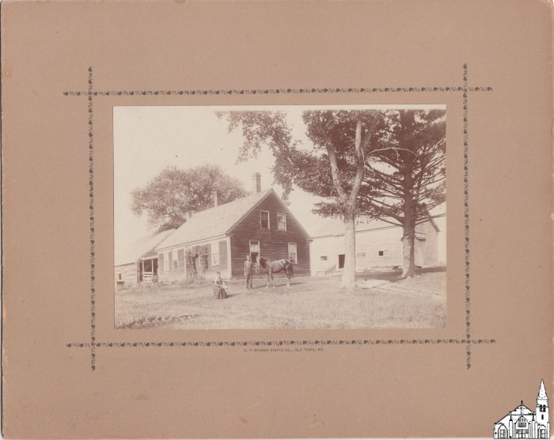
Unknown Farmhouse with Family and Horse [1896-1904] (OBJ.N.2021.75)
Photo of a family with a small child and a horse in front of an unknown farmhouse at an unknown location. According to the caption, the picture was created by C.F. Rhodes.

Slide 428
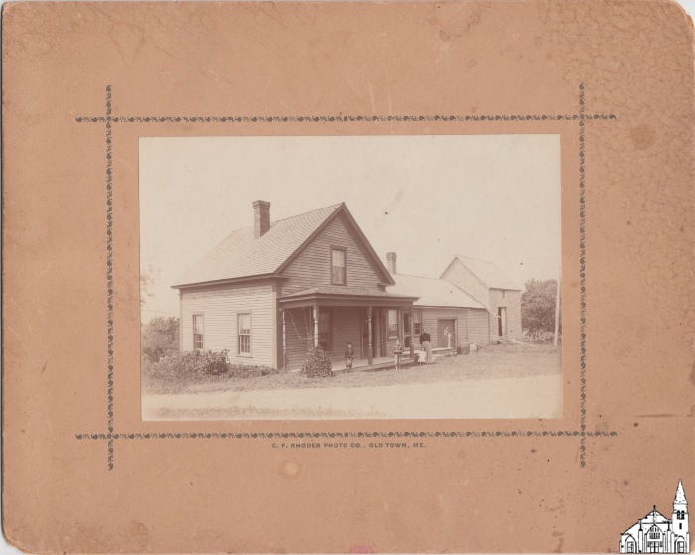
Unknown Farmhouse with Family [1896-1904] (OBJ.N.2021.76)
Photo of a family with one woman, one small girl and two boys in front of an unknown farmhouse at an unknown location. According to the caption, the picture was created by C.F. Rhodes.

Slide 429
Strike at Penobscot Shoe Co. [1940s] (OBJ.N.2021.8)
Photo of a strike at the Penobscot Shoe Co, probably part of the 63-day strike at that company and the Old Town Shoe Co. in 1949.

Slide 430
Model for Post Office Front Entry (OBJ.N.2021.9)
Photo of a model of the front entry for the new Old Town Post Office with various dimensions. Other than a description of the type of material, the model has "Old Town Me. #1" and "made by E.C. Barstow" written on it. Provenance unknown.

Slide 431
Where I Hugged the Dear Old Horse [Poem by John F. Young] (OBJ.N.2022.1)
A modern photocopy of a poem by John F. Young, resident of Old Town in the first decades of the 20th century. Titled "Where I Hugged the Dear Old Horse" and priced at 10 cents, it was apparently intended for local sale and distribution in the form photocopied. The poem is thirteen stanzas long, presented in two columns.

Slide 432
Old Town Shoe Work Ledgers (2) [1930s-1960s] (OBJ.N.2022.10)
Two tear-away ledgers for shoe orders, used at Old Town Shoe during the 1930s-1960s. They were produced by Lowell Stationery Co., Inc., 735 Broadway, Lowell, Mass. The cover page reads, "Slips for each day's work must be placed in box every morning. Have your number and total appear on slip. Case numbers must be listed in order. ANY ACCIDENTS, no matter how slight, MUST be reported at once to the office." The tear-away slips within would be used to track hand-stitched shoe orders. Old Town Shoe was a workshop on Main Street, located in the former Old Town Woolen Mill and converted into the senior housing complex River House in 1980. One ledger contains an accounting totals page identifying it as belonging to Edward Joseph "Bidou" LeBretton Sr., who was a maintenance supervisor for several Penobscot Shoe Company workshops, including Old Town Shoe until its closure in the 1960s.

Slide 433
Old Maine Trotters Waxed Cords [1930s-1960s] (OBJ.N.2022.11)
A tangle of brown cord, waxed. These heavy threads would have been used in hand stitching Old Maine Trotters shoes at Old Town Shoe, a shoemaking workshop run by Penobscot Shoe Company until its closure in the 1960s. Old Town Shoe was located in what is now River House on Main Street. The Trotters Brand was acquired with the sale of Penobscot Shoe Company to the Phoenix Footwear Group in 2000.

Slide 434
Singer Oil Can (Container Half) [1930s-1960s] (OBJ.N.2022.12)
The bottom part of a steel Singer brand oil can, the dome-shaped container which would have held oil, missing its dispenser nozzle. This oil can would have been used at Old Town Shoe, a workshop located in the building on Main Street converted into senior housing in 1980 and now called River House. Old Town Shoe was run by Penobscot Shoe Company until its closure in the 1960s. Penobscot Shoe Company was founded in 1935 by Max Kagan and Philip W. Lown as Philco Shoe Company and sold in 2000 to Phoenix Footwear Group, which maintains a distribution center at 107 Main St., Old Town, ME.

Slide 435
Wax Cake for Hand-Stitching Shoes [1930s-1960s] (OBJ.N.2022.13)
A cylindrical wax block with groves around its side, used by hand stitchers of shoes to quickly apply wax to their cords or threads. This one would have been used at Old Town Shoe, the Penobscot Shoe Company workshop in operation until the 1960s in what is today named River House in Old Town, ME. Penobscot Shoe Company was founded by Max Kagan and Philip W. Lown in 1935 as Philco Shoe Company and purchased by Phoenix Footwear Group in 2000.

Slide 436
Leather Needles for Hand-Stitching Shoes (3) [1930s-1960s] (OBJ.N.2022.14)
Three curved steel needles used in hand-stitching leather shoes. These would have been used at Old Town Shoe, a workshop that until its closure in the 1960s was located on Main St., Old Town, ME in what today is known as River House, a senior housing complex renovated in 1980. Penobscot Shoe Company (originally Philco Shoe Company, est. 1935) ran Old Town Shoe, so these needles were likely used in the production of their Old Maine Trotters. The Trotters brand passed to Phoenix Footwear Group when they acquired Penobscot Shoe Company in 2000.

Slide 437
Needles (3) and Nails (4) for Shoemaking [1930s-1960s] (OBJ.N.2022.15)
Three needles with large eyes and four tiny, tack-like nails used in handmaking leather shoes. These were part of the estate of Edward Joseph "Bidou" Le Bretton Sr. and Lillian "Cite" LeBretton, who were a maintenance supervisor and hand stitcher for Old Town Shoe, respectively. A workshop of the Penobscot Shoe Company, Old Town Shoe operated in what is today River House on Main Street until the 1960s. The building was renovated in 1980 for its current residential purpose.

Slide 438
Old Town Shoe Price Sheets [1930s-1960s] (OBJ.N.2022.16)
Large folded sheets of paper on which are typed columns listing shoe patterns, price per pair, and price per case. These would have been used at Old Town Shoe, a workshop in operation in what is now River House until the 1960s. The papers were part of the estate of Edward Joseph "Bidou" Le Bretton and Lillian "Cite" Le Bretton, who were maintenance supervisor and hand stitcher respectively for this shoe workshop. On the back of the folded papers either "Bidou" or "Cite," (presumably) jotted several equations for sums, perhaps denoting accounts owed or orders completed. As an example of contemporary prices, pattern #3440 cost $0.66 per pair and $11.88 per case. It is not specified whether these are production costs, wholesale prices, or end-consumer retail prices, though the former two are most likely based on the papers' factory origin.

Slide 439
Fabric Tape for Shoemaking [1930s-1960s] (OBJ.N.2022.17)
A roll of fabric tape, about an inch wide and likely holding several yards, spooled, that would have been used in the production of shoes at Old Town Shoe before the factory's closure in the 1960s. The roll comes from the estate of Edward Joseph "Bidou" Le Bretton and Lillian "Cite" Le Bretton, who were maintenance supervisor and hand stitcher respectively at Old Town Shoe. This Main Street workshop, run by Penobscot Shoe Company (est. 1935 as Philco Shoe Company by Max Kagan and Philip W. Lown), had originally been Old Town Woolen Mill and was renovated in 1980 after years of disuse into senior housing. It continues to serve this purpose today as River House.

Slide 440
Old Maine Trotters Box [1960s?] (OBJ.N.2022.18)
A shoebox missing its lid, labeled to contain color 'Green Bay' and size 8B. The logo design is a light brown faux wood exterior print and the brand name "Old Maine Trotters" in small block letters for 'OldMaine' and large stylized handwritting for 'Trotters' with the capital T crossed extra-large. The box likely dates to the 1960s, when Old Town Shoe ceased operating as a factory for hand stitching this signature Penobscot Shoe Company brand, and 8B was one of Old Town Shoe's "Model Sizes," for demonstrating designs. Penobscot Shoe Company had been founded in 1935 as Philco Shoe Company by Max Kagan and Philip W. Lown; it controlled several shoe workshops locally, including Old Town Shoe on Main Street. The Old Town Shoe building was coverted into senior housing in 1980 and is today known as River House.

Slide 441
Old Town Shoemakers' Hand-Stitching Bench [1930s-1960s] (OBJ.N.2022.19)
A wooden workbench, half woven leather seat and half flat workspace. It was made by Edward Joseph "Bidou" Le Bretton Sr. when he worked as a maintenance manager for Old Town Shoe and other Penobscot Shoe Company workshops in the area. "Bidou" handwove the seat from leather scraps and offcuts left over from the shoe production and built the wooden framing from materials to hand. He would have made multiple of these benches for Old Town Shoe hand stitchers, like for example his wife Lillian "Cite" Le Bretton. Old Town Shoe ceased operations in the 1960s, though Penobscot Shoe Company remained in business until Phoenix Footwear Group bought them in 2000. The Main Street building that had been Old Town Shoe was renovated into residences in 1980 and exists today under the name River House.

Slide 442
City Hall, Old Town, Me. [Postcard] (OBJ.N.2022.2)
A colorized postcard created by the Metropolitan News Co. of Boston Mass. and Germany, made in Germany likely between 1900 and 1920, depicting the Old Town, ME Town Hall built 1870. The structure was located at the intersection of North Brunswick and Middle Streets and demolished sometime in the 20th century.

Slide 443
Baby Doll [1910-1912] (OBJ.N.2022.20)
A baby doll with porcelain head, hands, and limbs, and jointed knees and wrists. She was given to Florence Cole Winter around 1910-1912. Florence was the daughter of Percy and Mable Henderson Cole, born and raised at 15 Franklin St. (now 21 Franklin St.) in Stillwater, part of Old Town. The doll's white lace-edged dress is original; her undergarments and leather shoes were made by Florence.

Slide 444
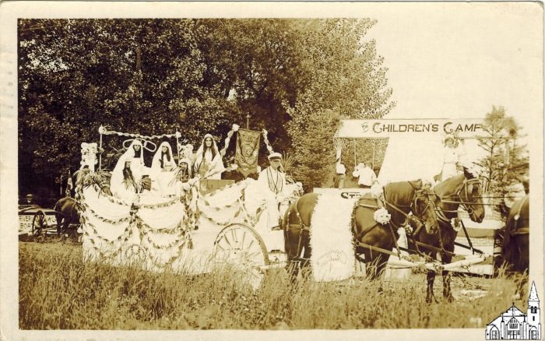
4th of July Parade Floats [1916] (OBJ.N.2022.21)
Postcard with a photo of various floats of the 1916 4th of July parade. Depicted are the floats of the Myrtle Rebekah Lodge (with E. Rae Brown as Rebekah at the Well), the Anti-Tuberculosis Association (with district nurse Margaret Hughes) and the Penobscot River and Pushaw Lake Motor Boat Club (with Commandore Butler). The postcard was mailed by Rae Brown to Presque Isle on the 17th of the same month, asking her correspondent if she could find her in the picture. Brown also mentions meeting W. Linwood Chase (1897-1983) of Stillwater, who at that point had just graduated from Presque Isle Normal School and was scheduled to teach in Old Town in the Fall. Ultimately, Linwood would go on to become a noted specialist in child behavior at Boston University. Rae (1895-1965) was born in Mattawamkeag, where her father, John William Brown, was round house foreman for Maine Central Railroad. The family moved to Old Town in 1909, when John William became round house foreman there. In 1921, Rae would marry Louis Littlefield (1882-1957) and the identical twins Berenice ("Bunny") Irene Littlefield Cousins (1921-2014), who stayed in Old Town, and Beatrice Irene Hackamack McCleary (1921-2016), who was a researcher in early computer science at Northern Illinois University, were two of their three daughters.

Slide 445
Novelty H.M. Burnham Postcard [c.1910] (OBJ.N.2022.22)
Novelty postcard with two Old Town scenes on the front (Indian Island and Main Street) and very little room to write. No room for anything other than an address on the back. Printed by N. E. Paper & Stationary Co, Mfrs. Ayer, Mass on behalf of H.M. Burnham (Old Town). Postmarked August 8, 1910.

Slide 446
Star in the East Lodge [Induction Certificate, 1911] (OBJ.N.2022.23)
Old Town Freemasons Lodge Induction Certificate for Charles H. Dudl(e)y (1867-1951) of Milford, who was Erold R. Madden's father-in-law. Note the spelling of Charles' last name. Most official documents have an "e", but the certificate does not.

Slide 447
Star in the East Lodge [Induction Certificate, 1921] (OBJ.N.2022.24)
Old Town Freemasons Lodge Induction Certificate for Erold Raymond Madden (1894-1979), who was Blaine B. Bean's father-in-law.

Slide 448
Star in the East Lodge [Induction Certificate, 1952] (OBJ.N.2022.25)
Old Town Freemasons Lodge Induction Certificate for Blaine ("Stinger") B. Bean (1926-1991) of Milford, donor Robert Cormier's father-in-law.

Slide 449
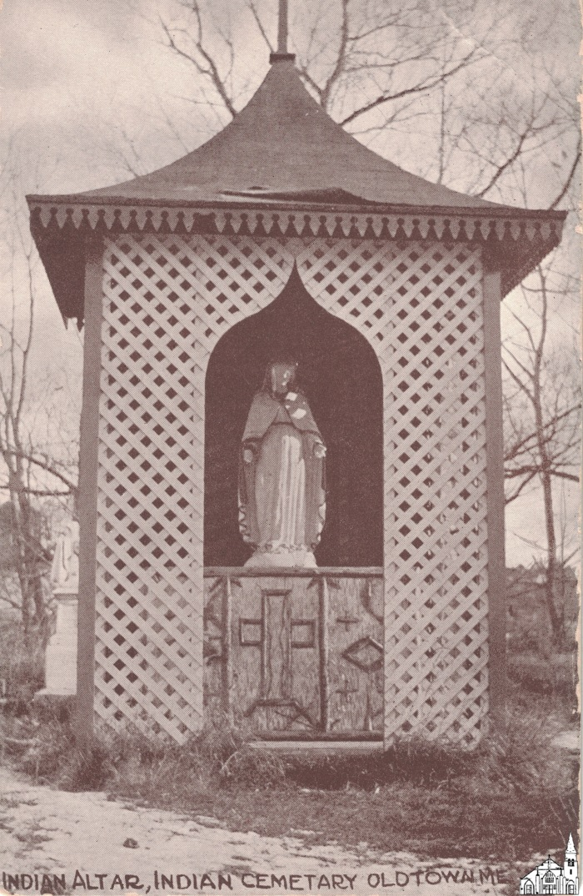
Outside Altar [c.1910] (OBJ.N.2022.27)
Photo of the outside altar at the Tribal Cemetery on Indian Island. Exact location unknown. Postcard no 1433 - Published by Boston Post-Card Co., 12 Pearl Street.

Slide 450
Menu folder from the March 30, 1891 Penobscot Club Banquet (OBJ.N.2022.3)
An embossed and tied folder, which contained the menu for a reception held by the Penobscot Club, a social club, for the new Mayor and City Council of Old Town, ME on March 30, 1891. An article in the April 4, 1891 edition of the "Old Town Enterprise" wrote that, "the preparations for this occasion resulted in a decided improvement in banquets as they are usually served in this vicinity." It continued, "The menu was printed in the form of a handsome folder with insert, the title page being handsomely decorated with a bouquet of flowers, and bearing the words, 'Complimentary: Penobscot Club to Old Town City Government, Cousins' Hotel, Monday, March 30, 1891," which exactly describes the item in Old Town Museum's collection. According to "Old Town Enterprise," forty-three people attended the banquet and were provided copies of the menu as a souvenier. This folder contains a single page on which Shakespeare is quoted, "Please ye, we may contrive...And do as adversaries do at law,-- strive mightily but eat and drink as friends."

Slide 451
S & H Green Stamps Saver Book [1960s-70s approx.] (OBJ.N.2022.30)
A blank booklet issued by the Sperry & Hutchinson Trading Stamps company, likely during their peak of popularity in the 1960s and early 1970s. S & H green stamps were a form of retail loyalty program: retailers would bulk-purchase the stamps and issue them to customers on the basis of their purchase amounts. Customers who collected the stamps would paste them into booklets like this one, which could be redeemed by mail for a dollar amount (this booklet, completed, would be worth $2.00 if redeemed for cash) or for consumer goods selected from the S & H catalogue. In 1960, the residents of Old Town, Maine pooled completed Green Stamp books to purchase the town's first ambulance.

Slide 452
Old Town Canoe Catalog [1952] (OBJ.N.2022.31)
A 45 page catalogue for the year 1952, advertising the excellence and history of Old Town canoes, as well as listing their available products and pricing. In '52, Old Town Canoe maintained a factory and an office in Old Town, ME, where the company had been founded in 1898 and incorporated in 1901 by brothers George and Herbert Gray. Predating their early 1970s move to plastics, competing with aluminum and fiberglass canoe manufacturers, the canoes featured in this catalogue are all constructed of wood, canvas, and brass. Photographs and testimonials are featured throughout the black-and-white pages. The full-color cover features a painting on front and back of holiday-makers on the water in various products.

Slide 453
Letter from H. E. Sargent to Don McKay [1961] (OBJ.N.2022.32)
A business-formatted typewritten letter from H. E. Sargent to then-president of Old Town's city council Don McKay. Herb Sargent started his construction company out of Alton, Maine in 1926 and by the time the letter was written on May 31, 1961 owned large parcels of land in Old Town. The letter concerns a donation of land off of Oak Street to the city, provided that the people of Old Town voted on June 5th, 1961 to authorize funding for the construction of a new junior high school on that site. The construction was authorized, and Leonard Middle School opened in 1964. This letter was held in the possession of Don McKay's wife Lillian McKay for over sixty years; at the time of donation Lillian was 101. It includes the original mailing envelope, with typewritten addressage and a $0.04 stamp shaped like an oval, on which a cameo in profile of a statesman is embossed.

Slide 454
Shiro's Old Town Hardware Co. Wrapping Paper [1950s] (OBJ.N.2022.33)
A branded piece of wrapping paper from Shiro's Old Town Hardware Co. Shiro's was a Jewish-owned business located at 222 North Main Street, Old Town, Maine in the 1950s.

Slide 455
Craig Funeral Home-Branded Mirror (OBJ.N.2022.34)
A decorative mirror backed with cut-out images of two fishers in a canoe, a pine treeline, and the fishers' foregrounded catch: a minnow being reeled in. Between the images of fish and canoe, another cutaway reveals an inset advertisement. It reads, "Courtesy of Alfred Craig and the Funeral Home, Old Town, Maine." Mr. Craig was born in Old Town, graduated 1936 from the New England School of Embalming in Boston, MA, and owned and operated Craig Funeral Home until 1965. This mirror advertisement is estimated to be from the 1950s or 60s, though its exact date of creation is unclear.

Slide 456
C. H. Randall-Branded Bamboo Calendar [1930s approx.] (OBJ.N.2022.35)
A wall hanging made of thin bamboo slats, printed with a generic, uncredited image of a flower-filled boat and person standing on the nearby jetty who appears to be wearing a kimono. Beneath this image there's a printed advertisement and torn paper where a calendar would have been attached. The ad reads, "Drink More Milk - Milk is Your Complete Food" and "C. H. Randall, Pure Jersey Milk and Cream, From Tuberculin Tested Herds, Telephone 188-11, Stillwater, Maine." No information could be found about C. H. Randall. This object is estimated to date from the 1930s because alphanumeric phone numbers, with two letters representing the nearest phone exchange followed by 5 unique numbers, were standard from approximately 1930. Testing of cattle for TB was commercially possible from 1891 and widespread globally from the turn of the 20th century. It was not unusual to still advertise tuberculin-tested milk in the 1930s. Bamboo scroll, or "roll-up" calendars of this type are still produced and examples from the 1930s exist. Object's connection to Old Town, Maine unclear.

Slide 457
St. Joseph's Band [photo] (OBJ.N.2022.36)
Photo of St. Joseph's Band in front of St. Joseph's Church. The back of the photo says Nelson Budway, ca 1915.

Slide 458
Selective Service Medal and Case (OBJ.N.2022.37)
An original case with a Selective Service Medal and lapel pin without any personalized inscription. Case also contains 4 other pins (Elks, Disabled American Veterans, Veterans of Foreign Wars, one with inscription that is too small to read). Also contains a lapel bar of unknown significance.

Slide 459
Pin for 30 Years of Service [Penobscot Fibre, ca. 1952] (OBJ.N.2022.38)
A pin in a plastic box. Awarded for 30 years of service with the Penobscot Fibre Company.

Slide 460
Marriage Certificate [Bradley, 1941] (OBJ.N.2022.39)
Marriage booklet/certificate for the marriage between Joseph Daniel Peters of Old Town and Bertha Belle Ross of Bradley, issued by the Reverend O. E. Thomas of Bradley, Me.

Slide 461
Old Town Area Manning's Directory [1956] (OBJ.N.2022.4)
A business directory for the year starting February 1956 compiled and published by the H. A. Manning Co. of Springfield, Mass. Includes information about Old Town and surrounding communities -- Orono, Indian Island, Bradley, Milford, and Veazie. Introductory pages tout the benefits of living and working in Old Town, e.g. "You Might Want To Know Old Town Is a Logical Center for Industry Being Served by Bus--Rail--Truck--Air."

Slide 462
WWII Non-Highway Gasoline Ration (OBJ.N.2022.41)
A booklet containing perforated stamps, or coupons, each for one "R" unit of gasoline "only for non-highway equipment and uses. The booklet is stamped VOID on each page. Its original owner, a resident of Old Town, ME, penciled on the binding that the stamps allowed purchase of "4 Gal. each" and [would be valid?] over a "6 ms. Period." Instructions for use on the inside front cover explain that the value in gallons of gas of one "R" unit could be changed in accordance with "the demands of the war program."

Slide 463
WWII Non-Highway Gasoline Ration (OBJ.N.2022.41.1)
A booklet containing perforated stamps, or coupons, each for one "R" unit of gasoline "only for non-highway equipment and uses. The booklet is stamped VOID on each page. Its original owner, a resident of Old Town, ME, penciled on the binding that the stamps allowed purchase of "4 Gal. each" and [would be valid?] over a "6 ms. Period." Instructions for use on the inside front cover explain that the value in gallons of gas of one "R" unit could be changed in accordance with "the demands of the war program."

Slide 464
WWII U.S. War Ration Book One [May, 1942] (OBJ.N.2022.42)
A booklet of perforated coupons, or stamps, authorizing the holder to buy rationed commodities during World War II. Book One was issued between May 4-7, 1942 and was originally for rationing sugar. This book was issued to Irma Adelaide Buchanan of Old Town, Maine. Only four stamps remain untorn in the book.

Slide 465
WWII U.S. War Ration Book Two [January, 1943] (OBJ.N.2022.43)
A booklet of perforated coupons, or stamps, authorizing the holder to buy rationed commodities during World War II. Book Two was issued in January, 1943. This book was issued to Alden Francis Buchanan of Old Town, Maine. It is empty of stamps.

Slide 466
WWII U.S. War Ration Book Two [January, 1943] (OBJ.N.2022.43.1)
A booklet of perforated coupons, or stamps, authorizing the holder to buy rationed commodities during World War II. Book Two was issued in January, 1943. This book was issued to Irma Adelaide Buchanan of Old Town, Maine. It is empty of stamps.

Slide 467
WWII U.S. War Ration Book Four [1943] (OBJ.N.2022.44)
A booklet of perforated coupons, or stamps, authorizing the holder to buy rationed commodities during World War II. Book Four was issued in 1943. This book was issued to Irma Adelaide Buchanan of Old Town, Maine. Multiple pages of stamps remain untorn.

Slide 468
WWII U.S. War Ration Book Four [1943] (OBJ.N.2022.44.1)
A booklet of perforated coupons, or stamps, authorizing the holder to buy rationed commodities during World War II. Book Four was issued in 1943. This book was issued to Alden Francis Buchanan of Old Town, Maine. Multiple pages of stamps remain untorn.

Slide 469
Jefferson Street School, 1955 [Photograph] (OBJ.N.2022.45)
A black and white photograph of students at Jefferson Street Elementary School in Old Town, Maine in 1955. In the background their teacher stands against a blackboard. He is identified as Harvey Piper. He was the principal of the school from its start in 1953, when Old Town High School moved out of the building, until 1970. Jefferson Street Elementary School served as an elementary school until its closure in 2004. The building was purchased in 2018.

Slide 470
Jefferson Street School, 1955 [Photograph] (OBJ.N.2022.46)
A black and white photograph of elementary school students at Jefferson Street School in 1955, two years after the high school had moved to its new building and its former building had been renamed to Jefferson Street School.

Slide 471
Student Visit to the Governor's Office [Photograph ca. 1990] (OBJ.N.2022.48)
A black-and-white photograph of 30 elementary school-aged children arrayed behind the desk of John R. McKernan Jr., who is seated at it in the center of the picture. McKernan was Governor of Maine in 1990, the approximate year this picture was taken. It is not known whether these were Herbert Gray School or Jefferson Street School students from Old Town, Maine on a visit to Augusta.

Slide 472
Elementary School Play [Photograph, ca. 1930s-1950s] (OBJ.N.2022.49)
A black-and-white photograph taken ca. 1930-1950 of elementary school students in theatrical costumes. The picture is identified as "from the photo files of Harvey Piper." Mr. Piper was a grammar school teacher in Enfield the 1930s and principal of the Jefferson Street School, Old Town, Maine by the 1960s. It is not known if the pictured students were from Old Town.

Slide 473
Purple Heart and Case (OBJ.N.2022.5)
An original case with a Purple Heart Medal inscribed "For Military Merit. Joseph D. Peters" and a Purple Heart lapel pin. Most likely Peters received his Purple Heart in 1932 or shortly thereafter, when the award was first created and many WW I veterans who had received a so-called "wound chevron" for sustained injuries were awarded the medal. Peters certainly seems to have fallen in that category. In 1919, the Old Town Enterprise reports that Joe Peters was discharged after he had been moved to serve behind the front lines because he had lost an eye as a result of an "accident" on the so-called Chemin des Dames, a historic route in northern France along which many WW I battles were fought. According to the 1919 Old Town Enterprise article, Joseph was in the 103rd Infantry Regiment (= 2nd of Maine until April 13, 1917) along with his brother "Gussie," (= John Angus Peters (1895-1962)) and their military records confirm that the brothers enlisted in the 103rd Infantry Division (Company I) in Eastport (ME), on April 14, 1917. Gussie was discharged as a private 1st class on April 14, 1919 at Camp Devens (MA), while Joseph was discharged as an ordinary private on April 4th, 1919 in St. Louis (MI). More than a year prior, in a letter to their mother dated April 6, 1918 that was also published in the Old Town Enterprise two month later, Gussie mentions that Joseph was in the hospital because of a "sore eye" due to "a fall coming from the trenches." Gussie also writes that Joe was fine and would be out of hospital soon, but maybe he just did not want to have their mother worry.

Slide 474
Jefferson Street Centennial Celebration [Enlarged Photograph, 1996] (OBJ.N.2022.50)
A foam-backed, enlarged black-and-white photograph credited to photographer Jessica Lee, enlargement "courtesy of James W. Sewall Co." The photo depicts a crowd of elementary school-aged children accompanied by teenage students as they walk up Jefferson Street in Old Town, Maine on June 11, 1996. It's captioned "The Jefferson Street School Community celebrates the 100th anniversary of the building of Jefferson Street," "led by 7 members of the Old Town High School Band."

Slide 475
Rubber "Fingers" for Poultry Plucking [Set of 17] (OBJ.N.2022.6)
Seventeen hard rubber "fingers" made by the Gordon Johnson Co. in the 1950s. Used together on a rotating reel for plucking poultry, these are labeled "Johnson Short Corrugated Rocking Finger, Pats. No. 2,337,201,2554,671, Pats. Pending." They were used at the Old Town farm on Brunswick St. owned by Norman and Sue Brilliant.

Slide 476
Painting of the Stillwater Bridge by Ann Perkins (OBJ.N.2022.7)
A framed pastel of the "double barrel" covered bridge over the Stillwater River, an Old Town landmark demolished in 1951. The art is signed by Ann Perkins (name penciled in block letters, as is the word "Stillwater"). The painting is thought to be very old, having passed through three generations of the donor's family, though the exact date of creation could not be determined. Perkins has used dark pastels or charcoal to depict the bridge and shadowed trees over a soft salmon-colored river reflecting a crepuscular sky.

Slide 477
Hand-Crocheted Bedspread [1970s] (OBJ.N.2022.8)
A cream filet crochet coverlet, made by Old Town local Mildred Pauline Randall Leclair in the 1970s. The pattern features scalloped edges, a border of roses, and a 4x8 grid of interior panels, each of which contains the crocheted image of a nosegay or small bouquet.

Slide 478
Old Maine Trotters Leather Heels (6) [1930s-1960s] (OBJ.N.2022.9)
A set of six cut and punched leather shoe heels in various colors. They were part of the estate of Edward Joeseph "Bidou" Le Bretton Sr. and Lillian "Cite" LeBretton, the maintenance supervisor for multiple shoe workshops around Old Town and a hand-stitcher at Old Town Shoe, a workshop on Main Street. The Old Town Shoe building had housed Old Town Woolen Mill from its 19th century construction until Max Kagan and Philip W. Lown acquired it for thier business. Kagan and Lown founded Philco Shoe Company in 1935, which was later rebranded Penobscot Shoe Company and produced a signature line of women's shoes, Old Maine Trotters, for which these leather heels were likely cut in the 30 years Old Maine Shoe operated and Mr. LeBreton worked there. The building that had been Old Town Shoe and Old Town Woolen Mill was redeveloped in 1980 as senior housing and is known today as River House. In 2000, The Phoenix Footwear Group purchased Penobscot Shoe Company and their Trotters brand. Phoenix maintains a distribution center near River House at 107 Main St., Old Town, ME.

Slide 479
Group Photo [military, 1944] (OBJ.N.2023.1)
Group photo of navy personnel with inscription "personnel office, March 1944". Typed name chart on separate sheet.

Slide 480
Garland Family Reunion [photo, 1928] (OBJ.N.2023.10)
Photo of the Second Garland Family Reunion held at the home of George L. Garland of Bennoch Road, Stillwater. According to an unidentified newspaper clipping on the frame that the photo came in, this was a reunion of the descendants of Joseph and Polly (Brackett) Garland and 105 people (mostly from Penobscot County) attended.

Slide 481
Indian Island [Postcard, 1920s-1930s] (OBJ.N.2023.100.1)
A black and white picture postcard printed by American Art Post Card Co. of Boston, Mass. It specifies that it should mail for one cent ("Place one cent stamp here"), which indicates a print date between 1919 and 1952. The photograph depicts many canoes on the Penobscot River, with land and two buildings with tall smokestacks in the background. At least two people are operating each canoe, and in the foreground one rower is standing up to face the camera. A caption printed on the photo calls this scene "Indian Island, Penobscot River, Old Town, Maine."

Slide 482
OTHS [Class of 1925] (OBJ.N.2023.101)
Framed photo of the Old Town High School Class of 1925, depicting a total of 76 students. Photo made by Perry Studios. Back of the frame lists all the names with the names of those who passed crossed out.

Slide 483
OTHS [Class of 1925] (OBJ.N.2023.102)
Framed photo of the Old Town High School Class of 1925, depicting a total of 76 students. Photo made by Perry Studios.

Slide 484
125th Anniversary of Old Town [Commemorative Plate] (OBJ.N.2023.105)
Commemorative plate issued on the occasion of the 125th anniversary of Old Town

Slide 485
Old Town Post Office Postcard [1920s-30s?] (OBJ.N.2023.106.1)
A souvenir postcard printed in the early 20th century by American Art Post Card Co. of Boston, Mass. The black and white photograph on its front depicts the Old Town, Maine Post Office building completed in 1914. A recommended postage cost of one cent indicates the card was produced before 1952. Postcard rates rose to two cents from November 2, 1917-July 1, 1919 and April 15, 1925-July 1, 1928 as well. A production date in the 1930s seems likely.

Slide 486
Old Town Double Barrel Bridge Postcard (OBJ.N.2023.107.1)
A souvenir postcard produced by American Art Post Card Co. of Brookline, Mass. The black and white photograph on the front depicts Old Town, Maine's "double barrel" covered bridge built in the 19th century and demolished in 1952. The date of production for this postcard is not known.

Slide 487
OTHS Graduation [Photo Collage, 1929] (OBJ.N.2023.108)
Composite photo with cabinet pictures of 75 members of the OTHS Class of 1929. One graduate, E. Merle Hildreth, is identified in a note on the back of the frame.

Slide 488
OTHS Track Team [1928-29?] (OBJ.N.2023.109)
A photograph of the OTHS track team, from the estate of E. Merle Hildreth, a member of the graduating class of 1929, who appears in the front row of this group shot.

Slide 489
Old Town Festival Chorus [1939] (OBJ.N.2023.11)
Flier for the (First) Annual Concert by the Old Town Festival Chorus (with Mrs. Constance King as Guest Artist) on Monday Evening, May 8th, 1939.

Slide 490
Marching Band [1912] (OBJ.N.2023.110)
Postcard photo of a marching band. May or may not be in Old Town. Date 1912 on the back

Slide 491
Collection of Nine Boy Scout Camp Postcards [1947-1952, approx.] (OBJ.N.2023.111)
Nine postcards printed by National Supply Service and copyright 1947, Boy Scouts of America. They depict a variety of camping scenes cartoonishly. Each card has an estimated postage rate of one cent, placing their publication between 1947 and 1952, when the postage rate for postcards was raised to two cents on January 1. The cards are presumed to have been collected at Camp Roosevelt, a Katahdin Area Council Campground, around the time of their manufacture, but their connection to Old Town, Maine, is unclear.

Slide 492
Our Nightlife! [BSA Postcard, 1947-52] (OBJ.N.2023.112.1)
A postcard that is part of collection OBJ.N.2023.111. It was printed by National Supply Service and copyright 1947 by the Boy Scouts of America. Its postage rate of one cent indicates a manufacture date no later than January 1, 1952. The front image is a cartoon of four Boy Scouts around a campfire, observed by an owl and rabbit, with the caption "Our Nightlife!" Connection to Old Town, Maine unclear.

Slide 493
No Trouble Getting Up Here! [BSA Postcard, 1947-1952] (OBJ.N.2023.113.1)
A postcard that is part of collection OBJ.N.2023.111. It was printed by National Supply Service and copyright 1947 by the Boy Scouts of America. Its postage rate of one cent indicates a manufacture date no later than January 1, 1952. The front is a cartoon of a bugling Boy Scout and singing bird waking up another Boy Scout still in his tent as the sun rises, with the caption "No Trouble Getting Up Here!" Connection to Old Town, Maine, unclear.

Slide 494
This Is the Life! [BSA Postcard, 1947-52] (OBJ.N.2023.114.1)
A postcard that is part of collection OBJ.N.2023.111. It was printed by National Supply Service and copyright 1947 by the Boy Scouts of America. Its postage rate of one cent indicates a manufacture date no later than January 1, 1952. The front depicts a cartoon of a relaxing Boy Scout with a fishing pole across his lap, observed by a rabbit and bird. The caption reads, "This is the Life!" Connection to Old Town, Maine unclear.

Slide 495
Just Arrived! [BSA Postcard, 1947-52] (OBJ.N.2023.115.1)
A postcard that is part of collection OBJ.N.2023.111. It was printed by National Supply Service and copyright 1947 by the Boy Scouts of America. Its postage rate of one cent indicates a manufacture date no later than January 1, 1952. The front depicts a cartoon of three Boy Scouts behind a log fence looking happy to see a boy carrying bags through the fence's gate. Its caption reads "Just Arrived!" Connection to Old Town, Maine unclear.

Slide 496
Had a Swell Time Here Will Be Home Soon [BSA Postcard, 1947-52] (OBJ.N.2023.116.1)
A postcard that is part of collection OBJ.N.2023.111. It was printed by National Supply Service and copyright 1947 by the Boy Scouts of America. Its postage rate of one cent indicates a manufacture date no later than January 1, 1952. The front depicts a cartoon of a Boy Scout shaking hands with a black bear, with a line of other woodland creatures behind it, all smiling anthropomorphically at the boy. The caption reads, "Had a Swell time here will be Home Soon." Connection to Old Town, Maine unclear.

Slide 497
Snapshot of the Gang! [BSA Postcard, 1947-52] (OBJ.N.2023.117.1)
A postcard that is part of collection OBJ.N.2023.111. It was printed by National Supply Service and copyright 1947 by the Boy Scouts of America. Its postage rate of one cent indicates a manufacture date no later than January 1, 1952. The front depicts a cartoon of ten Boy Scouts in a row and one dog. A flag obscures the face of one scout, who is labeled "Me." The caption reads, "Snapshot of the Gang!" Connection to Old Town, Maine unclear.

Slide 498
This is the Life! Variant [BSA Postcard, 1947-52] (OBJ.N.2023.118.1)
A postcard that is part of collection OBJ.N.2023.111. It was printed by National Supply Service and copyright 1947 by the Boy Scouts of America. Its postage rate of one cent indicates a manufacture date no later than January 1, 1952. The front depicts a cartoon of two swimming boys, one diving into the water and the other submerged, observed by two birds. The caption reads, "This is the Life!" Connection to Old Town, Maine unclear.

Slide 499
Learning Something New Every Day! [BSA Postcard, 1947-52] (OBJ.N.2023.119.1)
A postcard that is part of collection OBJ.N.2023.111. It was printed by National Supply Service and copyright 1947 by the Boy Scouts of America. Its postage rate of one cent indicates a manufacture date no later than January 1, 1952. The front depicts a cartoon of a Boy Scout studying bear tracks while a black bear laughs behind his back. The caption reads, "Learning Something New Every Day!" Connection to Old Town, Maine unclear.

Slide 500
Poster Old Town Indians [1972-3] (OBJ.N.2023.12)
Poster with 7 photos showing various Old Town High School football players and coach Hadley. Names of the players only match the 1972-3 season.

Slide 501
Chow's Fine Eating Like a Horse [BSA Postcard, 1947-52] (OBJ.N.2023.120.1)
A postcard that is part of collection OBJ.N.2023.111. It was printed by National Supply Service and copyright 1947 by the Boy Scouts of America. Its postage rate of one cent indicates a manufacture date no later than January 1, 1952. The front depicts a cartoon of three Boy Scouts at a dining table, variously eating happily or getting elbowed and looking annoyed while another helps himself to a dish. The caption reads, "Chow's Fine," and in smaller font, "Eating Like a Horse." Connection to Old Town, Maine unclear.

Slide 502
Boy Scouts of America Camp Roosevelt Pictures and Postcards [1928-193?] (OBJ.N.2023.121)
A collection of 38 pictures and picture-postcards, all black and white. They were taken from approximately 1928 to sometime in the 1930s at Camp Roosevelt, a Boy Scouts of America campground located in Eddington, Maine. Some pictured attendees were known to be from the Milford/Old Town area, but further connection to Old Town, Maine is unknown.

Slide 503
Camp Roosevelt Scouts [Photograph, 1927] (OBJ.N.2023.122.1)
A sepia photograph of twelve teenage boys or young men standing, facing the camera in two rows. An annotation on the back identifies the front row as, "Roundy, Flagg, Brown, Ledbetter, and Monqouan" and the back row as, "Ordway, Condon, Blake, Hildreth, Pond, Huot. [sic], and McKay." The year 1927 is also written on the back of the picture. The photo is part of a collection of pictures and postcards taken at Camp Roosevelt, a Boy Scout camp located outside Eddington, Maine, in the 1920s and 30s.

Slide 504
Camp Roosevelt Scouts [Photograph 192?] (OBJ.N.2023.123.1)
A sepia photograph of six teenage boys or young men standing in a row. The photo is part of a collection of photographs and postcards taken at Camp Roosevelt, a Boy Scout camp located outside Eddington, Maine, in the 1920s and 30s. This photo identifies the boy fourth from the left as E. Merle Hildreth, a resident of Milford, Maine.

Slide 505
Camp Roosevelt Postcard [192?-3?] (OBJ.N.2023.124.1)
An unused postcard with a photographic front image. The picture shows a campground in black and white. Four tents are grouped around a flagpole. One person is visible, but semi-obscured by smoke. The card is part of a collection of photographs and postcards from visitors to Camp Roosevelt, a Boy Scout camp located outside Eddington, Maine. The collection was taken in the 1920s and 30s.

Slide 506
Camp Roosevelt Scouts [Photograph, 192?-3?] (OBJ.N.2023.125.1)
A black and white photograph of twelve Boy Scouts arranged in two rows facing the camera, with tents visible in the background. The scout second from the left in the back row is identified by a handwritten note on the back of the picture as E. Merle Hildreth. The photo is part of a collection of pictures and postcards taken in the 1920s and 30s at Camp Roosevelt, a Boy Scout camp located outside Eddington, Maine.

Slide 507
Camp Roosevelt Barrel Sign [Photograph 192?-3?] (OBJ.N.2023.126.1)
A black and white photograph that is part of a collection of photos and postcards taken in the 1920s and 30s at Camp Roosevelt, a Boy Scout camp located outside Eddington, Maine. This photo shows six barrels stacked in two pillars of three, with a handmade sign placed between them to make a gate. The sign reads, "Katahdin Council, Aroostook County, Boy Scouts of Am., Maine." Some boy scouts and tents are visible in the background.

Slide 508
Camp Roosevelt Pledge [Photograph, 192?-3?] (OBJ.N.2023.127.1)
A black and white photograph that is part of a collection of photos and postcards taken in the 1920s and 30s at Camp Roosevelt, a Boy Scout camp located outside Eddington, Maine. This picture shows dozens of uniformed scouts and, presumably, scout leaders standing in a long rank and file, each holding up his left hand. Presumably, they are reciting a pledge. Trees are visible in foreground and background.

Slide 509
Camp Roosevelt Campsite [Postcard, 192?-3?] (OBJ.N.2023.128.1)
An unused black and white postcard that is part of a collection of photographs and postcards taken in the 1920s and 30s at Camp Roosevelt, a Boy Scout camp located outside Eddington, Maine. This card depicts an empty campsite surrounded by trees. Logs for seating surround an unlit campfire in front of a tent.

Slide 510
Camp Roosevelt - Fitts Pond [Photograph, 192?-3?] (OBJ.N.2023.129.1)
A black and white photograph that is part of a collection of photos and postcards taken in the 1920s and 30s at Camp Roosevelt, a Boy Scout camp located outside Eddington, Maine. This picture shows a wooden dock built over a large body of water with trees in the background, presumably Fitts Pond. Twelve teenage boys or young men dressed in swimming trunks are visible on the dock.

Slide 511
Ashtray [souvenir, 1960s] (OBJ.N.2023.13)
White ashtray with a drawing of two pine cones on a branch inscribed Old Town, Maine.

Slide 512
Camp Roosevelt Truck Ride [Photograph, 192?-3?] (OBJ.N.2023.131.1)
A sepia photograph sized for a wallet that is part of a collection of photos and postcards taken in the 1920s and 30s at Camp Roosevelt, a Boy Scout camp located outside Eddington, Maine. This picture shows a truck with a large bed and high sides made from wooden planks. Boy Scouts are standing in the truck bed, waving over the side at the camera. A man in the foreground appears to be taking another picture from closer to the truck.

Slide 513
Camp Roosevelt Building [Photograph, 192?-3?] (OBJ.N.2023.132.1)
A black and white photograph that is part of a collection of photos and postcards taken in the 1920s and 30s at Camp Roosevelt, a Boy Scout camp located outside Eddington, Maine. It depicts the exterior of a large building constructed of logs, with a flagpole in front. An American flag hangs motionless from the pole, and the background is a forest.

Slide 514
Boy Scout Troop 72 [Photograph, 1939] (OBJ.N.2023.133.1)
A black and white photograph that is part of a collection of photos and postcards taken in the 1920s and 30s at Camp Roosevelt, a Boy Scout camp located outside Eddington, Maine. This is a staged photo of nine boys in two rows, facing the camera. A flag in the background features an eagle's head in profile and the number 72. A note from the collection donor on the back identifies these boys as Troop 72 of Old Town, Maine and dates the picture to 1939. Named individuals in the picture include Dan O'Keefe, Leonard O'Keefe, and boys with the last names Boyle, Cross, Folster, Hatch, and Madoc. Further notation on the back of the picture cites the occasion for the photo as "Honor Patrol Penquis Achievement."

Slide 515
Portage Lake Sponsors and Councilors [Postcard, 1936] (OBJ.N.2023.134.1)
A black and white postcard that is part of a collection of photographs and postcards taken in the 1920s and 30s at Camp Roosevelt, a Boy Scout camp located outside Eddington, Maine. This card is actually identified as coming from a different camping ground, captioned, "Sponser [sic] & councilors 1936 Camp Aroostook, Portage Lake." It features nine men, presumably Boy Scout sponsors and councilors. One individual is identified as E. Merle Hildreth, who was a scout leader from Milford and Old Town, Maine.

Slide 516
Hail to the Scouts [Postcard, 1939] (OBJ.N.2023.135.1)
A black and white postcard that was mailed on February 13, 1939 from Andover, Maine. It is part of a collection of postcards and photographs taken in the 1920s and 30s at Camp Roosevelt, a Boy Scout camp located outside Eddington, Maine, but this card is actually addressed to "Mr. Merle Hildreth" in Dover-Foxcroft, ME, where the Penquis District B.S.A. Roundtable is held. The front of the postcard is a picture of a promotional placard titled, "Hail to the Scouts." The placard, propped up on what appears to be a tablecloth, shows a Boy Scout holding an American Flag walking alongside Uncle Sam. Above this image, the caption points to supposed news headlines and says, "When you read about these: 'Boy Bandits Confess;' 'Communists Seek Young Recruits;' 'European Children Taught Hymn of Hate;' it's a great relief to read about these." Another arrow points to the scout and Sam and the caption concludes, "One Million Loyal American Boy Scouts."

Slide 517
Hail to the Scouts [Photograph, 1939?] (OBJ.N.2023.136.1)
A black and white photograph that is part of a collection of pictures and postcards taken in the 1920s and 30s at Camp Roosevelt, a Boy Scout camp located outside Eddington, Maine. This picture replicates the front image of a postcard in the collection, and may be the source photograph used to create it. The postcard was sent on February 13, 1939 from Andover, Maine to Dover-Foxcroft, Maine; this photograph is assumed to have been taken not long before if it is the source image. The photo depicts a placard promoting the Boy Scouts of America titled "Hail to the Scouts." A detailed description of the placard is included with the entry for the postcard, item OBJ.N.2023.135.1.

Slide 518
Camp Roosevelt Buildings [192?-3?] (OBJ.N.2023.137.1)
A black and white photograph sized for a wallet that is part of a collection of pictures and postcards taken in the 1920s and 30s at Camp Roosevelt, a Boy Scout camp located outside Eddington, Maine. This image depicts some miscellaneous buildings surrounded by trees. People are visible in the photo, but too distant to identify.

Slide 519
Camp Roosevelt Salute [Photograph, 192?-3?] (OBJ.N.2023.138.1)
A black and white photograph sized for a wallet that is part of a collection of photos and postcards taken in the 1920s and 30s at Camp Roosevelt, a Boy Scout camp located outside Eddington, Maine. This photo depicts twenty-five scouts standing to attention in front of a flagpole, saluting. Their backs are to the camera.

Slide 520
Camp Roosevelt Parade [Photograph, 192?-3?] (OBJ.N.2023.139.1)
A black and white photograph sized for a wallet that is part of a collection of pictures and postcards taken in the 1920s-30s, approximately, at Camp Roosevelt, a Boy Scout camp located outside Eddington, Maine. This image is of a parade, or march, of uniformed scouts with adults at the head of the procession holding the American flag and a flag which may represent the scouting troop participating. The latter flag has, "Newport," printed on it legibly. Houses and old-fashioned automobiles line the street where the scouts are holding their activity. Exact location or date of this parade unclear.

Slide 521
Ashtray [souvenir, 1970s] (OBJ.N.2023.14)
Glass ashtray with a drawing of a native-American and inscribed Old Town, Maine.

Slide 522
Camp Roosevelt Tents [Photograph, 192?-3?] (OBJ.N.2023.140.1)
A black and white photograph sized for a wallet that is part of a collection of pictures and postcards taken in the 1920s and 30s at Camp Roosevelt, a Boy Scout camp located outside Eddington, Maine. This picture portrays a camp of pitched tents and one unidentified scout or scout leader.

Slide 523
Camp Roosevelt Lineup [Photograph, 192?-3?] (OBJ.N.2023.141.1)
A black and white photograph sized for a wallet that is part of a collection of pictures and postcards taken in the 1920s and 30s at Camp Roosevelt, a Boy Scout camp located outside Eddington, Maine. This picture portrays seven boy scouts of various heights standing in a line under a cabin porch overhang, with trees in the background.

Slide 524
Camp Roosevelt March [Photograph, 192?-3?] (OBJ.N.2023.142.1)
A black and white photograph sized for a wallet that is part of a collection of pictures and postcards taken in the 1920s and 30s at Camp Roosevelt, a Boy Scout camp located outside Eddington, Maine. This picture portrays a long parade line of boy scouts marching double-file away from the camera down a town street. The town where this parade occurred and troops involved are not identified.

Slide 525
Camp Roosevelt Lake Dock [Photograph, 192?-3?] (OBJ.N.2023.143.1)
A black and white photograph that is part of a collection of pictures and postcards taken in the 1920s and 30s at Camp Roosevelt, a Boy Scout camp located outside Eddington, Maine. This picture portrays five teenage boys in swim trunks on or beside a wooden dock, presumably at Little Fitts Pond, the lake by which Camp Roosevelt is built. One boy is seated in a canoe tied to the dock, one standing at the dock edge, and two are crouched over the fifth boy, who is lying face-down on the dock. The lake's waters and surrounding forest are visible in the background.

Slide 526
Camp Roosevelt 555 Ft. [Photograph, 192?-3?] (OBJ.N.2023.144.1)
A black and white photograph that is part of a collection of pictures and postcards taken in the 1920s and 30s at Camp Roosevelt, a Boy Scout camp located outside Eddington, Maine. This picture is an aerial view of Camp Roosevelt, showing a grid of tents, buildings, and surrounding trees. A handwritten caption reads, "R Camp Scene from the 555 ft. Level."

Slide 527
Boy Scouts at Redoubt #5 [Photograph, 192?-3?] (OBJ.N.2023.145.1)
A black and white photograph that is part of a collection of pictures and postcards taken in the 1920s and 30s at Camp Roosevelt, a Boy Scout camp located outside Eddington, Maine. An annotation on the back of this picture reads, "On embankments, interior of redoubt #5, Constitution Island, May." The picture portrays a troop of boy scouts, seated and standing on an embankment with trees in the background. Presumably, this Maine troop went on a field trip to Constitution Island on the Hudson River and visited the 18th century redoubts (#5, 6, and 7).

Slide 528
Camp Roosevelt Activity Tent [Photograph, 192?-3?] (OBJ.N.2023.146.1)
A black and white photograph that is part of a collection of pictures and postcards taken in the 1920s and 30s at Camp Roosevelt, a Boy Scout camp located outside Eddington, Maine. This picture portrays a long, open-sided tent for collective activities like crafts or meals. A group of boy scouts are visible standing in the tent, though the activity they are engaged in is not clear. Trees surround the scene in fore and background.

Slide 529
Camp Roosevelt Landscape [Photograph, 192?-3?] (OBJ.N.2023.147.1)
A black and white photograph that is part of a collection of pictures and postcards taken in the 1920s and 30s at Camp Roosevelt, a Boy Scout camp located outside Eddington, Maine. This picture is all landscape, portraying trees in the fore and background, with lake waters between. The lake is presumably Little Fitts Pond.

Slide 530
Camp Roosevelt Dock Crowd [Photograph, 192?-3?] (OBJ.N.2023.148.1)
A black and white photograph that is part of a collection of pictures and postcards taken in the 1920s and 30s at Camp Roosevelt, a Boy Scout camp located outside Eddington, Maine. This picture portrays a large group of boys, over two dozen, in swim trunks standing on a lake dock and variously facing the camera or interacting with each other and ignoring it. The dock is presumably on Little Fitts Pond. One boy in the background is standing at a raised elevation, in what is likely a lifeguard post.

Slide 531
Camp Roosevelt Tents and Troops [Postcard, 192?-3?] (OBJ.N.2023.149.1)
A picture-postcard, never mailed, with a black and white photograph on the front that is part of a collection of postcards and photos taken in the 1920s and 30s at Camp Roosevelt, a Boy Scout camp located outside Eddington, Maine. This picture portrays about two dozen scouts standing at attention in rows facing each other, outside of pitched open-sided tents. Trees surround the scene.

Slide 532
Card Deck Holder [Souvenir, 1960s] (OBJ.N.2023.15)
Leather card deck holder with a circular image of a native-American on the flap and "Old Town, Maine" inscribed on the strap. Card deck still present with front and back cards discolored due to the leather.

Slide 533
Camp Roosevelt Dock Crowd #2 [Photograph, 192?-3?] (OBJ.N.2023.150.1)
A black and white photograph that is part of a collection of pictures and postcards taken in the 1920s and 30s at Camp Roosevelt, a Boy Scout Camp located outside Eddington, Maine. Like OBJ.N.2023.148.1, this picture portrays a lake dock and a crowd of boys in swim trunks standing on it. There is more activity in this shot, with one boy diving from the end of the dock and others running to line up to dive. There are about 22 individuals visible, none of whom are identified.

Slide 534
Camp Roosevelt Handicraft Display [Photograph, 192?-3?] (OBJ.N.2023.151.1)
A black and white photograph that is part of a collection of pictures and postcards taken in the 1920s and 30s at Camp Roosevelt, a Boy Scout camp located outside Eddington, Maine. This picture portrays a classroom interior, with a chalkboard fronted by a table on which various posters and objects are arranged. Three displays of various knots are visible. A bust on a plinth stands to one side of the chalkboard. An annotation on the back reads simply, "Display of Scout Handicraft."

Slide 535
Camp Roosevelt Dock Crowd #3 [Photograph, 192?-3?] (OBJ.N.2023.152.1)
A black and white photograph that is part of a collection of pictures and postcards taken in the 1920s and 30s at Camp Roosevelt, a Boy Scout camp located outside Eddington, Maine. This picture, like OBJ.N.2023.148.1 and 150.1 features a crowd of boy scouts in swim trunks standing on a lake dock, presumable on Little Fitts Pond. Uniquely in this picture, a line of floats delineates a swimming area, where four boys are already in the water. Two more boys are in the water on the other side of the dock from the swimming area, by a canoe. Others appear to be stretching or getting ready to dive. There are approximately 20 boys visible in the picture, none of whom are identified.

Slide 536
Camp Roosevelt Cabin and Tent [Photograph, 192?-3?] (OBJ.N.2023.153.1)
A black and white photograph that is part of a collection of pictures and postcards taken in the 1920s and 30s at Camp Roosevelt, a Boy Scout camp located outside Eddington, Maine. This picture portrays a wooden building or cabin and tent in the foreground. A second building is visible in the background. No people are pictured.

Slide 537
Camp Roosevelt Scout Crowd and Cabins [Photograph, 192?-3?] (OBJ.N.2023.154.1)
A black and white photograph that is part of a collection of pictures and postcards taken in the 1920s and 30s at Camp Roosevelt, a Boy Scout camp located outside Eddington, Maine. This picture portrays a crowd of boy scouts facing away from the camera, towards a cabin. On the porch of the cabin, a figure, presumably an adult scout leader, faces the boys from a slight elevation. Another cabin can be seen in the distance, and the background is filled in with trees. None of the people in the photo are identified.

Slide 538
Camp Roosevelt Dock Lineup with Dog [Photograph, 192?-3?] (OBJ.N.2023.155.1)
A black and white photograph that is part of a collection of pictures and postcards taken in the 1920s and 30s at Camp Roosevelt, a Boy Scout camp located outside Eddington, Maine. This picture portrays a close-up of a lake dock, presumably on Little Fitts Pond, with a dog in the foreground, facing away from the camera and towards a lineup of nine teenage boys in swim suits. The nine boys are not identified.

Slide 539
Camp Roosevelt, Interior Scene [Photograph, 192?-3?] (OBJ.N.2023.156.1)
A sepia photograph that is part of a collection of pictures and postcards taken in the 1920s and 30s at Camp Roosevelt, a Boy Scout camp located outside Eddington, Maine. This picture may have originated at a different location, as it portrays the interior of a large, well-lighted meeting room with apparently tiled walls and floors. It looks more like a school or convention space than a camp building. In this space, numerous uniformed boy scouts are seated in a rectangle, facing the camera. None of these individuals is identified.

Slide 540
Camp Roosevelt Jetty [Photograph, 192?-3?] (OBJ.N.2023.157.1)
A black and white photograph that is part of a collection of pictures and postcards taken in the 1920s and 30s at Camp Roosevelt, a Boy Scout camp located outside Eddington, Maine. This picture portrays the end of a wooden dock, or jetty, protruding into presumably Little Fitts Pond. There are three swimmers visible, as well as a group of seven people on the dock, some in swim gear and two fully-clothed. None of these individuals is identified. As the shot is candid, none are facing the camera directly.

Slide 541
Anniversary Week [Photograph, 1941] (OBJ.N.2023.158.1)
A black and white photograph that is part of a collection of pictures and postcards taken in the 1920s and 30s at Camp Roosevelt, a Boy Scout camp located outside Eddington, Maine. This picture, however, includes an annotation, which reads, "Anniversary Week, Feb. 10, 1941." In the picture, the interior of a basketball court has been decorated for a scouting event. An American flag and scouting, or troop, flag are mounted on poles on either side of a central table, under a basketball hoop backboard. There are four additional tables, two on either side of the flags. A row of candles in candlesticks, one higher than the rest, are lit on the central table, with three more candles on each additional table. There are two people visible, one behind the central table and one to his right, holding up his right hand. Both appear to be boy scouts or scout leaders in full uniform.

Slide 542
Camp Roosevelt Camping Gear [Photograph, 192?-3?] (OBJ.N.2023.159.1)
A black and white photograph, slightly over exposed, that is part of a collection of pictures and postcards taken in the 1920s and 30s at Camp Roosevelt, a Boy Scout camp located outside Eddington, Maine. This picture portrays a tent, in front of which pots and pans have been hung on sticks posted in the ground for that purpose. No people are visible.

Slide 543
Decorative Box from Old Town, Maine [1960s approx.] (OBJ.N.2023.16)
A small, wooden souvenir box with mass-manufactured brass latch and hinges. It has two raised wooden "feet." The lid is emblazoned with "Old Town, Maine" and a stereotypical depiction of a Native American girl. She wears premodern clothing, has feathers stuck in her braided hair, and is holding a pottery vessel with a zig-zag pattern around it. The image appears to date this box to the 1960s, although it is in very good condition and could be of more modern design and make.

Slide 544
Camp Roosevelt Log Cabin [Photograph, 192?-3?] (OBJ.N.2023.160.1)
A black and white photograph that is part of a collection of pictures and postcards taken in the 1920s and 30s at Camp Roosevelt, a Boy Scout camp located outside Eddington, Maine. This picture, annotated simply, "Camp Roosevelt," portrays a log cabin, outside of which one flagpole flying the American flag, is visible. Three people can be seen, one on the ground and two on the cabin porch. They are facing away from the camera and unidentified.

Slide 545
Milford Grammar School Commencement Booklet [June 13, 1929] (OBJ.N.2023.161)
This Milford Grammar School commencement booklet belonged to Edward Merle Hildreth, a resident of Milford, and contains many personalized inscriptions by him and his peers. The front cover features a decorative yellow border and stylized vase of blue and yellow flowers over the words "Graduation Time." Each page features a blue and yellow border with an inspirational quote. Rather than an outline of the commencement ceremony, the booklet contains space to write memories and future plans, as well as two pages for signatures from one's classmates, which in Hildreth's are filled completely. He wrote that he had won $20 in gold for excellence classical subjects (Bowdoin Classical Prize) and noted graduation gifts he'd received, along with the giver (e.g. Wrist Watch -- Mother; Clothes -- Papa). The date of the commencement was June 13, 1929, though the Baccalaureate Address occurred on June 9.

Slide 546
Decorative Wooden Vessel from Old Town, Maine [1960s approx.] (OBJ.N.2023.17)
A very small wooden cup that is broader at the base than at the rim; it may be a pencil holder though its intended function is unclear. Emblazoned on its side are "Old Town, Maine" and a color printed face in profile that depicts a stereotypical Native American man (i.e. wearing a feathered headband, with his hair in two braids). This object was likely made in the 1960s though could be of more recent manufacture.

Slide 547
Old Town Public Library Wooden Block Art [1999] (OBJ.N.2023.18)
A wooden block cut to resemble the outline of the Old Town Public Library and painted on one side with a two-dimensional depiction of this 1903 Carnegie Grant-funded building. The back of the block reads, "Old Town Public Library; Old Town, Maine; History, Science; Open to All," and ""Available at Touch of the Past, Brewer, Maine." The back also features a copyright holder: "Copyright 1999 The Cat's Meow, CSTM 14557" and artist's signature: "Joline 99."

Slide 548
Old Town, Maine Sovenir Handkerchief Box [1960s approx.] (OBJ.N.2023.19)
A leather-covered box with a snap clasp lined in red velvet-like fabric. The lid features a painted, embossed landscape image (a blue river, pine forest on its banks, and cloud-filled sky) and the words "Handkerchiefs" in large cursive font and "Old Town, ME." in block capitals. The box contains four different handkerchiefs, folded, and a scented sachet with a poinsettia flower embroidered on it. The box was likely made in the 1960s or later.

Slide 549
Group Photo [Military, 1944?] (OBJ.N.2023.2)
Group photo taken at Naval Training Station Newport (R.I.). Flags on the side say Co.389 and 5th Week. Probably taken when the mission of NTS Newport has changed to Large Ship Pre-commissioning Training (after November 1943). An (incomplete) list of autographs and addresses of personnel depicted is added. Presumably Arthur Knapp is depicted too, but his name is not included.

Slide 550
Old Town, Maine Souvenir "Mother" Acrostic Poem [1960s approx.] (OBJ.N.2023.20)
A square of synthetic pink fabric with a pink fringe, meant to be displayed on a wall or surface. Images depicting two stereotypical Native American people (a girl with a wooden bow and feathered headband and a man in profile, wearing a war bonnet), and miscellaneous nature scenes (a log cabin in pine woods, deer, a horse by a river) surround the center text. That text reads, "Old Town, Maine" and featues the following acrostic poem about mothers: "M is for the million things she gave me / O means only that she's growing old / T is for the tears she's shed to save me / H is for her heart of purest gold / E is for her eyes with love light shining / R means right and right she'll always be / Put them all together / they spell Mother / A word that means the world to me." Materials used and design suggest this was made in the 1960s.

Slide 551
Flood [Old Town, 1923] (OBJ.N.2023.22)
Postcard of the Flood of May 1923 with a view of Hoos' Market on the far end of N. Main Street. Photo #35 of the Myers series.

Slide 552
Flood [Old Town, 1923] (OBJ.N.2023.23)
Grouping of two postcards depicting the Flood of 1923. Locations and photographer unclear.

Slide 553
Old Town High School [1910-1925] (OBJ.N.2023.24)
Hand-colored photograph of the Old Town High School with the small addition of 1910, but without the second wing that was added in 1925. Published by Alexander Fraser of Old Town.

Slide 554
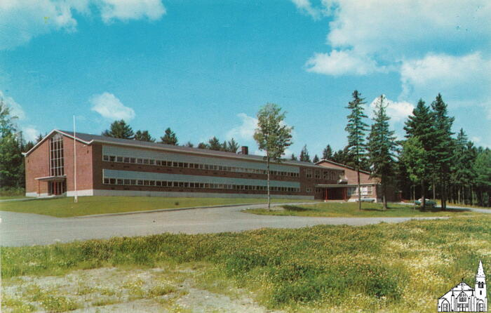
New Old Town High School [1950s] (OBJ.N.2023.27)
Postcard depicting the Old Town High School after its relocation (1954). Published by the Eastern Publishing Company in Belfast. Color by Alton (Leroy) Johnson (Sr) (1893-1962). The postcard itself is probably a more recent printing.

Slide 555
Sunkhaze Meadow Camping Trip [1904] (OBJ.N.2023.28)
Cyanotype depicting a canoe with two people. Inscription on the back places the photo at Sunkhaze Meadow. There is also a list of names. This list largely coincides with the list of participants of a camping trip to an unmentioned location that the Old Town Enterprise of September 17th, 1904 reports on. Likely, the two events were one and the same.

Slide 556
Folsom Block [Fire of 1935] (OBJ.N.2023.29)
Photo of the aftermath of the fire of Jan 28, 1935 that consumed the Folsom Block. Created from a nitrate film negative, with "Agfa Nitrate Film" in reverse and a notch in the bottom left corner. Possibly a modern photo from an older negative.

Slide 557
Poster for Military Revue [1945] (OBJ.N.2023.3)
Top half of a poster for the fourth performance of a military revue at 8pm on Friday, February 9, 1945.

Slide 558
Old Town Fire Department Members [1960s] (OBJ.N.2023.30)
Typewritten list with members of the Old Town Fire Department and their years of service. Origin unclear with no dates later than 1963.

Slide 559
Registry Bill Old Town [1891] (OBJ.N.2023.31)
Registry Bill for a registered letter send from Old Town to Arthur M. Folsom in Palmer Lake, Co. on August 6, 1891. Postmarked at Palmer Lake on August 13, 1891 and returned to Old Town

Slide 560
Business Card [c.1900] (OBJ.N.2023.32)
Business card for "Miss Bertha M. Rose, Dress Making and Millinery, at the corner of Center and Brunswick Streets." Miss Rose was likely the same as the Bertha M. Rose who was born in Bradley in 1868 and died in Los Angeles in 1941.

Slide 561
Herbert Gray School [1943 OTHS Cohort] (OBJ.N.2023.33)
Photo of the 1933 second grade class of Herbert Gray School. Barbara Conners was in this class.

Slide 562
Herbert Gray School [1943 OTHS Cohort] (OBJ.N.2023.34)
Photo of the 1934 third grade class of Herbert Gray School. Barbara Conners was in this class and the teacher (not depicted) was Edie Gammon.

Slide 563
Herbert Gray School [1943 OTHS Cohort] (OBJ.N.2023.35)
Photo of the 1935 fourth grade class of Herbert Gray School. Barbara Conners was in this class and the teacher (not depicted) was Miss (Essie) Wood.

Slide 564
Herbert Gray School [1943 OTHS Cohort] (OBJ.N.2023.36)
Photo of the 1936 fifth grade class of Herbert Gray School. Barbara Conners was in this class and the teacher (not depicted) was Miss (Helen) Greenan.

Slide 565
PCFAA Baseball Score Book [1923-4] (OBJ.N.2023.37)
Baseball Score Book for PCFAA from August 1923 through August 1924. Possibly donated by Clifford Duplissa in 1978.

Slide 566
PCFAA Baseball Score Book [1924-31] (OBJ.N.2023.38)
Baseball Score Book for PCFAA from August 1924 through October 1931. Possibly donated by Clifford Duplissa in 1978.

Slide 567
Old Indian Island Penobscot Bridge (OBJ.N.2023.39)
Photolux postcard of the Old Indian Island Bridge viewed from the Old Town side, taken probably not too long after it opened in 1951. Published by the American Art Postcard Company of Boston.

Slide 568
Old Town High School Souvenir Plate [1953] (OBJ.N.2023.4)
A decorative plate sold in 1953 to support Old Town High School's Music Booster's Club. It depicts a line drawing of the school from an aerial perspective. The plate's rim is tinted pale green, inside of which is a gold-colored design around the plate's basin and central image. The outer rim has an embossed pattern and the outermost edge of the plate is also colored gold. The stamp on the back identifies the plate design as Eggshell Georgian, which was produced in the 1930s-1950s by Homer Laughlin Plates. The customized picture of Old Town High School was added by World Wide Art Studios, Covington, Tenn. Also printed on the back of the plate is a paragraph about Old Town High School's newly built addition. The plate back reads, "This plate is being made available by the Music Boosters Club, an organization of parents and music supervisors, whose main objective is to assist in the promotion and development of music organizations in Old Town High School. Construction of the new Old Town High School building was begun in July of 1952 and was completed in the fall of 1953. The building is one of the best-planned and most attractive secondary school buildings to be found in New England and when the landscaping of the grounds is completed, the city of Old Town will have another landmark which will be greatly admired by visitors as well as by local citizens. Among the special features, there are sixteen classrooms, three laboratories, a library, modern guidance facilities, a cafeteria, a music room, a clinic room, an audio-visual room, an office-practice room and a spacious auditorium-gymnasium which will seat nearly 2,000 people. The building was designed to accommodate 550 senior high school pupils." The front of the plate, beneath the picture of the school, reads, "Old Town High School, September 1953."

Slide 569
Sachem [March, 1918] (OBJ.N.2023.40)
March 1918 Sachem owned by Catherine Bradbury (1899-1974), daughter of Samuel Bradbury and grandmother of the donor.

Slide 570
Sachem [1967] (OBJ.N.2023.41)
1967 Sachem

Slide 571
Class of 1941 [55th reunion] (OBJ.N.2023.42)
Guestbook for the 55th Reunion of the class of 1941.

Slide 572
Class of 1941 [45th reunion] (OBJ.N.2023.43)
Guestbook for the 45th Reunion of the class of 1941 on July 5 & 2, 1986. Harry S. Dalton, the father of the donor was part of this class.

Slide 573
Class of 1942 [50th reunion] (OBJ.N.2023.44)
Guestbook for the 50th Reunion of the class of 1942 on August 8, 1992.

Slide 574
Sachem [1940] (OBJ.N.2023.45)
1967 Sachem

Slide 575
Sachem [1936] (OBJ.N.2023.46)
1936 Sachem

Slide 576
Sesquicentennial Button [1990] (OBJ.N.2023.47)
Green pin-back button commemorating the Old Town Sesquicentennial of 1990. With city logo. Manufactured by the Badge-A-Minit Company of LaSalle, IL.

Slide 577
Third Annual Old Town Police Banquet [Program, 1965] (OBJ.N.2023.48)
Program for the Third Annual Old Town Police Banquet and Dance at the Dow Air Force Base on February 24, 1965. Lots of ads. Ticket included.

Slide 578
Third Annual Old Town Police Banquet [Ticket, 1965] (OBJ.N.2023.48.1)
Ticket for the Third Annual Old Town Police Banquet and Dance at the Dow Air Force Base on February 24, 1965.

Slide 579
Old Town Pennant [1960s] (OBJ.N.2023.49)
Leather pennant with "Old Town, Me." printed on one side, along with a representation of a Native-American woman weaving a basket. Leather string to attach the pennant included.

Slide 580
Helen Hunt School Note Card (OBJ.N.2023.5)
A blank note card with envelope, both made of white paper. The image printed on the front of the card is a painting of Helen Hunt School signed by Collette King and dated 2006. King was a Bangor artist who's since retired. Named for Helen S. Hunt, who taught at the older Brunswick Street School for about 30 years in the 19th century and passed away in 1900, the 1903 brick building housed 4th and 5th graders until its 2004 closure and recreation as PCHC's Helen Hunt Health Center in 2008.

Slide 581
Special Postmark [OTHS, 1995] (OBJ.N.2023.50)
Envelope with Old Glory domestic stamp and special postmark "Old Town High School Band Station".

Slide 582
Anchorage Hotel Alcohol List [1950s] (OBJ.N.2023.51)
A Mixed Drinks and Wine List for the Hotel Anchorage Lounge in Old Town.

Slide 583
Ballard Golden Oil Co [Flier, 1920-1940] (OBJ.N.2023.52)
Flier for Ballard's Golden Remedies---the four products that the Ballard Golden Oil Company on Davis Street manufactured.

Slide 584
Old Town Brochure [1979] (OBJ.N.2023.53)
A Visitors' guide to Old Town ("the city with a past ... and a future") in the form of a brochure. With a photo of the 1978 Franco-American Festival and a September date for the 1979 edition.

Slide 585
Old Town Brochure [1940s] (OBJ.N.2023.54)
A brochure entitled "Old Town. Gateway to Northern Maine" with an extensive enumeration of all industries at the time. Very similar to OBJ.N.2023.58, but lists the 1940 census population size.

Slide 586
Center Street, Old Town [blow-up] (OBJ.N.2023.56)
Blow-up of Postcard 4938 by the American Art Postcard Company with a view of Center Street from Folsom Square facing East. Shows Kenney's Restaurant on the left, which was active in the 1940s. There are also traffic lights visible, which were first installed in 1941.

Slide 587
North Main Street, Old Town [blow-up] (OBJ.N.2023.57)
Blow-up of Postcard 1398 by the American Art Postcard Company with a view of North Main Street from a little North of Folsom Square facing North. Shows remnants of trolley tracks, which were removed in 1941. Also visible are Woolworth's and Mutty's. Car models are from the 1940s.

Slide 588
Old Town Brochure [1930s] (OBJ.N.2023.58)
A brochure entitled "Old Town. Gateway to Northern Maine" with an extensive enumeration of all industries at the time. Lists the 1930 census population size.

Slide 589
Old Town Brochure [late 1970s] (OBJ.N.2023.59)
Two identical brochures listing Old Town attractions. Refers to the Old Town Museum (established in 1976) and lists a population of 8500 people, whereas the 1980s census lists a population of 8422 and the city's population has only gone down since.

Slide 590
Helen Hunt School Roofing Slate Magnet (OBJ.N.2023.6)
A roofing slate with a reproduced image of a painting of Helen Hunt School glued to the front and a round magnet glued to the back. The back has a label on it which reads, "Century old roof slate. Design by Maine artist Collette King." Larger prints of the same painting reveal that King signed and dated it in 2006. Helen Hunt School housed Old Town's fourth and fifth graders from 1903-2004. The building, still located on South Brunswick Street, reopened in 2008 as Helen Hunt Health Center, operated by PCHC.

Slide 591
The Beautiful Penobscot Bay [Poem by John F. Young] (OBJ.N.2023.60)
Photocopy of a poem by John F. Young (1883-1953) of Old Town. Original printed in two columns and priced at "10 Cents per Copy." Bottom lines of the poem missing.

Slide 592
Bottle Opener [Anchorage Hotel] (OBJ.N.2023.62)
Flat aluminum bottle opener with chain and inscription "Compliments of Anchorage Hotel, Old Town, Maine."

Slide 593
Old Town Canoe [Ad] (OBJ.N.2023.63)
Full-page ad for Old Town Canoe. Appeared in Outing. Sport - Adventure - Travel - Fiction, Vol.69 (1916-17), Feb. 1917, p.605.

Slide 594
OTHS Football Team [1947-8] (OBJ.N.2023.64)
Photo of the 1947-8 OTHS Football Team. Identical to the photo in the 1948 Sachem (p. 66). With dedication to Harold Lacadie (who was on the team). List of names of players affixed.

Slide 595
Helen Hunt School [1903-1917] (OBJ.N.2023.65)
Colorized postcard of the Helen Hunt School (built in 1903) before its addition of 1917 (when the south wing was added)

Slide 596
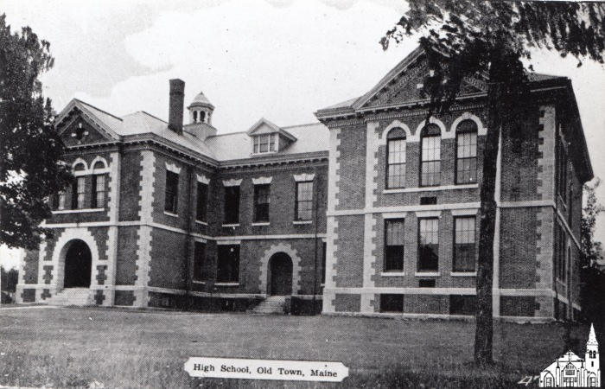
Old Town High School [photo of postcard] (OBJ.N.2023.66)
Copy of a postcard kept at the Old Town Public Library, depicting the Old Town High School as it would have looked one or two decades after its last addition in 1925 (given the height of the trees, which were absent in 1925). The photo was used on p.16 of Milliken's Equations of Motion (Bentley Press, 2006).

Slide 597
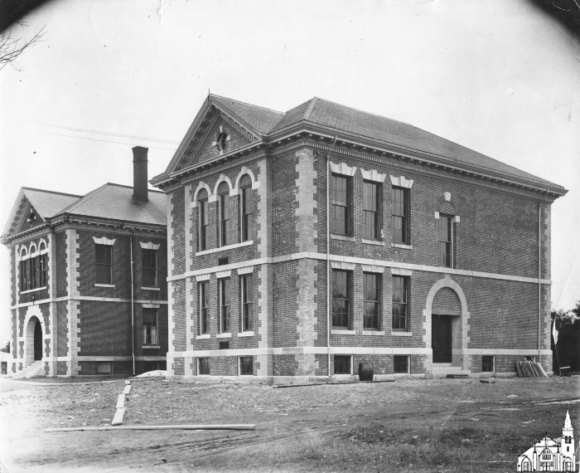
Old Town High School [1925] (OBJ.N.2023.67)
Photo of the Old Town High School building as the second addition of 1925 was being completed. Stamp of the James W. Sewall Company on the back.

Slide 598
Old Town Festival Chorus [1938] (OBJ.N.2023.69)
Program for a Concert by the Old Town Festival Chorus (with Mrs. Elsa Parshley of the University of Maine as Guest Artist) on Monday Evening, April 25th, 1938.

Slide 599
Stillwater Covered Bridge [watercolor] (OBJ.N.2023.7)
A watercolor sketch of the Stillwater covered bridge found by the donor in an antique store. Signed in right bottom corner with two Chinese looking characters, the first of which could also be highly stylized initials F.E.N. or F.E.H.

Slide 600
A Hero in Rags [Program] (OBJ.N.2023.70)
Program for a play "A Hero in Rags" at the City Hall in Old Town on Tuesday, February 25, 1908. Manager and Director was Ernest W. Veno (1889-1939).

Slide 601
Old Town Woolen Co. [Baseball Club, 1922] (OBJ.N.2023.71)
Photo of the Old Town Woolen Co. Baseball Club dated 1922 and signed Myers Studio. The location is unclear, but it appears that the Fagan House is visible in the background. Some of the names are on the back.

Slide 602
Penobscot Boy [photo] (OBJ.N.2023.72)
Copy dated 05/13/2010 of a photo taken by Ruth Gray of an Penobscot boy with bullhorn cap.

Slide 603
Envelope side flier [1914-1925] (OBJ.N.2023.73)
Envelope with one full side an advertisement for Old Town with five photos. The photo of the high school shows the school before the second wing was added in 1925, while the photo of the new post office places the photo after 1914, when the new post office was completed. Typography suggests 1910s.

Slide 604
Soldiers Memorial for 8th of Maine Infantry, Co. K [1865] (OBJ.N.2023.74)
Civil War Soldiers Memorial for the 8th Regiment of Maine Infantry Volunteers, Company K (which was formed in Old Town). Lithograph by Major & Knapp of New York and rather similar to the ones produced for many other (Union) companies. Enumeration of history, feats, and all members (including deserters) of the company against a backdrop of fanciful illustrations. No date of publication. However, the latest engagement listed is Spring Hill on December 10, 1864, even though the company did participate in later engagements. Also, there is no mention that the regiment was mustered out in January 1866.

Slide 605
Bickmore Letterhead [1895] (OBJ.N.2023.75)
Note on Bickmore Gall Cure Company letterhead dated November 11, 1895. The note is signed by A.P. Bickmore.

Slide 606
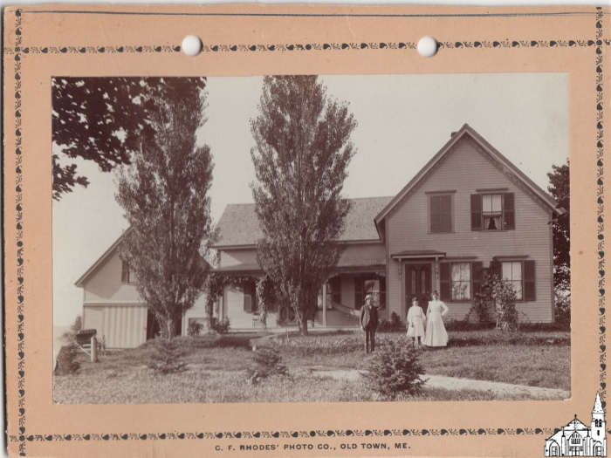
Keniston House [1896-1904] (OBJ.N.2023.76)
George Kenniston with wife Ella and daughter Elsie in front of their Franklin home (now 21 Hog Bay Road). Photo by C.F. Rhodes.

Slide 607
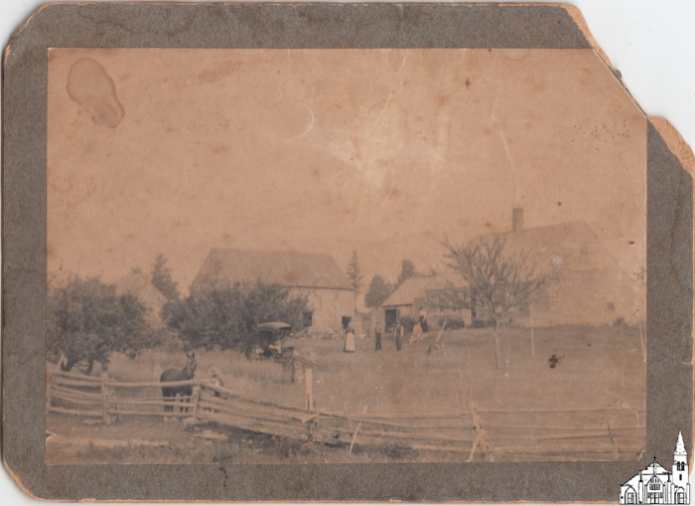
Unknown Farmhouse [1880-1920] (OBJ.N.2023.77)
Photo of unknown provenance of unknown farmhouse at unknown location.

Slide 608
Our Neighborhood Club [Members and Agenda 1937-1938] (OBJ.N.2023.78)
A printed booklet of six two-sided pages and a cream-colored cardstock cover. The front cover reads, "Our Neighborhood Club -- Old Town, Maine 1937 - 1938." Interior contents include a tribute to the club founder, Mrs. Georgia Pulsifer Potter, with picture, a list of current club members and officers, a schedule from November-May of bimonthly meetings, past club presidents, and a prayer titled, "Collect for Club Women." Women's clubs such as Our Neighborhood Club were, by the 1930s, part of a nationwide social movement wherein women reformers advocated for progressive political change. This pamphlet alludes to a March 1938 presentation on 'Civic Welfare,' but does not indicate strongly that this club chapter was very politically motivated.

Slide 609
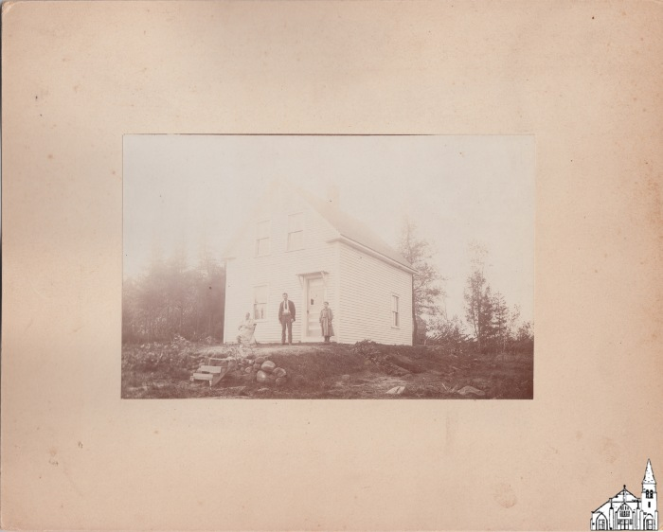
Unknown House with family [1896-1904] (OBJ.N.2023.79)
Photo of an older woman, a middle-aged man and a young girl in front of an unknown house at an unknown location. According to label on the back, the picture was created by Rhodes.

Slide 610
OTJH Braves Team [photos, 1961-1970] (OBJ.N.2023.8)
Set of 10 photos of the Old Town Junior High School Basketball Team, one for each season from 1960-61 through 1969-70.

Slide 611
J.A.L. Middle School 1990-1991 Yearbook (OBJ.N.2023.80)
Copy of the 1991 Old Town Middle School yearbook with lots of inscriptions to "Mike".

Slide 612
Old Town Canoe Letter Head [1941] (OBJ.N.2023.81)
Letter signed by S.B. Gray on Old Town Canoe Co. letterhead dated February 6, 1941.

Slide 613
Myrtle Rebekah Degree Lodge [Constitution] (OBJ.N.2023.82)
Booklet (32 pp, printed by Smith & Sale in Portland) entitled: Constitution, By-Laws and Rules of Order of Myrtle Rebekah Degree Lodge, Number Fourteen of the Independent Order of Odd Fellows, Oldtown, ME. Instituted January 31, 1888. With revisions dated December 22, 1931 and July 3, 1934.

Slide 614
What Every Bible Reader Should Know [The American Baptist Publication Society] (OBJ.N.2023.83)
A tract, 16pp., titled "What Every Bible Reader Should Know" and produced by The American Baptist Publication Society, 16 Ashburton Place, Boston, Mass. Though the tract is not dated, it features an advertisement for the New Cambridge Turquoise Type Reference Bible, which was originally produced in the 1920s. The tract likely dates from the 1920s as well. Its connection to Old Town, Maine is not clear.

Slide 615
University of Maine Postcards [1930s] (OBJ.N.2023.84)
Five black-and-white picture postcards of various buildings on the campus of the University of Maine. Three were manufactured by Machleith Photo System in Milwaukee, WI and two are unattributed to a printer. The former are labeled, "Library Walks & Trees, University of Maine; Campus View, University of Maine; and Hannibal Hamlin Hall, University of Maine." The latter two cards are labeled, "Oak Hall - Men's Dormitory - University of Maine; and Phi Etta Kappa, University of Maine." The original Oak Hall burned in 1936 and Machleith produced postcards in the 1930s, so all five cards likely date to the early 1930s. The connection of these cards to Old Town is unclear.

Slide 616
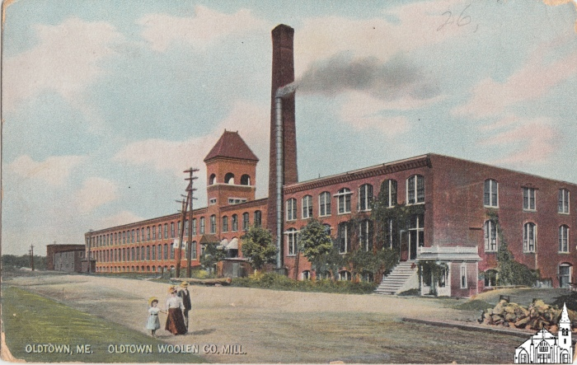
Old Town Woolen Co. Mill [1906-1909] (OBJ.N.2023.85)
Colored postcard of the front of the Old Town Woolen Mill. The back of the postcard says "Hugh C. Leigh[ton C]o, Manufacturers. This would be the Leighton Company of Portland, ME which was active under that name between 1906 and 1909.

Slide 617
Old Town Bandstand [1930s] (OBJ.N.2023.87)
Modern reproduction of a photo of the Old Town Bandstand (erected in 1935 in what is now Binette Park) taken from the North West. The railroad bridge to French Island and the T. M. Chapman Co. building are visible on the right. No known copy of the original.

Slide 618
Penobscot Times Calendars [2015-2019] (OBJ.N.2023.88)
Set of three calendars (2015, 2016, 2019) published by the Penobscot Times, all three with historical pictures of Old Town. Photos of varying reproduction quality, with many photos taken from the Old Town Museum's collection.

Slide 619
Economy Cleaners Branded Town & Country Calendar [1956] (OBJ.N.2023.89)
1956 Town & Country calendar branded for Economy Cleaners, North Main Street, Old Town. Includes pencil and metal hook.

Slide 620
OTJH Braves Team [photo, 1967] (OBJ.N.2023.9)
Three copies of the 1966-67 photo in OBJ.N.2023.8 on floppy paper.

Slide 621
Old Town Souvenir Postcards [1910s-1930s?] (OBJ.N.2023.90)
Nine black and white postcards.

Slide 622
Favorite Songs of Good Will [1924] (OBJ.N.2023.91)
A booklet containing the lyrics to forty-five songs, published in 1924 by Good Will Publishing Co. of Hinkley, Maine. Connection to Old Town unclear.

Slide 623
Eva (Martin) LaForge (1895-1919)[c. 1919] (OBJ.N.2023.92)
Heavily retouched photo in oval frame of Eva (Martin) LaForge (1895-1919) of Old Town. Eva died of Spanish Flu and left behind two young children. Photographer unknown.

Slide 624
Alma & Geraldine LaForge [c. 1919] (OBJ.N.2023.93)
B/W photo of Louis and Eva LaForge's daughters Geraldine (1916-2009) & Alma (2018-1998) in oval frame. Photographer unknown.

Slide 625
Geraldine LaForge [c. 1919] (OBJ.N.2023.94)
Heavily retouched photo of Geraldine LaForge (1916-2009) in oval frame. Photographer unknown.

Slide 626
Old Town Main Street Postcard [1930s?] (OBJ.N.2023.95.1)
A black and white postcard depicting the corner of Main Street and Center Street. The Eastern Trust Bank building and a Woolworth's 6 and 10 cent store are visible, covered in icicles. A personal note on the back reads, "What do you think of our fire? -Mary." The postcard is unstamped and never mailed. The Old Town Woolworth's remained open through the 1970s, but the style of dress in this photograph suggests its was taken around the 1930s. The postcard itself may have been created at a later date.

Slide 627
Jefferson Street School [Two Postcards, 1930s?] (OBJ.N.2023.96.1)
Two identical black and white postcards by the American Art Post Card Co. of Boston, Mass. The cards depict Jefferson Street School, captioned "High School, Old Town, Maine." This building served as the high school from 1900 to 1953, when a new high school was built.

Slide 628
Main Street Postcard [1920s-30s?] (OBJ.N.2023.97.1)
A black and white post card looking down Main Street, Old Town, from Center Street. The age of vehicles depicted and suggests the photograph was taken in the 1920s or 30s. It was made into a postcard by American Art Post Card Co. of Brookline, Mass.

Slide 629
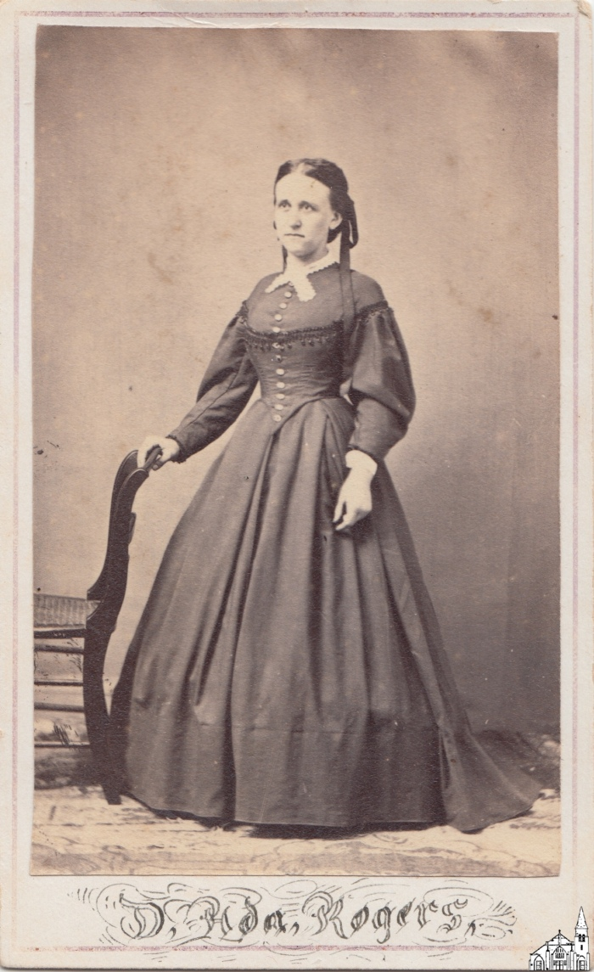
Ada Rogers [1868-1870] (OBJ.N.2023.98)
Carte de Visite for D. Ada Rogers, as listed on the front. Most likely this was D(elia) Ada Rogers (1843-1923). Born in Lincolnville, she married J. Oscar Foss (then of Milford) in Rockland in 1868. Oscar must have passed away soon after, as Ada remarried in 1870, this time with William Blackman (1837-1923) of Bradley---a grandson of Bradley Blackman, after whom the town was named. Again, vows were exchanged in Rockland, but both Ada and William are listed as from Bradley. In 1872, the couple, along with three of William's younger brothers and their families, relocated to what was then Washington Territory. William's brothers settled in Snohomish, WA, where a number of former Bradley residents had settled two decades earlier. Soon, they were heavily engaged in lumbering and over time they had a major impact on the economic development of the area. It seems likely that William and Ada were in Snohomish as well, but by 1883, they lived in Seattle, about 20 miles south of Snohomish, where William was engaged in the lumber trade for many years. It is unclear when the photo was taken. Since Ada's maiden name is used and she appears to be wearing mourning clothing, it seems plausible that the photo was taken when she was between her two marriages. As listed on the back, the photo was taken by Moses Luther Averill (1825-1894), who was active as a photographer in the 1860s and early 1870s.

Slide 630
The Penobscot River [Two Postcards, 1920s-1930s?] (OBJ.N.2023.99.1)
Two identical black and white postcards. Their fronts depict The Penobscot River, Old Town, Maine. A building with smokestacks visible in the distance could be Old Town Woolen Mill, later used as a shoe factory and renovated in the 1980s into River House apartments. The cards were printed by American Art Post Card Co. of Boston, Mass. and specify "one cent stamp" to be used for mailing, which indicates they could have been manufactured between 1925 and 1952.

Slide 631
OTHS Class of 1951 [Photo book] (OBJ.N.2024.1)
Photo book entitled "My SENIOR Year" for the Old Town High School Class of 19512. Put out by Modern Studio.

Slide 632
Old Town Police - Record Book (OBJ.O.1976.1)
Contains arrest records by perpetrator, offence, fine (if any), and arresting officer. With index.

Slide 633
Sam Harris Barbershop [Interior, 1890-1920] (OBJ.O.1976.12)
Seven male barbers in suit and tie inside Sam Harris' Barber Shop. George Cyr is in the back row (where?), while Sam Harris and Henry Shaw are in the front row (where?). "A.F. Orr, Old Town, ME" embossed on bottom border and inscription "Robert W. Shaw, 30 Cedar St, Old Town" on back.

Slide 634
Sam Harris Barbershop [Interior, 1890-1920] (OBJ.O.1976.13)
Photo of six unidentified barbers cutting hair inside Sam Harris' Barber Shop. Signed by Adelbert Orr, who was most active between 1890 and 1920.

Slide 635
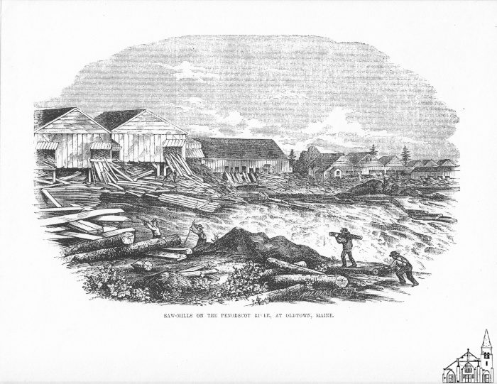
Saw Mills on Penobscot River [Gleason's, 1854] (OBJ.O.1976.16)
Framed and matted cutout of an engraving with a view of saw mill on the Penobscot River as published on p.312 of Vol. 6 of Gleason's Pictorial Drawing-Room Companion, published in 1854. No coloring.

Slide 636
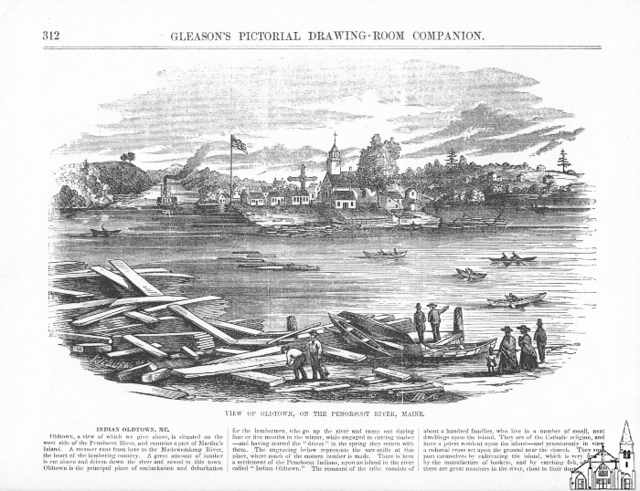
View on Indian Island [Gleason's, 1854] (OBJ.O.1976.17)
Framed and matted cutout of an engraving with a view of Indian Island as published on p.312 of Vol. 6 of Gleason's Pictorial Drawing-Room Companion, published in 1854. No coloring.

Slide 637
Hair Care - Child Barber Chair Booster Seat (OBJ.O.1976.2)
Child barber chair booster seat with leather covered wooden bottom and wired sides and back. Used in Sam Harris' shop.

Slide 638
Wooden Box (OBJ.O.1976.3)
Wooden box used in Sam Harris' Barber Shop to raise a child barber chair to its proper height.

Slide 639
Barber Chair (OBJ.O.1976.4)
Wooden adult barber chair with metal pedestal and leather back and bottom cushion. Used in Sam Harris' Barber Shop.

Slide 640
Moving the Treat and Webster Island Bridge [Photos (3)] (OBJ.O.1977.13)
Three black and white photographs taken on June 8, 1977. They depict the bridge to Treat and Webster Island being moved as well as unidentified construction workers.

Slide 641
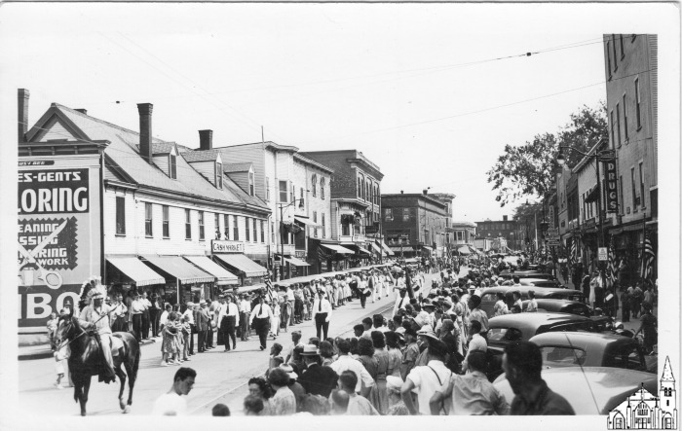
Parade going north on N. Maine Street [1941] (OBJ.O.1977.18)
Set of two photos from slightly different angles of a parade going north at the merging of Water Street and Main Street. Both photos shows chief Poolaw leading on horseback, followed by police officers Guy Moors (City Marshal from 1934-1944), Otis LaBree, Robert Lee and Clement Violette and a marching band led by Watie Akins. A billboard for Sibo Tailoring & Cleaning is on prominent display. The trolley tracks are clearly visible, as is a traffic light on Main Street. Since the trolley was discontinued in 1941 and the traffic light installed that same year, the photo likely was taken that year. Possibly this was the parade on August 9 that was part of the big Indian pageant that summer.

Slide 642
Old Town High School Gym [1920s] (OBJ.O.1977.19)
Mounted photograph wrapped in protective plastic of a gym, most likely at the old high school. Paperboard mounting has an embossing reading Reynolds Studio followed by an illegible town name. No photographer by the name of Reynolds ever was active in Old Town, but there was a Reynold's Studio in Rumford in the 1920s.

Slide 643
Four Old Town Police Men [1959] (OBJ.O.1977.23)
Photo of 4 police men (alledgedly including Robert Lee). Copy from the Penobscot Times Archives (no.6185) dated FEB 23 1959 (presumably the date the photo was issued as Lee died on 2/21 - see his obituary in the Penobscot TImes of 2/26). Originally came with a simple wood frame which was discarded.

Slide 644
Old Town Library Printer's Block (OBJ.O.1978.14)
Printer's block of the old Old Town Library building

Slide 645
Towboat at Eagle Lake [1893] (OBJ.O.1978.18a)
(Copy of a?) photo of a steampowered towboat at a dock with lots of lumber in front. Part of a set of three photos originally glued on one page. On the back it says that the photo was taken at Eagle Lake in 1893. This probably means it was taken at the H.W. Robinson operation on the South side of the lake.

Slide 646
H.W. Marsh's Office at Eagle Lake [1904] (OBJ.O.1978.18b)
(Copy of a?) photo of the office of the H.W. Marsh (and F.W. Ayer) logging operation on the South side of Eagle Lake.

Slide 647
Pea Cove Boom [c.1910] (OBJ.O.1978.18c)
(Copy of a?) photo of logs at the Pea Cove Boom with three men working the logs.

Slide 648
Photograph of Old Town High School Track Team [circa 1920s-30s] (OBJ.O.1978.19a)
A sepia photograph of seventeen high school boys in a row, wearing track shorts and tank tops, and one man in a suit and tie, all standing in an athletic field with another person in the distance, harder to make out. The photo has a frame mat printed with the logo of Perry Studio, which operated a photography studio in Old Town in the 1920s. The subjects in the foreground of this photo are identified as the Old Town High School track team and named from right to left: Ray Curran (Coach -- the man in the suit), H. Brangwnne, A. Burnham, R. Durette, C. Sleeper, B. Spencer, J. Desjardin, E. Thompson, G. Russell, E. Temple, E. Hodsdon, Ge. Scott, G. Sewall, L. Merrill, K. Blake, H. Shepherd, D. Buchanan, W. Spruce. Coach Ray Curran of the Old Town High School Track Team is mentioned in local papers from the late 1920s to the early 1930s.

Slide 649
Semi-Pro Basketball Team {PCF, 1919] (OBJ.O.1978.23)
PCF Semi-Pro Basketball Team 1918-19 with six players and two coaches. Names of the coaches and the players are on the back: Dan MacEacharn, Earnest Fortier, Albert Broadway, Henry Goldberg, Bill Michaud, Stanley Pond, Clement Paradey, Carl Carey. The photographer was Perry Studio.

Slide 650
Male Basketball Team [OTHS, 1920] (OBJ.O.1978.24)
Matted photo with seven players and coach Jerry Reardon. The names of the players are attached to the back. Front: Leslie Fayles, Charlie Ratcliff, Art Larcher, Dave Goldberg; back: ? Lait, Ben Hoos, Izzie Goldsmith.

Slide 651
Male Baseball Team [OTHS, 1923] (OBJ.O.1978.25)
Photo of the Old Town High School Football team taken by Frank Myers, probably on the occasion of winning the championship fo Northern Maine that year. Left bottom corner says Champions of Northern Maine. A separate piece of paper has all the names of the players typed out.

Slide 652
Semi-Pro Baseball Team {PCF, 1923] (OBJ.O.1978.26)
P.C.F. Semi-Pro Baseball Team 1923 with ten players and a coach.

Slide 653
Semi-Pro Baseball Team [Knights of Columbus, c1920] (OBJ.O.1978.28)
Photo of ten members of the Knights of Columbus baseball team with coach and batboy. Probably taken around 1920. The photographer was Perry Studio in Bangor (which had a branch in Old Town run by Walter Erb)

Slide 654
OTHS Basketball Team [1918] (OBJ.O.1978.29)
Photo of the 1919 OTHS basketball team. Names typed on piece of paper glued to the front and include ? Lait, Fred Hutchinson, Wesley Babkirk, Norman Fraser, Hollis Phelps Sr. (?), Elmer Athean, Cy Verdine, Virgil MacKenzie, Charlie Rackliff (the only one in suit and perhaps slightly older), Felix Goldhammer. Two members are unnamed.

Slide 655
Unknown Play [Cast, 1930s] (OBJ.O.1978.34)
Photo of the cast of an unknown play at Old Town's City Hall. Note the six actors in blackface.

Slide 656
An Irish Eden (Cast, 1924) (OBJ.O.1978.35)
Photo of the cast of the play "An Irish Eden," performed in Old Town on January 23, 1924. The photo has the name of the play, the town and the date at the bottom, as well as the name of the photographer (Myers). According to the Old Town Enterprise, the cast was recruited from the St. Cecilia Choir of St. Joseph Catholic Church and took place at the New Central Theatre. A listing of the cast can be found in the Enterprise as well. The play was a comedy in three acts which was written by the actor and playwright George Michael Rosener (1884-1945) and first published in 1911.

Slide 657
Clarence [OTHS Cast, 1924] (OBJ.O.1978.36)
Photo of the cast of the play "Clarence," performed by the Old Town High School in 1924. The photo has the name of the play, the town and O.T.H.S.'24 at the bottom, as well as the name of the photographer (Myers). According to the Old Town Enterprise, the play was performed on May 16 as part of the Victory Field Carnival (a fundraiser for the Victory Field) and was a repeat of the preceding year. The performance was coached by Mrs Harold G. Hamlin of Orono and Miss Edith Bussell. A partial list is glued onto the back of the paperboard the photo is mounted on. Another partial list was published by the Old Town Enterprise. The original play was written by Booth Tarkington and first performed on September 20, 1919 on Broadway.

Slide 658
Clarence [OTHS Cast, 1924] (OBJ.O.1978.38)
Photo of the cast of the play "Clarence," performed by the Old Town High School in 1924. The photo has the name of the play, the town and O.T.H.S.'24 at the bottom, as well as the name of the photographer (Myers). According to the Old Town Enterprise, the play was performed on May 16 as part of the Victory Field Carnival (a fundraiser for the Victory Field) and was a repeat of a performance during the preceding year (possibly on Dec. 7, 1923). The performance was coached by Mrs Harold G. Hamlin of Orono and Miss Edith Bussell. The original play was written by Booth Tarkington and first performed on September 20, 1919 on Broadway. The photo is reproduced on p.53 in the 1924 Sachem with a listing of the full cast.

Slide 659
Inside Cookhouse (OBJ.O.1978.41)
Photo of the interior of a cookhouse. According to the label, this was a Jordan Lumber Cookhouse at Grindstone (the principal location where Jordan Lumber hauled wood). Depicted are Paul Michaud, Henry Thibodeau, Mrs. Heald and Daughter as well as (?) Arsenault---again according to the label.

Slide 660
Hauling Logs. (OBJ.O.1978.42)
Picture of logs being hauled to the river, presumably for Jordan Lumber at Grindstone. Old Catalog entry says that the man "in front" is Joe White.

Slide 661
Jordan Lumber Company Crew (OBJ.O.1978.43)
Group photo of a (the?) Jordan Lumber Company crew totaling 26 men in the winter of 1916-17. On the back, several members are identified: Tom Michaud (cook), C. Heald, Henry Thibodeau, ? Lancaster, Dick Sheen, Ray Rollins, Louis Lagasse, Nick Costigan, Nick Doyle, Sam Rawsey, Louis Heald (foreman). Others are just listed as Russian (2), Polish (4), and Finnish (1).

Slide 662
Junior High School Literary Society [Constitution, 1915] (OBJ.O.1978.47)
Printed booklet entitled "Constitution, By-Laws and List of Members of Junior High School, Literary Society, Old Town, Maine".

Slide 663
Grange Meeting [c.1915] (OBJ.O.1979.21)
Photo of a big group meeting in Old Town. Based on the staffs held by the right-most seated young man and woman, this was probably an early Old Town Grange Meeting or possibly a Pomona Meeting. Picture also features the McKinley grade school, so it must have been taken before New Year's Eve 1917 when the school burned down. Since the Old Town Grange (#522) was only established on February 2, 1913, the picture must postdate that date. Most likely, the picture was taken during the Grange's first Field Day on October 29, 1913. The second man from the right on the front row is probably Horace Mann Burnham, one of the City's apothecaries and the Grange's first Master. The older woman in white on the right of the craggy looking man in the middle looks like Mrs. Lunt. The man on the very left might be Herbert Gray. On the back of the photo, it has directions for the frame, the date Jan 15, and the address "Green, Middle St., Old Town, ME." The latter may be a reference to Cyrus A. Green(e) (1867-1925), a well-known horse trader and auctioneer who lived on Middle Street in the 1910s, or to his wife Alice M. Greene. According to the Old Town Enterprise, the latter attended a Pomona meeting in Olamon in May 1913.

Slide 664
Collection of Advertising Cards [19th-early 20th century] (OBJ.O.1979.36)
Dozens of small cardstock ads from the 1870s through the early 20th century. They are for various everyday articles, like thread, dye, perfume, soap, etc. Most have no apparent connection to Old Town, though the collection contains two cards promoting "James Weymouth. Crockery, Glassware & Fancy Groceries, Main Street, Oldtown, - Maine." More advertisements for Mr. Weymouth's "Fancy Groceries" were printed in the Old Town Enterprise in 1889 and 1895, so these two cards presumably date to the 1880s-90s. They are unprinted on one side and green with a spray of full-color pink, red, and white flowers on the front.

Slide 665
Ladies' Pocket Calendar by Clark Thread Company [1878] (OBJ.O.1979.38)
A pocket-sized trade card calendar for the year 1878, advertising 'Clark's Spool Cotton O.N.T.' The front features a limited-palette color print illustration of two yellow-haired, peach-skinned children wearing blue, peach, white and red clothing beside a green, white, and red plant and peach, red, green, and yellow toys (wheeled horse and carriage and doll). One apparently uses thread from a blue, yellow, and white spool of Clark's O.N.T. to pull the wheeled horse while the other apparently coos at a white kitten playing with the spool. The reverse, featuring the full 12-month calendar divided by days in columns and months in rows, is printed blue-on-white and centers another Clark's ad that says, "Be Sure To Use [Clark's O.N.T. Spool Cotton, Trademark] for Hand & Machine Sewing. Geo A. Clark, Sole Agent." Various sources cite O.N.T. as an initialism for Our New Thread, a promoted product line as indicated by the presence of O.N.T.-labeled antiques (e.g. other trade cards, display cases) dated to the 1870s-1880s in various online collections. Connection of this trade card to Old Town, ME unclear.

Slide 666
Calling Card (OBJ.O.1979.39)
A 19th century calling card featuring a picture of a humming bird. Connection to Old Town unclear.

Slide 667
Collection of Cigarette "Silks" [19th-early 20th century] (OBJ.O.1979.40)
Cigarette "silks" were a type of advertising included in the purchase of tobacco products from around 1870 and into the early 20th century. They could be made of different fibers; this collection appears to be satin. The collection comprises 25 silks printed with various color illustrations and labeled with different brands of cigarette. Connection to Old Town unclear.

Slide 668
Spittoon (OBJ.O.1979.4a)
Metal spittoon with black bottom and white enamal top with small opening.

Slide 669
Spittoon (OBJ.O.1979.4b)
Metal spittoon with black bottom and white enamal top with small opening.

Slide 670
Sawdust Trail to Indian Island (OBJ.O.1979.55)
Photo of the sawdust trail to Indian Island.

Slide 671
Buzzell Song Sheet Music (OBJ.O.1979.60)
Sheet Music for the song "Parlez-Vous Anglais?" with lyrics by Marion Stephanie Buzzell of Old Town.

Slide 672
Langlais Landscape (OBJ.O.1979.62)
Watercolor (?) painting of landscape with a tree and green grass in front of it. Signed B. Langlais in right bottom corner. Framed and matted by Charles Buck after acquisition (according to old catalog).

Slide 673
Langlais Landscape (OBJ.O.1979.63)
Watercolor (?) painting of stream in wooded area. Signed B. Langlais in right bottom corner. Framed and matted by Charles Buck (according to old catalog).

Slide 674
Langlais Sketch (OBJ.O.1979.64)
Colored sketch of a young, blond woman wearing a turtleneck. Framed and matted.

Slide 675
Langlais Portrait (OBJ.O.1979.65)
Oil painting on canvas of subway car scene with standing man. Commercially framed in 2018.

Slide 676
Langlais portrait (OBJ.O.1979.66)
Oil painting on canvas of a seated woman with a child on either side of her. BLanglais written on back. Commercially framed without a backpanel.

Slide 677
Charter and Ordinances of the City of Old Town [1893] (OBJ.O.1980.19)
A copy of the 1893 Old Town, ME Charter and Ordinances.

Slide 678
Joe Duplissie (OBJ.O.1980.24)
Three photos of Joe Duplissie on a log, presumably on the Penobscot river. Joe Duplissie (aka Joseph M. Duplessis)(1896-1987) came from Madawaska to Old Town and later settled in Milford.

Slide 679
Old Town High School Dance [Ticket, 1939] (OBJ.O.1980.49)
Ticket for the Old Town High School Dance at the Helen Hunt Auditorium on Thursday, February 9, 1939. The Watie Atkins Orchestra was playing.

Slide 680
Program for the Neeburban Club.[1924/5] (OBJ.O.1980.56)
Printed pamphlet, listing the program for the Neeburban Club for the year (Oct-May) as well as all members, officers, and committees.

Slide 681
Joseph Doe [Photograph] (OBJ.O.1980.57)
A sepia 1/2 portrait taken by M. S. Buker of Old Town, ME, likely in the 1880s. The subject is Joseph Doe. He wear a three piece suit, watch chain, necktie, and full beard. A Joseph Doe is recorded to have lived in Milford, ME in the mid-to-late 19th century; this may be him.

Slide 682
Edith Bussell [Photograph] (OBJ.O.1981.12)
A black and white 1/4 portrait taken in the 1900s by Ramsdell & Halloran of Bangor, ME. The subject is Edith Bussell, and well-known local educator who lived on Center St. in Old Town. In this photo she is wearing a dark dress with stripes of lace and a high neck. Her hair is pinned in a bouffant and she wears a long chain necklace.

Slide 683
Amy Maxfield [Photograph for the U of M Class of 1903] (OBJ.O.1981.15)
A black and white 1/4 portrait taken by Chalmers of Bangor, ME. The subject is Amy Maxfield in her Class of '03 graduation photo from the University of Maine. Her hair is gathered in a bun and she wears high necked dress and bodice with puffed sleeves.

Slide 684
Earl P. Freese [Photograph for the Bates College Class of 1907] (OBJ.O.1981.16)
A black and white half portrait taken by Harry L. Plummer, Journal Bld. 6, Lewiston, ME. The subject is Earl P. Freese. In this graduation photo for the Bates College Class of 1907, he is a young man wearing a dark suit, necktie, pince nez glasses, and lapel pin. He's posed looking slightly to his left.

Slide 685
Maury M. Blaisdell [Photograph] (OBJ.O.1981.17)
A sepia 1/4 portrait taken in 1902 by Ramsdell & Halloran of Bangor, ME. The subject is Maury M. Blaisdell. He is a young man looking slightly to his left, wearing a buttoned suit coat and striped bowtie.

Slide 686
A. H. Harris [Photograph] (OBJ.O.1981.18)
A black and white 1/4 portrait photograph taken around the turn of the 20th century by Geo Sansil. The subject is A. H. Harris. In the picture he is a balding, dark-haired man with a moustache, wearing a pinstripe suit and necktie.

Slide 687
Ella Maddox [Photograph] (OBJ.O.1981.21)
A black and white 3/4 body portrait by Chalmers of Bangor, taken in the early 20th century. The subject is identified as Ella Maddox. She is wearing a graduation cap and gown, though her class and alma mater are not known. This photograph was recovered from the Center Street house of Edith Bussell.

Slide 688
Roy E. Russell [Photograph for the U of M Class of 1902] (OBJ.O.1981.24)
A 1/4 studio portrait taken by Ramsdell & Halloran of Bangor, ME in 1902. The subject is Roy E. Russell, Class of 1902 at the University of Maine. He wears a suit and large patterned bowtie and is posed looking slightly to his right.

Slide 689
Edith Bussell [Photograph] (OBJ.O.1981.27)
A sepia 3/4 portrait taken by Frank C. Weston, 'artistic photographer,' 23 Hammond St., Bangor, ME, likely around the turn of the 20th century. The subject is Edith Bussell, a well-known Old Town educator. She is dressed in a long, dark skirt and loose, light-colored blouse, accessorised with a round locket or pendant on a chain and oversized bow holding back her hair.

Slide 690
S. E. Fessenden [Photograph] (OBJ.O.1981.28)
A 1/4 studio portrait taken in the 1900s by Ramsdell & Halloran of Bangor, ME. The subject is S. E. Fessenden of Bridgeton, ME. He's a young man looking slightly to his left and wearing a suit and bowtie with polka dots.

Slide 691
Henry C. French [Photograph for the U of M Class of 1902] (OBJ.O.1981.29)
A 1/4 studio portrait taken by Ramsdell & Halloran of Bangor, ME in 1902. The subject is Henry C. French, Class of 1902 at the University of Maine. He's wearing a suit and white bowtie and is posed in semi profile, looking to his right.

Slide 692
Florence Balentine [Photograph for the U of M Class of 1905] (OBJ.O.1981.30)
A 1/4 studio portrait taken in 1905 by Chalmers of Bangor, ME. The subject is Florence Balentine, a young woman in a high-necked dress with lace collar and her hair pulled back. This is likely a graduation photo, as Miss Balentine was a senior studying biology at the University of Maine in 1904.

Slide 693
Merritt Fernald [Photograph] (OBJ.O.1981.31)
A black and white 1/4 portrait by Ramsdell & Halloran Studio of Bangor, ME. The subject is identified as Merritt Fernald. In the picture he is a bald man with mutton chops in a tuxedo and bowtie. This same photograph appears in the 1914 University of Maine yearbook, where the subject is further identified as Merritt Caldwell Fernald, Ph.D., L.L.D., and Professor Emeritus of Philosophy. Dr. Fernald was born in 1838 and died in 1919 in Orono. He was an accomplished educator and academic throughout his career.

Slide 694
Two Girls [Photograph] (OBJ.O.1981.32)
A half portrait of two girls, taken in the 1900s by Geo Lansil of Bangor, ME. They are posed leaning against each other. One has her hair pulled back and wears a striped blouse with puffed sleeves. The other wears her hair loose and a darker dress with puffed sleeves. Connection to Old Town unclear.

Slide 695
Miss Gifford [Photograph] (OBJ.O.1981.33)
A black and white 1/4 portrait taken in the 1900s by The Ramsdell Studio of Bangor, ME. The subject is identified as Miss Gifford. She is a young woman wearing a dress with a ruffled lace collar. Her hair is styled in a bouffant and she wears a locket and brooch. She's posed looking slightly to her right.

Slide 696
Arthur E. Silver [Photograph for the U of M Class of 1902] (OBJ.O.1981.34)
A sepia 1/2 portrait taken in 1902 by Ramsdell & Halloran of Bangor, ME. The subject is Arthur E. Silver in his University of Maine graduation photo. He's a young man looking slightly to his right in a three piece suit with high collar and patterned, diamond-point bowtie. Silver was active in organizing Class of 1902 events and reunions; Fogler Library houses an archive of photographs and textual materials that Silver curated in his lifetime regarding this graduating class. Silver spent his career in electrical engineering, receiving professional recognition for a cost saving innovation in rural electrification in 1951 and an honorary doctorate from U of M in 1954.

Slide 697
Herbert O. Farrington [Photograph for the U of M Class of 1902] (OBJ.O.1981.35)
A black and white 1/4 headshot taken in the 1902 by Heath of Bangor, ME. The subject is Herbert Oscar Farrington, from Portland, ME, in his U of M graduation portrait from that year. In the photo he is a young man wearing glasses, a checked necktie, and high collared shirt under a suit jacket. Farrington earned a degree in electrical engineering.

Slide 698
Alice Lord [Photograph] (OBJ.O.1981.40)
A black and white 1/4 portrait taken in the 1900s by Ramsdell & Halloran. The subject is Alice Lord, a young woman posed looking slightly to her right. She wears a dress with ruffled shoulders and collar but no accessories. Her hair is pinned back.

Slide 699
Gertrude L. Fraser [Photograph for the U of M class of 1901] (OBJ.O.1981.41)
A black and white studio portrait taken in 1901 by Ramsdell & Halloran of Bangor, ME for the U of M graduating class. The subject is Gertrude L. Fraser. According to UMO records, she was a member of the Phi Gamma sorority during her time as a student. Gertrude wears pince nez glasses and a high necked frock with frilled shoulders and lace netting over the bodice. Her hair is pinned up. This photo was recovered from the Center Street house of Edith Bussell.

Slide 700
Graduation Picture Great Works (OBJ.O.1981.45)
Graduation picture with five students and Edith Bussell. Since Bussell was head of the Great Works Elementary School in the first decades of the 1900s, the picture probably was taken then and the students must have been from Great Works. Exact date unknown.

Slide 701
Evangeline Haynes [1890-1900] (OBJ.O.1981.46)
Photo with "Evangeline Haynes, Teacher OTHS, French, History" written on back and "Excel Studio" embossed on matting. Evangeline Mabel Haynes (1858-1953) was either born in Old Town or came to Old Town at a very young age (the 1860 census has her already living there). In the 1890s and early 1900s she was teacher of French and History (and occasionally Botany) at the Old Town High School, while taking Summer classes at the State College. Bussell might have been one of her students during that period. In 1912, Haynes moved in with her brother Harold who was an Universalist minister in Mount Vernon, NY and retired from teaching. She died in Binghamton, NY, where she is also buried. Photo made in the late 19th century (based on sleeves and hairdo). No further information could be found about the Excel Studio.

Slide 702
Myra O'Connor [Photograph] (OBJ.O.1981.47)
A black and white portrait taken in the first or second decade of the 20th century by an unknown photographer. The subject is Myra O'Connor. In 1917, along with many other Old Town women, Ms. O'Connor signed a petition for the voters in a Sept. 10 special election to vote in favor of women's suffrage. In the photograph she is wearing a gingham dress with V-cut lace panel and high neck, over which she wears a small metal cross on a chain and a glass flower brooch at her throat. Her hair is pinned up.

Slide 703
Nineteenth Century Calling Cards [Pre-Civil War] (OBJ.O.1981.8)
A collection of ten 19th century calling cards, from approximately 1865-1975. They are chiefly floral in design, incorporating motifs such as birds and hands. The card backs indicate they had been glued into a scrapbook, but are now atached to a long ribbon as a hanging display. Connection to Old Town unclear.

Slide 704
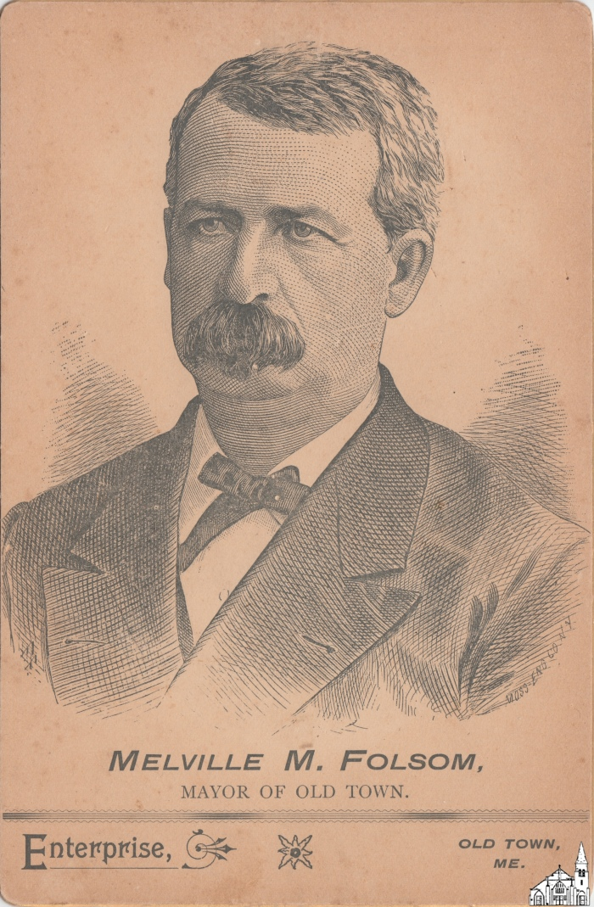
Melville M. Folsom [Lithograph, 1892] (OBJ.O.1982.35)
Lithograph of Mayor Melville M. Folsom with on the back a listing of the Old Town City Government for the term 1892-1892.

Slide 705
Old Town and Orono Souvenir Booklet [1892-3] (OBJ.O.1982.46)
Souvenir of Old Town and Orono, Maine booklet published by Gilmore the Photographer, containing heavily brushed photographs of landmarks in Old Town and Orono. M.G. Gilmore had a store at 21 Centre Street from 1892-1894 (based on his ads).

Slide 706
Lombard Steam Hauler and Engineer [1890-1920] (OBJ.O.1983.15)
A card-mounted photograph of several men with the Lombard Logging and Hauling Company, including Nelson LaBree, engineer, in the doorway to the steam hauler. Location may be Silver Lake, north of Milo. Probably taken 1901-1910.

Slide 707
Cassidy/Sutton Mill (Stillwater) (OBJ.O.1983.51)
Photo of the Cassidy/Sutton Steam Mill (Stillwater) in mid-20th-century frame. On back panel it says "Steam Mill 1884 as per A-90 slide", so possibly a copy of something else. Some water damage, although not to the photo itself. Small hole in photograph, possibly caused by insects.

Slide 708
Photo of the Bed for the Railroad Bridge Over Stillwater River [Constructed 1830s] (OBJ.O.1983.52)
A card-mounted reproduction of a black and white photograph, likely copied and mounted in the 1980s, the original of which was likely taken in the 1830s during the construction of the Bangor-Piscatiquis Railroad. The picture shows the bridge bed for the Bangor-Old Town branch of the Railroad, crossing the Stillwater at what, in 1983, was the Pinkham Farm on Stillwater Ave.

Slide 709
Dr. H. C. Mason, D.D.S. [Photograph] (OBJ.O.1983.54)
A black and white 3/4 portrait taken by The Joy Studio of Ellsworth, ME likely around 1910. The subject is Dr. H. C. Mason, a doctor of dental surgery from 1910-1946. The portrait was donated by his daughter, Hester Mason Jordan, who lived in Old Town until her death in 1991. In the photo, Dr. Mason wears a three piece suit with watch chain, ascot, and high collar. He's seated, posed with his fists on his thighs and looking slightly to his right. His hair is parted and pomaded.

Slide 710
Edee Gammon (OBJ.O.1983.8b)
Photo of Edee Gammon (1879-1970) as a young woman. She was a teacher at the Helen Hunt School and a longtime principal of the Herbert Gray School. She also was a music teacher at the High School.

Slide 711
Parker Bickmore? [Photograph] (OBJ.O.1984.249)

Slide 712
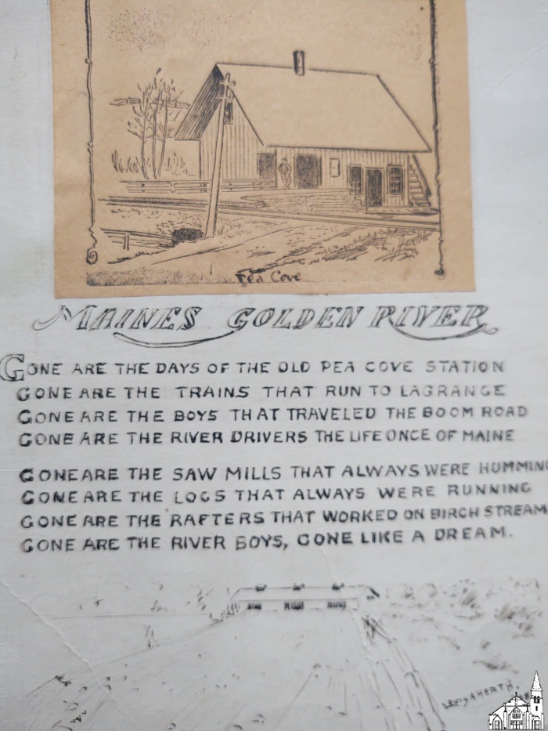
Sketch & Poem by Louis A. Heath [1948] (OBJ.O.1984.58)
A picture affixed to a piece of poster board depicting the Railway Station at Pea Cove, which operated from the late 1860s until sometime between 1907 and 1911. Beneath the picture, there is a poem titled "Maine[']s Golden River," which laments the loss of the station and of local industry, as well as a hand-drawn picture. Poem and drawing are signed "Louis A. Heath, '48." On the reverse side of the posterboard Heath wrote in clear, carefully-lettered cursive a message to the intended recipient of this handmade gift, "Warren Dority, the boy that snored out loud," and second poem, signed "In friendliness toward all men. Louis A. Heath." In the message to Mr. Dority Heath explains that the Pea Cove Station picture on the front side "is one [he] made during the years [he] worked for the Daily News;" and that "it has faded some - it was printed in the News." Heath was 78 when he made this gift, according to the reverse-side message. This identifies him as the engraver and illustrator Louis Alfred Heath (1870-1951). In 1906, Heath was employed in the Bangor Daily News Art Department. The printed version of the drawing has not yet been identified. A typewritten transcription is enclosed with the object.

Slide 713
Shaving Mug (OBJ.O.1984.6)
White shaving mug with gold trim and Mason symbol, originally owned by Howard Lancaster (?-1920) and then used for 40 years by his son Hartwell C. Lancaster (1920-1997). At one point, it was part of Sam Harris' collection of shaving mugs.

Slide 714
Young Parker Bickmore [1880s] (OBJ.O.1984.76)
Photo of young man, possibly Parker Bickmore. Picture taken by C.L. Marston of Bangor (who was most active in the 1880s)

Slide 715
Valentine (OBJ.O.1984.78)
A two-sided card Valentine with no handwritten inscription. It appears to have been made in the late 19th or early 20th century, based on its artistic style and a silk fringe around the border. One side depicts stylized plum blossoms and a dove holding an envelope with the words "St VAlentine's Day" and "With My Love." The other side features realistic lilies and a short poem by "E.S.F." Connection to Old Town, Maine unclear.

Slide 716
Leather Pocket Watch Box (OBJ.O.1985.11)
A leather box lined in purple satin and velvet to hold a pocket watch. Made approx. 1880-1890 in Gallipolis, OH. Connection to Old Town unclear.

Slide 717
Pincushion (OBJ.O.1985.128)
A tan-and-yellow square pillow pincushion, accented with tulle, ruffles, lace, and embroidery. Date of origin likely 1920s-1940s. Connection to Old Town unclear.

Slide 718
Scrapbook Contents [Postcards, Misc.] (OBJ.O.1985.129)
A collection of pastel illustrated postcards and holiday greetings, likely created in the late 19th or early 20th century. They were removed from a scrapbook. Connection to Old Town not clear.

Slide 719
Comb [Hard Rubber] (OBJ.O.1985.140)
A tapered, black, hard rubber comb. It reads "689 -- 'Master Barber Sociate'." Date of manufacture and connection to Old Town unclear.

Slide 720
Comb [Aluminum] (OBJ.O.1985.143)
An aluminum pin tail, or rat tail, comb with uneven teeth. Model #253 is visible on one side, but manufacturer cannot be discerned. Date of manufacture and connection to Old Town unclear.

Slide 721
Hair Curlers [set] (OBJ.O.1985.149)
A set of originally 6 metal hair curlers with rubber fasteners, with currently only one present. Probably dating to the 1950s. Goody brand. Connection to Old Town unclear.

Slide 722
Lester J. Blethen [Photograph] (OBJ.O.1986.108)
A sepia 1/4 headshot taken by Weston of Bangor, ME in the late 1890s. The subject is Lester J. Blethen, a young man in a suit with checked lapels and white ascot. His hair is parted and curled and he looks slightly to his right. Connection to Old Town unclear.

Slide 723
Military Band [1905-08] (OBJ.O.1986.33)
Photo of a military band. On the back is a stamp saying Brown F. Atkin, Photgrapher, Fort Williams, Me. It is stated in pencil that the date was 1915, that the third person from the right in the back row is Guy Oliver and that the photo was donated by Lloyd Oliver Jr. The former undoubtedly refers to Guy Raymond Oliver (1887-1923), who was born in Orono, but later lived in Stillwater. Lloyd E. Oliver Jr. (1931-1994) was his grandson. The date of 1915 almost certainly is incorrect, as Oliver was not mobilized for service until the US entered the war in 1917. However, he did enlist previously in 1905 and his military papers say that he was discharged from service at Fort Williams in 1908. Also, Brown F. Atkin, a sergeant in the Hospital Corps, appears to have died in Kansas (where he served at Fort Riley in 1912) in 1913.

Slide 724
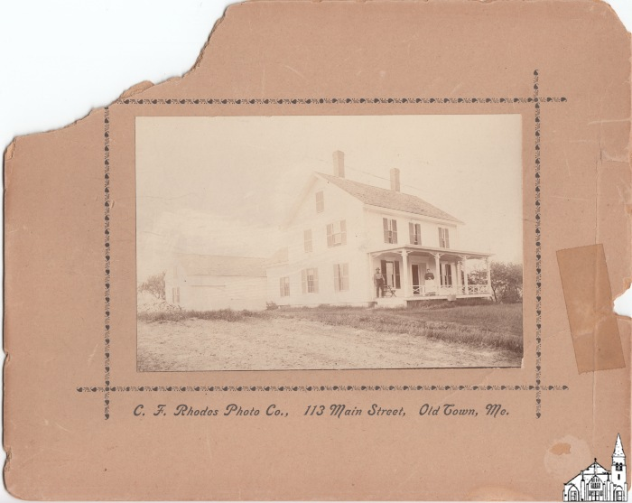
Unidentified Couple on Front Porch [1896-1904] (OBJ.O.1986.48)
An original photograph of an unidentified man and woman on their front porch. A white house with two chimneys is centered, beside which a dirt driveway leads to a coachhouse/garage with the same shutters and siding. The left half of the photograph is faded. Location unknown. According to the caption below the photo, the image was taken by C.F. Rhodes.

Slide 725
Tin Type Photo (OBJ.O.1986.64)
A framed tintype photo of young women with "sausage" curls. Connection to Old Town unclear.

Slide 726
Old Town Officers and Committees [1937-1938] (OBJ.O.1987.5)
A tri-folded pamphlet on heavy beige paper. The cover page reads, "City of Old Town, Maine Officers and Committees 1937-1938." It bears the Old Town city seal and lists an alarm code by number of bells rung: 3 Bells, Chief's Call 2 Bells, After Alarm, All Out 3 Bells, Curfew 4 Bells, Milford Call 5 Bells, Out-of-town Call 6 Bells, Bradley Call 7 Bells, Boy Scout Call 9 Bells, National Guard Call This code likely relates to the Fire Alarm Boxes and "Phantom" Boxes listed on the back of the pamphlet. Fire Boxes were widely adopted in the 1930s as a means of firefighting, used to signal the nearest fire station directly from the attached address or, in the case of "phantoms," from a larger business campus or geographic area. The pamphlet interior lists the city government starting with the Mayor, Edgar F. Cousins, down to Weighers of Coal, Hay, Etc. and Trustees of Old Town Water District, who are listed before the Constable, Patrolmen, Special Officers, and Board of Engineers.

Slide 727
Cufflinks (OBJ.O.1987.51ab)
A pair of white, blue, and silver "snap link" cufflinks owned by Milford police officer [1910-1940] Harvey MacDonald, donated by his grandson Douglas MacDonald.

Slide 728
Constable Badge [Milford] (OBJ.O.1987.52)
Metal shield-shaped badge with star and inscribed with "Constable" and "Milford". Vertical clasp.

Slide 729
Special Police Badge [Milford] (OBJ.O.1987.53)
Metal circular badge with star and inscribed with "Special Police". Vertical clasp.

Slide 730
"Gold" Brooch (OBJ.O.1987.92)
A gold-finish brooch made of stamped metal with large red plastic "stone" inset with floral and white bead "pearl" filigre. This colorful costume jewel likely dates to the 1940s-50s. Connection to Old Town unclear.

Slide 731
"Gold" Pendant on Chain (OBJ.O.1987.93)
A gold-finish pendant and chain. The stamped-metal pendant holds a red plastic "stone" with floral and white bead "pearl"filigre. This colorful costume jewel likely dates to the 1940s-1950s. Connection to Old Town unclear.

Slide 732
Tedd-Lait Military Revue [1945] (OBJ.O.1988.1)
Photo of the cast of the Military Revue performed under the auspices of the Tedd-Lait American Legion Auxiliary on January 29, 1945. The back of the photo lists Lucy Poolaw ("Princess Watawaso") in the center, Mac Gray as Uncle Sam, Harriet Goodman as the Statue of Liberty and one of the nurses as Hope McLaughlin. It also has the date as 1943 or 1944 (which is incorrect).

Slide 733
Large White House [Bangor Museum Photograph] (OBJ.O.1988.106)
A mounted reproduction of a black and white photograph, likely taken in Bangor, ME in the early 20th century. It depicts a large white house at the intersection of two tree-lined residential streets, which are still in the process of being paved and so are wheel-rutted mud in the picture. Clean cement sidewalks front the houses in both directions. It's unclear what the exact location and date shown are.

Slide 734
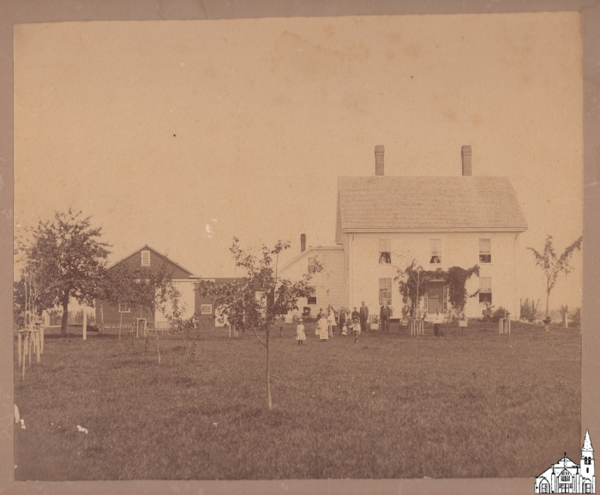
Sanborn Residence [1896-1904] (OBJ.O.1988.107)
Sanborn residence in Argyle (ME) with barn and shed. Family posing in front and in the window openings. Leroy Sundreland Sanborn (1851-1934), a native of LaGrange, was a longtime resident of Argyle, where he owned a farm two lots north of Charlie Dow's. In 1878, he had married Adeline Mary Bussell (1853-1910), a member of one of the settler families of Argyle. After Adeline's death, he left Argyle for a while, but in 1917, he returned after marrying Julia Waterhouse (1855-1935), a sister of William Waterhouse, then mayor of Old Town. Photographer unclear, but probably Rhodes.

Slide 735
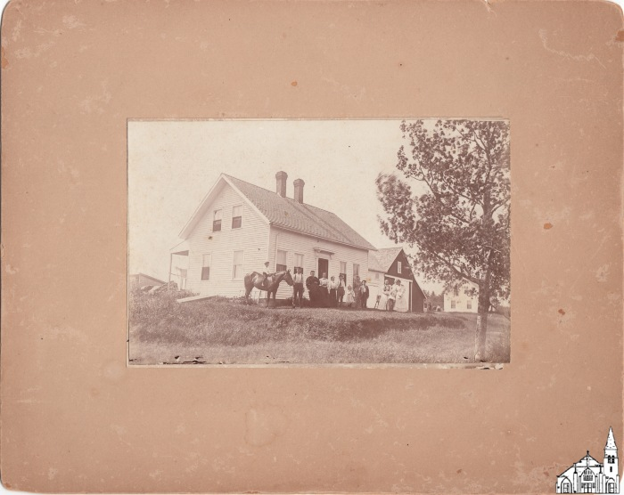
Freeze House [1896-1904] (OBJ.O.1988.108)
Photograph of what is described as the Freeze House in Argyle (ME) with family (and horse) in front. The exact location is not clear, but a comment on the back of a duplicate seems to suggest that the house in the back is the John Dow house. The lot to the north of John Dow's land was in fact owned by William W. Freeze (1841-1913), a Civil War veteran and lumberman, so the photo may depict his house. According to the 1875 Comstock map, Freeze's house was on the land side of the road and actually to the south of Dow's, which agrees with the sunlight in the photo as indicated by the shadows cast by the chimneys. According to the label on the back, the picture was taken by C. F. Rhodes.

Slide 736
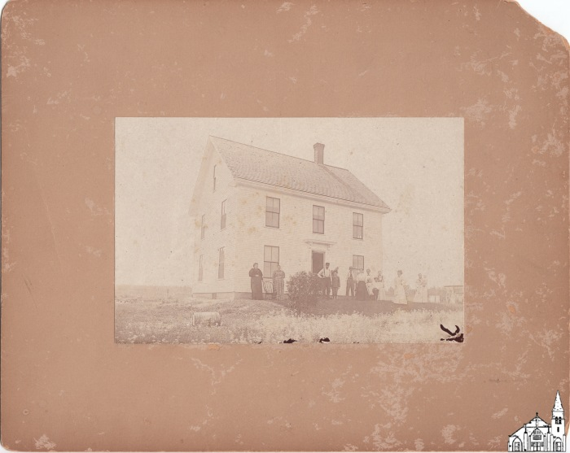
Unidentified Farmhouse with family [1896-1904] (OBJ.O.1988.111)
Unidentified farmhouse with a family in front. Picture taken by Charles A. Rhodes of Old Town.

Slide 737
Walter Bussell [Photograph] (OBJ.O.1988.113)
An enlarged copy of a photograph likely taken in the 1870s-1880s by an unknown photographer. It depicts Walter Bussell in sepia headshot. He's a mustachioed man in a three piece suit. This is likely the Walter Bussell who lived in Bangor, ME in 1940 and was born around 1854. Connection to Old Town unclear.

Slide 738
Saved by the Head Hunters [Movie Handbill, 1914] (OBJ.O.1988.115)
Movie Handbill for the Warner's movie "Saved by the Head Hunters" shown on Mar.4-5, 1914 at New Central Theatre.

Slide 739
The Mother Penitent [Movie Handbill, 1914] (OBJ.O.1988.116)
Movie handbill for Warner's "The Mother Penitent" shown at New Central Theatre on Feb.25-26, 1914

Slide 740
A Daughter of Ireland [Program, 1914] (OBJ.O.1988.117)
A printed program for Warner's "A Daughter of Old Ireland" (in three parts) and four shorts shown at New Central Theater on Feb.20-21, 1914. Almost identical to the announcement printed in the Old Town Enterprise. Feb.21, 1914, p.4.

Slide 741
The Cubans [Program, 1914] (OBJ.O.1988.118)
Program for the vaudeville act "The Cubans" shown on Feb.23-25, 1914 as well as the 7 parts deal for Feb.23-24, 1914.

Slide 742
Loyalty [Program ,1914] (OBJ.O.1988.119)
Program for the Belgian Pathé drama "Loyalty" (original title: "La fille de Delft") shown on Jun.5-6, 1914 (along with other features) at New Central Theatre.

Slide 743
Free Automobile Flier (OBJ.O.1988.120)
Flier for a free automobile (imp cyclecar) contest. Separate print identical to the ad published in the Old Town Enterprise of August 29, 1914, p.8. Various Old Town participated and are mentioned by name.

Slide 744
Photo Postcard of Belle Lancaster [early 1900s] (OBJ.O.1988.128)
A postcard with amateur black and white photograph taken in the early 1900s, Old Town, ME. Depicts Belle Lancaster, out of focus. She's seated in a house coat beside a table with a huge flower arrangement in a wide mouthed, footed vase. The room is further decorated with a fringed rug over patterned linoleum, floral wallpaper, and five framed pictures on the walls. The note on the back, undated, reads, "Dear Aunt Dora: - Am sending you a picture of dear mother. When you come down again, call in. With love. Belle Le -"

Slide 745
Flood [Old Town, 1923] (OBJ.O.1988.95)
Postcard of the Flood of May 1923 with a view toward the point where Water Street and Main Street merge. Dated May 1, 1923. Photo #10 of the Myers series.

Slide 746
Willis Longley [Photograph, 1897] (OBJ.O.1989.147a)
A sepia 1/4 headshot portrait by C. A. Smith Photo Co., Winterville, ME, taken in 1897. The portrait is of Willis Longley and was enclosed inside a marriage booklet celebrating his wedding to Eva Carroll of Old Town in that year. In the photo he wears a suit with loose, patterned bowtie and has his hair sharply parted. Willis was from Milford, where the couple briefly lived together, until Eva's death in 1899.

Slide 747
Eva C. Carroll and Unidentified Woman [Photograph, 1890s] (OBJ.O.1989.147b)
A black and white 1/4 portrait of two women taken by C. A. Smith Photo Co., 7 Main Street, Waterville, ME. The standing woman is identified as Eva Carroll, Willis L. Longley's first wife. Her seated companion is not identified. Both are wearing dresses with wide, dark collars with white trim and have their hair pinned up. The picture was likely taken in the 1890s. Eva passed away in 1899. The photo was enclosed in her and Willis' wedding invitation from June, 1897.

Slide 748
Marriage Invitation [Wednesday, June 30, 1897] (OBJ.O.1989.147c)
A printed wedding invitation for the wedding of Eva C. Carroll to Williis L. Longley on Wednesday, June 30, 1897 in Milford, Maine. Enclosed are separate photos of Willis and Eva with an unidentified woman.

Slide 749
Albert True Brase [Photograph] (OBJ.O.1989.148)
A black and white studio photograph taken by Howe of Old Town, ME, likely in the very late 19th century or early 20th. The subject is identified as Albert True Brase. In the picture he is a young man in a tweed suit with necktie and large collar. His hair is parted down the middle and curle up at the sides.

Slide 750
Six Women [Tintype Photograph] (OBJ.O.1989.155)
A tintype photograph, likely taken in the late 19th century. The subjects are six well-dressed women, four standing and two seated. They are identified as M. Doble, E. Fongley, S. Dumphey, and M. Verrt standing, as well as I. Hall and V. Trembley, seated. Spelling of names transcribed as written on the photo's envelope. Connection to Old Town unclear.

Slide 751
Indian Pageant [1941] (OBJ.O.1989.165)
Booklet for the Indian Pageant Celebrating Old Town's 50th Anniversary on August 7-9, 1941. Lots of ads.

Slide 752
Third Annual Labor Day Celebration [1936] (OBJ.O.1989.166)
Booklet with program for the Third Annual Labor Day Celebration on September 7, 1936. Sponsored by Union Local No. 80 (Pulp Sulphite Workers) of PCFC.

Slide 753
Milford Firemen's Indoor Carnival [1930] (OBJ.O.1989.167)
Booklet for the Milford Firemen's Indoor Carnival (= fundraiser) in Milford's Town Hall, Nov. 10-15, 1930. Scant description of the carnival activities, but lots of ads. The event seems to have escaped the attention of the Old Town Enterprise.

Slide 754
Community Chautauqua Program [July 22-26, 1920] (OBJ.O.1989.168)
The Chataqua Movement, an adult education and cultural event series that flourished from the 1870s to the mid 1920s, was started in 1874 as the Chataqua Lake Sunday School Assembly, a training program for Sunday school teachers. This became the Chataqua Institution, which remains in operation and which inspired numerous independently-run rural "chataquas" throughout the continental U.S. and southeastern Canada. The movement was a successor to the lyceum movement of the early 19th century. This item is the "Program de Luxe" by Community Chataqua, Inc. for their events hosted in Old Town, Maine on July 22-26, 1920. It is a large fold-out pamphlet on heavy paper stock, with promotional photographs and descriptions of featured lectures and acts including a large spread for the play "Polly of the Circus" in the interior and on the front cover. The back of the pamphlet provides the full schedule broken down by time and day, as well as ticket information, a mission statement on the nature of service by the president of Community Chataquas, Inc. (Loring J. Whiteside), a poem for children and daily schedule of children's programming. Adult programming for this chataqua blended educational lectures (e.g. "The Future of Devastated France," by Percy Allen; "Americanism, the Goal of History," by Dr. E. E. Violette; and "Keeping in Trim," by Louise L. McIntyre) with various musical and theatrical entertainment, like the play "Polly of the Circus." Children's programming featured games for different age groups (under 10 years of age and over 10 years of age), daily story hour at 4 p.m., and rehearsals for a pageant to be performed on the last day.

Slide 755
National Grange Golden Sheaf Certificate (OBJ.O.1989.176)
Certificate in box issued to Bertha Flanders in recognition of 50 years of service or membership of the National Grange of the Patrons of Husbandry.

Slide 756
Milford Fire Department Parade Float [Photograph, 1890s?] (OBJ.O.1989.187)
A sepia photograph taken approximately in the 1890s. It is titled "Milford Fire Department," but appears to be of a wooden, horse-drawn fire wagon decorated to serve as a Fourth of July parade float. The wagon, on which is painted partially-obscured initials which likely read M.F.D. (for Milford Fire Department) and "Hose I," has been draped in starry fabric bunting along its sides and down the length of a fire ladder that extends off the back. Nine children, apparently boys, dressed in near-identical white shirts and boat hats are riding the wagon, posed facing the camera. Two adults, apparently men, in dark uniforms are posed at the front of the wagon, where reins and part of a harness lead off out of shot. That this is a Fourth of July parade is inferred by the children's summer clothing, leaves on the visible trees, the stars on the bunting, and multiple miniature American flags also decorating the wagon/float. Space on the back of the photograph to write and send a postcard has been left blank.

Slide 757
Gold Toothpick (OBJ.O.1989.194)
A retractable gold-colored metal toothpick in a black sheath of hard rubber with "Fairchild" imprint. This New York manufacturer produced gold nibs, pens, pencils, and toothpicks from the 1830s-1890s.

Slide 758
Sancton Jewelry Co. Spasmodic Alarm (OBJ.O.1991.1)
Steel alarm clock by Sancton Jewelry Co., 165 Main St., Old Town. Patented Mar. 15, 1898, Jan 29, 1901, Feb. 12, 1901, Jan 29, 1907.

Slide 759
Old Town Dog License [1935] (OBJ.O.1991.25c)
The document reads: "Dog License. Registered No. 137. Amount of License, $1.15. License is hereby granted to Clifford Boulanger of Still Ave for a male dog, of Black color breed Spitz and Spaniel, aged 3 years, and named Buddy to run at large until the first day of April, 1936, next, subject to the provisions of the statutes in such cases made and provided. Given under my Hand, this 18th day Oct A.D. 1935, Inez Priest [CB] Clerk. N.B. -- Every dog except those covered by a special kennel license, must wear around its neck, a collar distinctly marked with the owner's name and registerd number. The law makes it the duty of City and Town authorities to cause all dogs within the City or Town not so licensed and collared, except those aforesaid, to be destroyed, under warrant issued within ten days after May First." The license was provided by "Dillingham's Stationers, Bangor, Me. 5M-4-'34-14363."

Slide 760
Great Works Grammar School. Class [1908] (OBJ.O.1991.28)
Graduation photo of the Class of 1908 of Great Works Grammar School with teacher Edith M. Buzzell. Depicted are Fred Francis Wheeler, Ella Mae Fuller, Bernice Smith, Georgia Anna Gifford, and Lawrence Edward Curran. All five graduated from Old Town High School in 1912.

Slide 761
Maine Central R.R. Ticket Book (OBJ.O.1991.35)
A clothbound booklet of perforated coupons, each worth 1 mile of travel on the Maine Central R.R., stamped as issued in 1912. The booklet would originally have contained 1,000 such coupons, with additional chits for baggage. Text inside the front cover reads, "Good for transportation on the Maine Central Railroad and leased lines for as many miles are are represented by attached coupons. Mileage coupons of this book must be detached in numerial order, and all distances traveled shall be computed and determined by the mileage table of the railroad dated February 1, 1907. Subject to conditions on inside back cover. Not good unless officially stamped. F. E. Boothby, Gen'l Pass'r Agent." The back inside cover details the terms of the contract under which passengers could use the coupon book.

Slide 762
Melville M. Folsom [Lithograph, 1892] (OBJ.O.1991.4)
A two-sided card. The front displays a lithograph of Melville M. Folsom with the subheading "Mayor of Old Town" and artist's signature "Moss Eng Co. NY." The back reads, "Old Town City Government. 1892. 1893. City Election March 21, 1892. Melville M. Folsom, Mayor," and following that a list in smaller font of Aldermen, members of the Common Council, Subordinate Officers, and "Standing Committees, Appointed April 4, 1892."

Slide 763
Flood [Old Town, 1923] (OBJ.O.1991.48)
Two photos of the 1923 flooding taken from an album. Dated May 1. One photo is said to show the Therrien house on Howard Street, whereas the other shows the Amos Markey house on the same street.

Slide 764
Last Sacrament Visitation Set [1910s-1920s approx.] (OBJ.O.1991.6)
A visitation set for administering Catholic last rites at home. This set includes the following items: a large (8.5" long x15" wide x3.5" deep) composite wood box with both a hinged lid and front panel to open into a miniature alter (exterior brass detailing on lid, interior painted purple); two pewter candle holders affixed to the box; two white candles; a pewter basin for holding holy water affixed to the box; a glass bottle from which holy water would be poured into the basin (impressed with a cross and crown one one side and "Holy Water" on the other); a small pewter or silver plated eucharist plate (a.k.a. paten or diskos) engraved with IHS (a monogram symbolizing Jesus' name in Greek, IHΣΟΥΣ) from which communion bread or a wafer would be offered; a silver plated spoon for offering communion bread; a crucifix made of wood and silver; a pamphlet excerpted from James Joseph McGovern's 1906 Manual of the Holy Catholic Church (How to Assist the Sick and Dying, Advice on Visiting the Sick); and a wooden-handled brush (aspergillum) for sprinkling holy water on the visited. This set was used by priests from St. Joseph's Catholic Church in Old Town, Maine, probably in the 1910s or 1920s. It was part of the estate of Phoebe Sirois, a parishioner of St. Joseph's who is buried in St. Joseph's cemetery. St. Joseph's parish and St. Mary's merged in 1992 into the Parish of the Resurrection of the Lord. The former St. Joseph's church was built in 1912 and is now named Holy Family Church. Old Town Museum is housed in the former St. Mary's Church.

Slide 765
Chippewa Loom Beads [ca. Early 1900s] (OBJ.O.1991.66)
A necklace of #11 size beads on silk thread given to donor and Old Town, ME resident Mary Ella MacDonald by her father, Roy M. Stanbrough. The necklace possibly hails from NY near the Great Lakes Region. It is attributed to an unknown Chippewa artist of the early 1900s.

Slide 766
Kukunsook Embossing Seal Dies (OBJ.O.1992.100)
Two Kukunsook embossing seal dies for the first half of the 19th century with modern (1960s) seal and pouch.

Slide 767
Paper Cosmetic Powder Box [1932] (OBJ.O.1992.106)
A paper powder box. Manufactured by Lady Esther, Ltd., Chicago in 1932. Powder of hue "Rachel." The bottom reads, "Dear Madam: Don't expect best results from my new Face Powder unless you follow these directions. First cleanse your face and neck with Lady Esther 4-Purpose Face Cream. No powder-base is necessary. This one cream leaves your skin so well cleansed, so soft and smooth that my powder will cling for 4 hours. Smooth on my Face Powder lightly with a clean velour puff for best effect. Never rub. Hard rubbing causes wrinkles. And don't forget your neck. Powder should be applied evenly from the hair line to the dress line. A contrast between your neck and face spoils your whole appearance. Always remove old make-up with Lady Esther Face Cream before applying new. Cordially, Lady Esther." Gift of Geneviève Violette, resident of Milford.

Slide 768
Paper Cosmetic Powder Box [1930s] (OBJ.O.1992.107)
A paper-covered metal powder box, dark blue with white decoration. Manufactured in the 1930s by Bourjois of New York it is of the "Evening in Paris" line, hue Rachel #2. The back reads "Make a Lovely Lady Even Lovelier." Gift of Geneviève Violette, resident of Milford.

Slide 769
Envelope from Pea Cove, ME Post Office Department [1900] (OBJ.O.1992.108a)
The envelope for a post office registry bill, ca. 1900, from Pea Cove, ME.

Slide 770
State of Maine Report of Inspection [1910s] (OBJ.O.1992.108b)
A blank Report of Inspection for buildings in the Town of Argyle. Dates are pre-filled with the year "191_," indicating that the report was created for use in the 1910s. The report reads as follows, with blanks to fill in the requested information: Owner, Location [Street and Number; Side], Occupant, How used, Construction [Frame, Brick, Concrete or Stone, etc.], Roof (shingle, slate, tin, patent roofing), Chimneys (double or single), " from ground, " condition, [Flues, stove pipes, caps], Ashes--how kept, Kerosene and gasolene--how kept, [Hay, if stored], Rubbish, Oily rags, Closets, Electric wiring, Heat--stove or furnace (hot air, steam, hot water), Yards and surroundings, Exposures, Attics, [If gas lights, are they protected], Remarks, Notice sent to owner 191_, Notice complied with 191_, (To be filed with City or Town Clerk or Chief of Fire Department)."

Slide 771
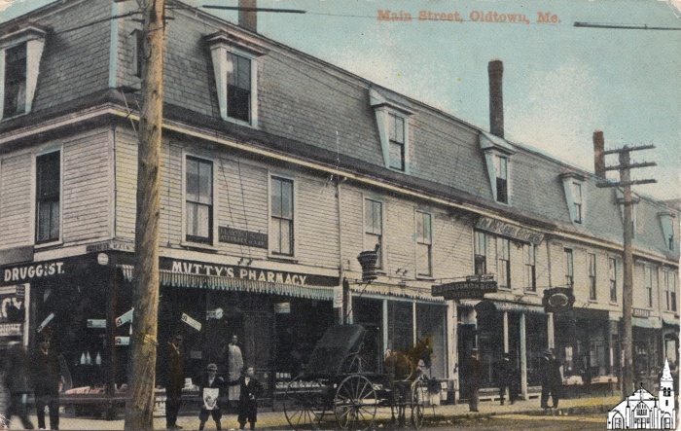
Folsom Block [Old Town, 1907-1912] (OBJ.O.1992.112a)
Photo of the NW-corner of Center and Main Streets, depicting the Folsom block with Mutty's Pharmacy, A.J. Goldsmith & Co. and the Old Town Enterprise offices (which were over Keith's Shoe Store) clearly visible. Since A. J. Goldsmith's was established in 1907 and the postcard's postmark is of 1912, the photo must have been taken between 1907 and 1912.

Slide 772
Old Town High School [before 1910] (OBJ.O.1992.112b)
Postcard showing the Old High School before the addition of 1910. One of four postcards depicting scenes from Old Town and Milford.

Slide 773
McKinley School (OBJ.O.1992.117)
Bluish photo, possibly a cyanotype, of the McKinley School in winter

Slide 774
McKinley School (OBJ.O.1992.119)
Photo of the McKinley School.

Slide 775
Class at McKinley Elementary School [1900-1910] (OBJ.O.1992.127)
Photo of an elementary school class at McKinley Elementary School. The back says that Ellen Davis is the girl at the center. This would be Ellen Margaret Davis, a daughter of Major Davis, who was born in 1892, putting the date of the photo in the early 1900s.

Slide 776
Photograph of a Big Sachem Parade Float for Old Town Woolen Co. [1933 approx.] (OBJ.O.1992.136)
A sepia photograph of a truck-bed float that was part of Old Town, Maine's Big Sachem Parade around 1933. It advertises Old Town Woolen Co., with four adult and two child performers using textile tools (e.g. spinning wheel, yarn winder, and a loom). The back of the photo identifies the performer at the spinning wheel as Barbara Lancaster.

Slide 777
Old Town Canoe Building [?] (OBJ.O.1992.147)
Two-tone photograph of the Old Town Canoe Building. Probably a newspaper or magazine clipping.

Slide 778
Unpaved Main Street, Old Town, ME (OBJ.O.1992.148)
A copy of a sepia photograph, likely originally taken in the early 20th century. It depicts Old Town, ME's unpaved main street, along a residential block intersecting with Middle St. Short plank bridges cross the drainage ditches on either side of the street in front of each house. One side of the street is lined with telephone or electrical poles and has a sidewalk, where the more steeply sloped side does not.

Slide 779
Hair Net [1940s] (OBJ.O.1992.55)
A nylon hair net by Jac-o-net. Patented 1946. Packaging reads "Your Best Bet...Jac-o-net; The Truly Invisible Hair Net Fits Any Hair Style." "10¢" "Guarantee; This net is expertly shaped and carefully inspected. It is guaranteed to be perfect." "Bob Size With Elastic For Short Hair; French Type Tiny Mesh." "Nylon; White; Run Resistant; Dura Finish." Originally from the estate of Florence Latno; connection to Old Town unclear.

Slide 780
Hair Net [1950s] (OBJ.O.1992.56)
A hair net by Lorraine. Apparently of a style sold in the 1950s. Packaging reads "Regular Size; White; Lorraine; Human Hair Style; Hair Net; Invisible." "Lorraine is the largest selling hair net in the world!" "There is a Lorraine net for every purpose! In all hair shades -- including grey and white." "15¢" "Guarantee: if this Lorraine hair net is not satisfactory, return it in this envelope, to any of our stores, and it will be exchanged without charge. -F. W. Woolworth Co." Originally from the estate of Florence Latno; connection to Old Town unclear.

Slide 781
Hair Net [1950s] (OBJ.O.1992.57)
A nylon hair net by Venida. Apparently of the style issued in the 1950s. Packaging reads "White; Regular Size; Venida Nylon Hair Net with Elastic; Super Fine Mesh...Run Resistant." "This Venida Net Has Been Sterilated." "Your Guarantee: If this net is found damaged, return it diret to us in the enclosed envelope with your dealer's name and we will send you a new net. -The Rieser Company, Inc., New York, N. Y. -- London, Eng." Originally from the estate of Florence Latno; connection to Old Town unclear.

Slide 782
Arches on Road to Pushaw Lake (OBJ.O.1992.93c)
Postcard depicting a grey dirt road wending through the green woods, on the way to Pushaw Lake, Old Town, ME. Reverse reads "Post Card; Place Stamp Here Domestic One cent Foreign Two cents."

Slide 783
Penobscot Chemical Fiber Company [1900-10] (OBJ.O.1992.93d)
Hand-Colored photo of the PCF Co. factory. On the back it says the photo was published by Alexander Fraser, Old Town, Maine.

Slide 784
Boat Ride at Pushaw Lake (OBJ.O.1992.93f)
Postcard depicting a boat on Pushaw Lake with 7 people in it.

Slide 785
Old Town High School [1900-1910] (OBJ.O.1992.93h)
Hand-colored early 20th century postcard with a photo of the Old Town High School. On the back it says the photo was published by Alexander Fraser, Old Town, Maine.

Slide 786
Center Street [1928] (OBJ.O.1992.98)
Photo of road work on Center Street. Back of the photo has a form stamp by the Portland Cement Association (33 West Grand Avenue, Chicago) with date 7/11/1928.

Slide 787
Postcards [Group of 7 Misc. Postcards] (OBJ.O.1993.103)
Seven picture postcards depicting various things and places around Old Town and Milford, ME. The cards related to Old Town and Milford show the old toll bridge in Old Town, the R.R. Station in Milford, and a carnival in Milford. Likely created in the early 20th century.

Slide 788
Cosmetic Compact [1928] (OBJ.O.1993.115)
A gold-colored metal compact inscribed with the initials AGV. Contains perforated metal powder dispenser and mirror under the lid. Patented Aug 5, 1924 by Norida. Donated by Geneviève Violette, resident of Milford.

Slide 789
Cosmetic Compact [1938] (OBJ.O.1993.116)
Silvery metal compact with hinged compartments for lipstick (inset on the lid), rouge (main compartment), and powder (beneath main compartment). Mirror on underside of lid. Made in 1938. Donated by Geneviève Violette, resident of Milford.

Slide 790
Cosmetic Compact [1920] (OBJ.O.1993.117)
A rectangular compact of brownish metal with a raised diamond pattern. Manufactured by Bourjois around 1920. Contains separate compartments for lipstick, rouge, and powder. Purchased in San Francisco by Lucy Sawyer, the aunt of donor Geneviève Violette. Violette was a resident of Milford.

Slide 791
Cosmetic Compact [1921] (OBJ.O.1993.119)
Round metal compact with embossed floral design. Contains powder, applicator, and mirror under lid. Donated by Geneviève Violette, resident of Milford.

Slide 792
Cosmetic Compact [1970] (OBJ.O.1993.120)
A light green plastic compact with white printed-on design. Labeled Avon "Rose Rachel" Powder Pak. Manufactured by Avon Products Inc., New York, around 1970. Gift of Geneviève Violette, a resident of Milford.

Slide 793
Cosmetic Compact [1930s-1960s approx.] (OBJ.O.1993.123)
A brown, rectangular cosmetic compact made of celluloid plastic. Silver embossed design. Date of manufacture unknown, estimated 1930s-1960s. Gift of Geneviève Violette, a resident of Milford.

Slide 794
Cosmetic Compact [1924 approx.] (OBJ.O.1993.124)
A silver metal compact with Art Deco design and floral logo. Brand Cara Nome manufactured by Langlois of New York 1920s-1930s. This compact dates to approximately 1924. Contains powder, mirror, and applicator. Gift of Geneviève Violette, a resident of Milford.

Slide 795
Cosmetic Compact [1939-1949 approx.] (OBJ.O.1993.125)
A square silver Coty brand compact, likely made during or shortly after the Second World War, approximately 1939-1949. Gift of Geneviève Violette, a resident of Milford.

Slide 796
Cosmetic Compact [1930s-1960s approx.] (OBJ.O.1993.126)
A maroon celluloid plastic compact with the initials C.G. on the lid in looping script. Contains powder and applicator. Date of manufacture unknown, but may have been 1930-1960. Gift of Geneviève VIolette, a resident of Milford.

Slide 797
Cosmetic Compact [1930s-1960s approx.] (OBJ.O.1993.127)
A cream and brown celluloid cosmetic box containing loose powder. Manufacturer and date of manufacture unknown, but likely 1930s-1960s. Gift of Geneviève Violette, resident of Milford.

Slide 798
Cosmetic Compact [1930s approx.] (OBJ.O.1993.128)
A brass compact manufactured by Primrose House of New York, likely in the 1930s. Raised primrose design on the lid. Contains rouge and mirror. Gift of Geneviève Violette, resident of Milford.

Slide 799
Stillwater Bridge [Colorized Photo] (OBJ.O.1993.130)
A colorized photo of the Stillwater Bridge which replaced the wooden covered bridge removed in 1951. Date of photograph and creator are not known.

Slide 800
Delia Talon Report Card [1908] (OBJ.O.1993.24)
St. Joseph's School 5th-grade report card for Delia Talon (1895-1993) for the school year 1907-8.

Slide 801
OTHS [Track Team, 1929] (OBJ.O.1993.34)
Photo of OTHS 1928-9 Track Team. No further information available.

Slide 802
Aerial View of Penobscot River, Great Works Dam, and Old Town [Postcard, 1890s] (OBJ.O.1993.40)
A black and white picture postcard, likely created in the late 1890s. It shows an aerial view of Old Town, ME and the Penobscot River. Part of what appears to be a biplane wing is captured at the far right of frame. A caption for the photograph reads, "View of Oldtown Taken from Aeroplane."

Slide 803
J. J. Newberry Co. Dime Store [Photograph, 1930s] (OBJ.O.1993.42)
A black and white photograph of Main Street, Old Town, ME, taken in March, 1939. Depicts the J. J. Newberry 25 cent store and a person crossing the snow-covered street. The wheel of a car in motion is visible, blurred, entering the frame from the left.

Slide 804
J. J. Newberry Store (OBJ.O.1993.43)
Photograph of the J.J. Newberry Company dime store on Main Street during winter time.

Slide 805
Dress Decoration (OBJ.O.1994.40)
A 54-inch long, narrow white ribbon studded with numerous rhinestones. Used as a dress or hat accent. Likely worn in the 1950s; connection to Old Town unclear.

Slide 806
Gleason's Pictorial Companion [1854] (OBJ.O.1995.24)
Framed original of p.312 of Vol.6 of Gleason's Pictorial Drawing-Room Companion with two engravings of Indian Island as seen from the ferry landing, sketched by a young Samuel Smith Kilburn (1831-1903) and engraved by A.B. (?) along with some (rather minimal) accompanying text. This page was part of No. 20 of that year, which issue was published on May 20, 1854. Kilburn went on to become a well-known illustrator. The American Antiquarian Society in Worchester (MA) still holds his sketchbooks from 1855 to 1860. No earlier sketchbooks appear to have survived.

Slide 807
Old Town Victory Parade [August 17, 1946] (OBJ.O.1995.25)
Batch of nine photos of the Old Town Victory Parade of August 17, 1946. Floats depicted include Iwo Jima and Spirit of '76. One picture has the Strand Theatre for its backdrop (featuring the 1946 movie "Janie got married" with Joan Leslie).

Slide 808
Bicycle License Plate [1944] (OBJ.O.1995.39)
A square metal license plate for a bicycle. It was issued in Old Town, ME in 1944.

Slide 809
Keychain Hanger [Otis Labree Adware] (OBJ.O.1995.47)
Leather keychain hanger with the sheriff badge and "Otis N. Labree" on the one side and "Thank You For Your Support. Re-Elect OTIS N. LaBREE Sheriff" on the other side.

Slide 810
Black Leather Wallet (OBJ.O.1995.48)
A leather wallet with two clasped metal compartments. Age and connection to Old Town unclear.

Slide 811
Old Town Furniture Co. Invoice Pad (OBJ.O.1995.7)
A carbon copy pad for ordering furniture from Old Town Furniture Co., likely used in the 1970s-1990s. An insert at the back of the pad reads, "Old Town Furniture Co. Founded in 1915 by Wirt Brown on 160-161 No. Main St., Old Town. Sales of home furnishings."

Slide 812
Bickmore Gold Star Insect Repellant (OBJ.O.1996.07)
A Bickmore Gold Star Insect Repellant bottle, likely produced in the 1910s. Bickmore Co. started in Old Town, ME in 1882 with their original Gall Salve and expanded their production line in 1892 after incorporation. This bottle reads "The Bickmore Company, Old Town, Maine." Active ingredients: Technical Piperonyl Butoxide consists of (butyl carbityl) (6-propylpiperonyl) ether and related compounds; Pyrethrins. Inert Ingredients: Water, Petroleum distillate, Polyoxyethylene Sorbitol oleate-laurate. Label includes ad copy for other Bickmore products XYZ Ointment and EXODR.

Slide 813
In Memorium [Poem by Janie Michaels] (OBJ.O.1996.08)
A folded paper pamphlet with a sepia photograph of the two-lane covered bridge over the Stillwater River affixed to the front cover. The cover reads "In Memorium By Janie Michaels." On the remaining pages follows a twelve stanza poem about the bridge's role in history (particular attention paid to the Civil War period and the Second Maine Cavalry Regiment of the Union Army) and this contextual information: "[the poem] Published June 16, 1944 in Bangor Daily News or The Penobscot Times. Bridge was built in 1835. They started to tear it down, September, 1951. Finished tearing it down in July, 1952."

Slide 814
Blotter [1910s-30s, approx.] (OBJ.O.1996.120)
A cardboard inkblotter. It reads, "Washington Underwriters of National LIberty Insurance Company of America. W. H. Powell, Agent," followed by "19 No. Main Street Old Town, Maine." National Liberty Insurance Company of America was active in the first half of the 20th century.

Slide 815
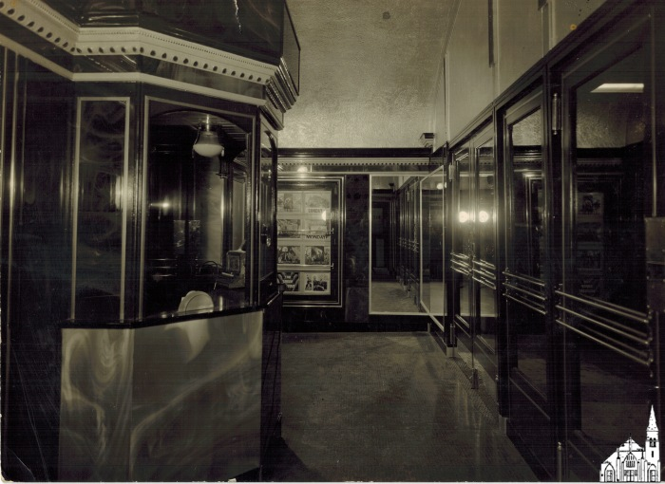
Interior of Strand Theater (1939) (OBJ.O.1996.125)
Photograph of the lobby of the Strand Theatre on South Main Street. Notice the lobby cards in the back for the 1939 Bible-retelling hit "The Green Pastures".

Slide 816
Sorting Gap on Penobscot [Postcard] (OBJ.O.1996.133)
An old postcard (1910-1930) depicting a sorting gap on the Penobscot River in black and white and captioned in white font "Sorting Gap on Penobscot."

Slide 817
Center Street, Old Town, ME [Postcard] (OBJ.O.1996.134)
A black and white photo postcard printed by American Art Post Card Co., Brookline, Mass., likely in the early 20th century. A caption on the front reads, "Center Street, Old Town, Maine." The street is wide, lined with early 20th century motor cars parked by the sidewalks in front of shops and pedestrians. Visible signs read, "Old Town Hardware" and "Monigan."

Slide 818
The Eagle House [Postcard, 1930s?] (OBJ.O.1996.151)
A postcard from approximately 1930-40. The front is a photograph also seen in musuem object OBJ.O.1996.56, a 1914 advertising card for The Eagle House hotel, hence the image is much older than the postcard. In it, a horse-drawn carriage is parked in front of the two-storey building, with people standing on the sidewalk out front and on the second floor balcony. A taller building, seen behind The Eagle House, is likely The Fransway Hotel, which Augustus G. Perro built onto the back of the older business in 1912 and which was located on Main Street until burning down in 1953. This postcard is captioned, "Eagle House A G Pero (sic.) Prop." and "Old Town ME."

Slide 819
Sockalexis Running Team [Photograph, 1914] (OBJ.O.1996.152)
A black and white photograph of the Sockalexis Running Team, likely taken in the 1910s. The team are seven men wearing white uniforms standing in a row in front of a chalk line. A large crowd of people stands behind them. Conceivably, this photo was taken on August 22, 1914, dubbed Sockalexis Day, in support of Andrew Sockalexis (1892-1919), the Olympian runner who grew up on Indian Island, Maine. The day was organized as a fundraiser to help Sockalexis cover the costs of his tuberculosis treatment. An annotated, low-resolution version of the same photo was also be found at https://noshistoiresdelile.org/pictures/h-312.jpg

Slide 820
Shaving Mirror (OBJ.O.1996.2)
A dresser-top shaving mirror brought from England in 1847. Connection to Old Town unclear.

Slide 821
Indian Island (OBJ.O.1996.50)
Photo of Indian Island viewed from roughly the foot of the current bridge to Indian Island. With several canoes on the river. St. Anne's Church is on the far right.

Slide 822
The Eagle House Advertising Card [1914] (OBJ.O.1996.56)
An advertising card from 1914 for The Eagle House, a hotel and meeting venue in Old Town, ME. The front features a photograph of a horse-drawn carriage in front of the hotel, five women standing on the second floor balcony, five men and a dog on the sidewalk out front, and more men leaning out of windows. Surrounding the photo are details and descriptions of the hotel's amenities: "Entrance on Main and Water Streets." "A. G. Perro, Prop." "Electric Lights, Electric Bells, Bath Room." "Special Rates to Theatrical People." "Private Dining Room . . American and European Plan." The back of the card features a poem, likely by local character John F. Young, who printed and distributed his poems to passersby in the 1910s, titled 'The Eagle House in Old Town, Maine.' The poem is seven stanzas, each four lines long. The last line of each stanza ends with "the Eagle House in Old Town, Maine." This use of repetition is found in other poems by Young. Augustus G. Perro, proprietor, expanded his Main Street location into the four storey Fransway Hotel, which outlasted The Eagle House but was destroyed by fire in 1953.

Slide 823
Gould House [Reproduction Photograph] (OBJ.O.1996.67)
A photocopy, made in 1996, of a black and white photograph originally taken in July, 1957. It depicts the Gould House at 192 Water St. in Old Town, ME. The large, yellow house had 22 rooms and "was taken over by White Canoe for the land" according to the image donor. In the foreground, the land immediately in front of the Gould House is crossed by three rail tracks.

Slide 824
Covered Bridge over the Stillwater [Postcard, 1930s-40s] (OBJ.O.1996.79)
A brightly colored postcard, whose illustration depicts the covered "double-barrel" bridge over the Stillwater in Old Town, removed in 1951. The card was probably made 1930-45, as it was manufactured by the Tichnor Brothers, Boston. The Tichnors produced a series of postcards of American landmarks during these years.

Slide 825
Braves Cheerleading Team [1956] (OBJ.O.1996.82)
Photo of six members of the Braves Cheerleading Team: C(alista) Sargent, E(velyn) Ingalls, D(olores) Robbins, J(oyce) Boardman, J(eannette) Boardman, and P(rudence) Grant, all OTHS Class of 1956.

Slide 826
OTMS Brass Band (OBJ.O.1996.86)
Photo of an eight member Old Town "Junior High" brass band, taken in the basement of the Helen Hunt School.

Slide 827
OTJH Band (OBJ.O.1996.89)
Photo of a "28-piece Junior High Band" including students and adults (teachers?). Taken on a gym floor in front of a sagging backdrop.

Slide 828
"Perkins the Shoeman" Shoe Horn (OBJ.O.1997.13)
A hardened leather shoe horn. It reads "Compliments Perkins the Shoeman; Old Town, Maine." Indeterminate age, but likely mid-20th century.

Slide 829
Matted and framed photo of the PCF plant (OBJ.O.1997.17)
Matted B/W photo of the PCF plant. Framed by S. Alpert in Boston. On the back it says that the photo was from the collection of Gust Johanson, assistant supervisor of the Sulphite Mill.

Slide 830
Center Street, Old Town [Reproduction] (OBJ.O.1997.19)
Reproduction picture of early 20th century Old Town ME's Center Street, printed in 1997. Copy of a black and white photograph, featuring two men in suits and hats. Original date of photograph and photographer unknown.

Slide 831
Jail Key [1950s] (OBJ.O.1997.2)
Brass Key made by the Decatur Iron & Steel Co. of Decatur, AL (1906-present) with Tag #19. Used in the Old Town City Jail.

Slide 832
Main Street, Old Town [Reproduction Image] (OBJ.O.1997.20)
Picture of early 20th century Old Town ME's Main Street, printed in 1997. Apparently a copy of an illustration rather than a photograph, artist unknown.

Slide 833
Jail Key [1950s] (OBJ.O.1997.3)
Brass Key made by the Decatur Iron & Steel Co. of Decatur, AL (1906-present) with Tag #20. Used in the Old Town City Jail.

Slide 834
Robert D. Linn, Confections Cigar Box [1880s-1900s?] (OBJ.O.1997.68)
A brown cardboard box labeled 'cigars' on the back and 'Robert D. Linn, Confections and Fancy Groceries, Tobaccos and Cigars. Try our famous 5 cent smoke. 129 Main Street, Old Town, ME.' on the front. The confectioner Robert D. Linn was born in Scotland in 1850 and already established in business in Old Town by 1892, when Holman Harry Flannery's mother Lucretia A. Currier married Linn. H. H. Flannery adopted his stepfather's name shortly after the 1900 census, later founding the Linn Manufacturing Co. in Morris, NY, known for the Linn Tractor. This cigar box was found in the wall of an Old Town house.

Slide 835
Stillwater Bridge Seasons Greetings Card (OBJ.O.1997.75)
A ripple-edged card with the caption "Seasons Greetings" under a black and white photograph of the covered wooden bridge over the Stillwater River. The back is signed by Samuel B. Gray, likely the doctor Samuel Braley Gray (1881-1961) from Old Town, ME, which might place the creation or use of this card in the earliest decades of the 20th century. This "double barrel" bridge was removed in 1951.

Slide 836
Autograph Book [1880s] (OBJ.O.1998.16)
An autograph book owned by Annie B. Hastings in the 1880s, used as a high school yearbook to collect notes from classmates. Annie was born in 1871 and married Ernest Jordan. Annie and Ernest were grandparents to Old Town local Edith Jordan Huntley Merrill. Due to its fragility, the yearbook cannot be transcribed in its entirety, but a sample note reads, "Sincerely your friend, Ethel F. Hunton, Milford, Maine, Jan 18, 1885." The book cover is brown cloth embossed with a white lily.

Slide 837
Chain Link Purse (OBJ.O.1998.27)
A small coin purse made of flexible "chainmail" links. The donor recalls carrying this as a child in 1920. Connection to Old Town unclear.

Slide 838
Silver Locket (OBJ.O.1998.28)
A rectangular locket, fabric-lined, apparently for keeping small objects (coins?) rather than portraits. Probably made in the early 20th century, around 1920-30. Connection to Old Town unclear.

Slide 839
2nd Maine Infantry [Company K, ??] (OBJ.O.1998.9)
Scanned photo by A.F. Orr of Company K of the 2nd Maine Infantry. During August 1917, Orr was at Fort Keyes (August, ME) to photograph various Maine regiments as they were mobilizing. Therefore, it seems likely that this particular photo was taken there. A recent photo by Orr of Company K is explicitly mentioned in the Old Town Enterprise of August 25th. The 2nd Maine Infantry was sent overseas in September 1917.

Slide 840
Folsom Drug Store [Cancelled Checks, 1900] (OBJ.O.1999.12)
A set of 24 cancelled checks from Folsom & Co., Druggist in an Eastern Trust and Banking Co. envelope, part of the estate of Mark Melville Folsom (1836-1900). Before Folsom's Drugs with his brothers, Major M. M. Folsom fought in the 11th Maine Regiment during the Civil War. In 1871, he also established the Hersey Light Infantry in 1871, a division of the state militia based in Old Town.

Slide 841
Folsom Drug Store [Check Stubs, 1892-1894] (OBJ.O.1999.13)
A booklet of check stubs written by Major M. M. Folsom for his drug store business between 1892 and 1894. Each page is headed "Amount brought forward." Folsom Drug was an Old Town institution until Folsom's death in 1900.

Slide 842
Folsom Drug Store Check Stubs [1894-1896] (OBJ.O.1999.14)
A booklet of check stubs written by Major M. M. Folsom for his drug store business between 1894 and 1896. Each page is headed "Amount brought forward." Folsom Drug was an Old Town institution until Folsom's death in 1900.

Slide 843
Checkbook of J. M. Robinson [1901-1905] (OBJ.O.1999.16)
A large book with brown, marbled cover containing tear-away checks issued by Eastern Trust and Banking Co. for J. M. Robinson of Old Town, ME. There are handwritten stubs of used checks from 1901-05 and two pages of unused checks.

Slide 844
Taxi Driver's Metal Badge (OBJ.O.1999.26)
A metal pin that reads, "Taxi Driver 10 Old Town; expires April 30, 1965." These types of "chauffeur badges" were adopted in the early 20th century but had begun to be replaced by cheaper paper licenses by the 1950s.

Slide 845
Davis Drug Store Wooden Sign [1 of 2] (OBJ.O.1999.55a)
A wooden sign, painted black, in the shape of a mortar and pestle. Used at Davis Drug Store. Davis Drug Store was located on Main Street in Old Town and closed in the early 1980s.

Slide 846
Davis Drug Store Wooden Sign [1 of 2] (OBJ.O.1999.55b)
A wooden sign, painted black, in the shape of a mortar and pestle. Used at Davis Drug Store. Davis Drug Store was located on Main Street in Old Town and closed in the early 1980s.

Slide 847
Main Street, Old Town [Card-backed Illustration] (OBJ.O.1999.92)
A color illustration, possibly a postcard, glued to a backing made to look like a wooden frame. Consequently, only the front is visible. This is a line drawing of Old Town's Main Street in the late 19th or early 20th century. A caption beneath reads, "Main St. Oldtown, ME." It is numbered 5558.

Slide 848
Beaded Dress Accent (OBJ.O.2000.11)
A decorative circle of fabric covered in a symmetrical "pie chart" bead pattern of identical "slices" with one central button of faceted plastic. Accentuates a matching draped silk dress. Both dress and beaded accent were handmade by Nellie F. Violette in 1920. Connection to Old Town unclear.

Slide 849
Infrastructure Improvement [5 Photos, 1980] (OBJ.O.2000.26)
A set of five photo prints taken by George Desjardins in 1980. They are various shots of construction equipment working to move a steel, girdered bridge near Main Street, Old Town. This may be a project undertaken as a result of the Highway and Bridge Improvement Program passed in 1979 and active from fiscal years 1980-83.

Slide 850
Old Town Soda Co. Glass Bottle (OBJ.O.2000.31)
A clear glass bottle reading "REGISTERED OLDTOWN SODA CO., OLD TOWN, ME." Likely produced and used in the early 1900s.

Slide 851
Old Town Soda Co. Glass Bottle (OBJ.O.2000.33)
A clear glass bottle reading "REGISTERED OLDTOWN SODA CO., OLD TOWN, ME." Likely produced and used in the early 1900s.

Slide 852
Old Town Soda Co. Glass Bottle (OBJ.O.2000.34)
A clear glass bottle reading "OLDTOWN SODA CO., OLD TOWN, ME." Likely produced and used in the early 1900s.

Slide 853
Old Town Soda Co. Glass Bottle (OBJ.O.2000.35)
A clear glass bottle reading "OLDTOWN SODA CO., OLD TOWN, ME." Likely produced and used in the early 1900s.

Slide 854
Fransway Hotel (Fire, 2001) (OBJ.O.2001.1)
Scan of a photograph of the 1953 fire that destroyed the Fransway Hotel in Old Town.

Slide 855
Garford Fire Truck (1917) (OBJ.O.2001.11)
Scan of a photograph of a 1917 Garford Fire Truck (according to label), presumably in Old Town.

Slide 856
Stillwater Fire Barn (OBJ.O.2001.14)
Scan of a photograph of the Stillwater Fire Barn (according to label)

Slide 857
American LaFrance Fire Truck (1939) (OBJ.O.2001.15)
Scan of a photograph of an American LaFrance Fire Truck (according to label), presumably in Old Town

Slide 858
Howe Pumper Fire Truck (1972) (OBJ.O.2001.16)
Scan of a photograph of an 1972 How Pumper Fire Truck (according to label), presumably in Old Town.

Slide 859
American LaFrance Fire Truck (1959) (OBJ.O.2001.18)
Scan of a photograph of a 1959 American LaFrance Fire Truck (according to label), presumably in Old Town.

Slide 860
Button Streamer Fire Truck [1885] (OBJ.O.2001.2)
Low-resolution scan of a photograph of unknown origin depicting a horse-drawn fire truck with officers. The glued-on label reads "1885 Button Streamer".

Slide 861
American LaFrance Fire Truck (1920s) (OBJ.O.2001.4)
Scan of a photograph of an American LaFrance Fire Truck (according to label), presumably in Old Town.

Slide 862
Stillwater Bridge (OBJ.O.2001.42)
Copy of an older, tinted photo of the covered Stillwater Bridge in matting and framed with glass cover. On the back of the frame is a typed-up write up on the history of the bridge. The write-up also mentions that the tinting was done by Abbie M. Fowler of Sangerville, ME (1880-1971), a Kindergarten and first grade teacher who was well-known for her tinting work. Additionally, the back has a stamp with the name Warren Spruce (of Bradley).

Slide 863
Stillwater Covered Bridge [1951 Photograph] (OBJ.O.2001.43)
A black and white photograph taken September, 1951 by Frederick L. Youngs of Bangor, Maine. It depicts the interior of the Stillwater River covered bridge before its removal that year.

Slide 864
Old Town Photographs [(20) Color Photos, 2001] (OBJ.O.2001.47)
Twenty color pictures taken around Old Town, ME in 2001 by Anthony J. Harkins of Houston, TX. Most depict buildings of historical or public interest, e.g. the library, Old Town Museum, Old Town Canoe, various houses, and Main Street. Three are pictures of a John Deere bulldozer working on an unspecified construction project.

Slide 865
Old Town: The Gateway to Northern Maine [Chamber of Commerce Brochure] (OBJ.O.2001.53)
A tourist and new resident brochure describing Old Town as "The Gateway to Northern Maine," offering "Diversified Business Opportunities; Superior Educational Advantages; and Unexcelled Recreational Facilities." Published by Penobscot Press; likely in the early 1960s based on wording, font, and the history of the publisher; the brochure lauds Old Town as a seat of local industry and culture. Its introductory sentence reads, "The Chamber of Commerce and the people of Old Town extend a cordial invitation to everybody to visit the gateway to Northern Maine; to see its canoe factories, woolen mills, pulp and paper plate mills, lumber and box mills, visit its theatre, its stores, its churches, schools, and parks; drive their cars through this land of nature--of mountains, lakes, streams, fighting fish, of deer, moose and all wild life, where your dreams crystalize into realities." The presence of a theatre at time of publication supports the likelihood that this brochure came out in the early 1960s, possibly the late 1950s. Old Town's The Strand Theatre on Main Street had been in operation since the 1900s and modernized in the 1930s, but did not operate beyond the early 1960s.

Slide 866
Leather Eyeglass Case And Brass-Framed Spectacles (OBJ.O.2001.55)
Made around the turn of the 20th century, this leather sleeve with flap closure holds brass-rimmed glasses that appear to have slightly tinted lenses. Connection to Old Town unclear.

Slide 867
Leather Key Case With C. H. Jellison Imprint (OBJ.O.2001.57)
A leather case with six hooks for hanging keys. Skeleton keys are hung from three hooks, two are empty, and one holds an imprinted steel tag reading "C. H. Jellison; Court No. 1186; I. O. F. ; Old Town ; ME." where semicolons denote line breaks. It also features a small stag's head illustration between the word Court and No. 1186, as well as four other small diamond-shaped embellishments. C. H. Jellison appears to have been an Old Town general store in the 1890s.

Slide 868
Burnham Drug Bottle Stickers [1860s- approx.] (OBJ.O.2002.06)
H. M. Burnham, Apothecary was established in Old Town in 1861. Burnham Drug operated through the end of the 20th century, but these bottle stickers, labeling various common prescriptions, appear to date to the company's earliest decades. The five stickers are for spirit of camphor, spirits of peppermint, castor oil, epsom salt, and "sweet oil." The latter is "used as a food and laxative for children." All are branded Burnham Drug Co. Apothecaries - Old Town, Maine.

Slide 869
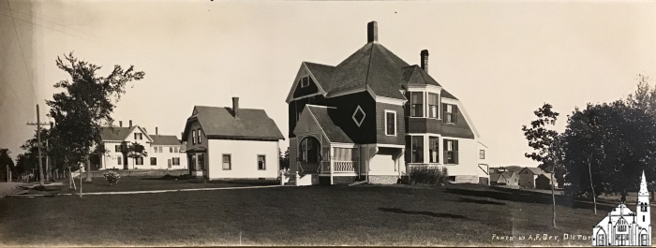
Three Houses [c.1920] (OBJ.O.2002.1)
Panoramic view of three houses by A.F. Orr. Location unknown, but most likely not the Old Town area.

Slide 870
Diary and Accounts U.S. P.O., Old Town, ME [1913] (OBJ.O.2002.11)
The Diary and Accounts book of Treasury Dept. superintendent Sid H. Nealy documenting the construction of Old Town Post Office in 1913. Nealy's handwritten index of the contents reads: General Statement........... A. Diary.................................. B. General Contract account C. Miscellaneous contracts.. D. Vouchers issued............... E. Transportation requests... F. Certificates forwarded..... G. Requisitions for Funds..... H. Visits from Inspectors....... I. Unnecessary Delays......... K. (J. is skipped) Unavoidable Delays.......... L. Delays on account of [illegible, possibly "nature"]... M. Index tabs are glued to the tops of the relevant pages.

Slide 871
Three Women [Photograph] (OBJ.O.2002.41)
A black and white studio photograph, likely taken in the 1930s or 40s by Myers Studio in Old Town, ME. The subjects are three women, identified as Jennie Martin, Vera White Snow, and Mamie Rossignol Leveille.

Slide 872
Postcard to Joyce Leveille from Marie Pinette [June 1923] (OBJ.O.2002.42)
A photo postcard postmarked from Old Town, ME in June, 1923. The message reads, "Hi Joyce, Do you know who the guys are on the Post card [sic.]. If you don't ask your father. Ma told me to send this to you. She has another one for herself. BYE Marie Pinette." It's addressed to Miss Joyce Leveille, 37 Pearl St., Bangor, ME. The picture on the postcard is a black and white portrait of two young men in suits and neckties, presumably members of the Leveille family.

Slide 873
Lillian Leveille Snell [Photograph] (OBJ.O.2002.45)
A black and white 1/2 portrait by Myers Studio of Old Town, ME, likely taken in the early 1900s. The subject is Lillian Leveille Snell as a young woman. She wears three strands of pearls and a shortsleeved dress with large corsage on her left shoulder.

Slide 874
Nathalie Leavitt Leveille [Photograph] (OBJ.O.2002.46)
A studio photograph in black and white of Nathalie Leavitt Leveille. She is seated in half profile with her face turned towards the camera. Her left hand is visible, as is her plain band wedding ring. Her dress is a dark, unpatterned fabric with full skirt, buttoned bodice, and semi-sheer sleeves. Mrs. Leveille was born July 23, 1860 and died aged 75 on July 21, 1936. She is buried beside her husband Emile in Old Town's Forest Hill Cemetery. Their children were Victor Leveille, Rudolph "Duffy"Leveille, Virgil Leveille, Lillian Leveille Snell, Delcina Leveille Deering, and Evelyn Leveille LaForge. The date of this photograph is unknown, but may have been taken in the 1890s-1910s.

Slide 875
Lillian Leveille [Photograph ca. 1924] (OBJ.O.2002.47)
A reproduction of a black and white photograph by an unknown photographer. Writing on the back identifies the subject as Lillian Leveille, circa 1924. Further description reads, "In front of home at 47 Bradbury St., Old Town. She later married Augustus Snell."

Slide 876
Emile and Nathalie Leavitt Leveille [Photograph 1920s] (OBJ.O.2002.48)
A reproduction of a sepia photograph taken by an unknown photographer, likely in the 1920s. Writing on the back identifies the subjects as Emile and Nathalie Leavitt Leveille. In the photo they are a middle-aged couple in winter coats, standing in front of a porch which is identified on the back as 47 Bradbury St., Old Town. Nathalie Leavitt Leveille has her hands in a large fur muff.

Slide 877
Leveille Group Photo [1920s] (OBJ.O.2002.49)
A sepia group portrait of five members of the Leveille family, taken by an unknown photographer likely in the 1920s. Writing on the back identifies the people in the back row as "Father - Emile Leveille and Mother - Nathalie Leavitt Leveille" and in the front row as "Sadie St. Peter Leveille, husband Virgil Leveille, and Delcina Leveille." They appear to be standing in front of their home at 37 Bradbury St., Old Town.

Slide 878
Collection of Leveille family photos [1920s-40s] (OBJ.O.2002.51)
Around 68 photographs and photo reproductions from the 1920s-1940s. The predominant subject is Mamie Rossignol Leveille, though miscellaneous members of the Leveille family and locations around Old Town appear.

Slide 879
Collection of Leveille family photos [1920s] (OBJ.O.2002.52)
Around 35 photographs and photo reproductions from the 1920s, approximately. The predominant subject is Lillian Leveille and the house at 37 Bradbury St., Old Town, though miscellaneous members of the Leveille family and locations around Old Town appear.

Slide 880
Collection of Leveille family photos [1920s-40s] (OBJ.O.2002.53)
Around 98 photographs and photo reproductions from the 1920s. The predominant subject is Victor Leveille, though miscellaneous members of the Leveille family and locations around Old Town appear.

Slide 881
Explosion on Center St. [Photograph] (OBJ.O.2003.1)
A black and white photograph of people sifting through the debris left after the explosion of Center Street Market that took place early on Tuesday, February 13, 1951 in Old Town, Maine. Four people in the picture are standing in the blast zone, looking down, while numerous other adults and children surround the scene, watching and talking to each other. The date the photograph was taken is not known, and only six of the more than 20 people in the picture are identified by name. They are Harland Shepherd, Jeannette Shepherd, Bernard Shepherd, Chester Shepherd, Mrs. Dyer, and Mr. Mymouth.

Slide 882
Center Street Explosion, Home Interior [Photograph] (OBJ.O.2003.2)
A black and white photograph taken after the explosion of Center Street Market early on Tuesday, February 13, 1951 in Old Town, Maine. It shows extensive damage to the interior of Chester Shepherd's house, which had been located next door to the market. Most of the wallpaper in what appears to be a living room was blasted inwards, revealing the lathe and plaster wall construction. In this shot a man, possibly Chester Shepherd, holds a broken piece of window frame up to where it should fit into the whole.

Slide 883
Pair of Sap Spigots (OBJ.O.2003.22)
A pair of metal taps or spigots for getting sap out of trees. Approximate date of origin, 1900s-1930s.

Slide 884
Eastern Trust and Banking Co. Dime Rolls (OBJ.O.2003.45)
Three unused paper rolls for $5 worth of dimes, bearing the label "Eastern Trust And Banking Co. Bangor - Brewer - Old Town - Machias. Complete Banking Service. Established 1887." The Eastern Trust was sold in 1969, so these rolls could date to any time between 1887 and 1969, but are likely from the late 19th or early 20th century to the 1940s, based on paper quality. The former location of the Old Town branch of Eastern Trust and Banking Co., opened on June 8, 1887, can still be seen at the corner of Main and Center Streets.

Slide 885
Stillwater Bridge [Aerial Photo] (OBJ.O.2003.82)
A framed, black and white aerial photograph of Old Town, ME. It centers the Stillwater River and covered bridge across it, dating the picture to before that bridge's removal in 1951.

Slide 886
Button Hook [One of Pair] (OBJ.O.2003.89)
A steel button hook of the kind often used to button up ladies' boots in the mid 19th-early 20th centuries. Features some decorative imprinting around the handles. Connection to Old Town unclear. Apparently identical to OBJ.O.2003.91

Slide 887
Button Hook [One of Pair] (OBJ.O.2003.91)
A steel button hook of the kind often used to button up ladies' boots in the mid 19th-early 20th centuries. Features some decorative imprinting around the handles. Connection to Old Town unclear. Apparently identical to OBJ.O.2003.89

Slide 888
Rug Hook [?] (OBJ.O.2003.92)
An antique pin with porcelain head. Identified as a rug hook that belonged to a "Mrs. Elizabeth Coffin," but could also be a hat pin or something similar. Connection to Old Town unclear.

Slide 889
Account Book [1910] (OBJ.O.2004.49)
An account book from May-August, 1910. It tracks routes and fares over that time of either coach or train journeys. Relation to Old Town unknown. On the inside front cover is a simple drawing of a man in a hat.

Slide 890
Photograph Album [1900s-1920s] (OBJ.O.2004.54)
An album of numerous postcards from various places and photographs from around Old Town. Includes poetry by Sarah Jane Freese. Most material within probably dates to the first two decades of the 20th century. About 25 pages, all filled on both sides. Original owner and creator unknown.

Slide 891
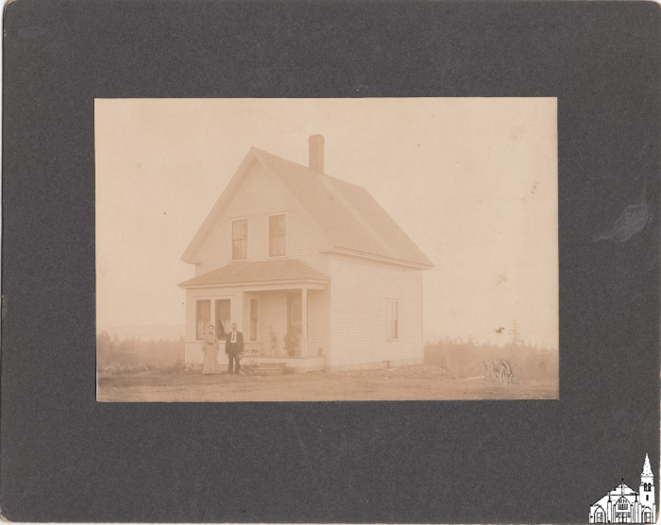
Minnie Freeze's House [1904-1921] (OBJ.O.2004.56.1)
Couple in front of their farmhouse. According to the info on the back of a duplicate, the woman's name was Minnie Freeze, but no person by that name could be identified in the Old Town area. Photographer unknown, but could be Orr.

Slide 892
Minnie Freese's House [1904-1921] (OBJ.O.2004.56.2)
Couple in front of their farmhouse. According to the info on the back, the woman's name was Minnie Freeze, but no person by that name could be identified in the Old Town area. Photographer unknown, but could be Orr.

Slide 893
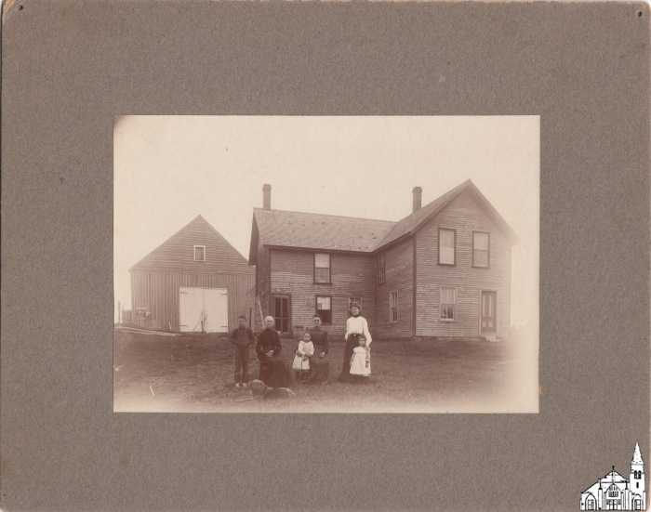
Unidentified Farmhouse [1904-1921] (OBJ.O.2004.56.3)
Unidentified family in front of a farmhouse and barn at an unknown location. According to a note on the back one of the women was "Mrs. Turtelot, Amos Webb's mother". This surely is a reference to Amos Harold Webb (1890-1971) of Bradley and his mother Anna Maria Webb Tourtlott (born Blissville, NB, c.1864), in which case Mrs. Turtelot would likely be the younger woman in the photo. The house is said to be "just above the cemetery," but there is no indication in which town. Anna lived in a number of places, including Vanceboro (1890, birth certificate for Amos), Costigan (1899, birth certificate for Marion Gladys T.), and Argyle (1900 census), before settling down in Milo (1910,1920 census). Both her husbands mostly worked as laborers. If the photo was taken in Argyle, the cemetery referred to probably would have been the Hemlock Stream Cemetery, right next to the Comstock & Leavitt Saw & Shingles mill and School #3. According to the 1875 Comstock map, the one house just north of it was a farmhouse owned by one J(ohn) Wesley Foster (1836-1892). Based on the same 1875 Comstock map, Argyle's other cemetery had a house just north of it too. However, that house belonged to Lorenzo Grant (1836-1896) and later his wife Lucy (Bussell) Grant (1841-1919). Given the social status of the Grants, the house on the photo seems a bit too modest. On the back there appear to be traces of a stamp similar to the one used by Orr.

Slide 894
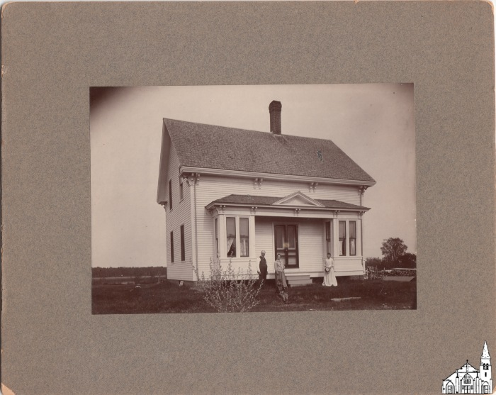
Charlie Dow House [1904-1921] (OBJ.O.2004.56.4)
Photo of the Charlie Dow House in Argyle with William (Billie) W. Brown (New Brunswick, 1843 - ?) and his wife Nettie (Freeze) (Argyle, 1847- 1933) in front. Nettie was the oldest sister of Hattie, who was married to Charlie Dow (1861-1945). Probably they were just visiting, which means the woman on the right may have been Hattie (1858-1928). Sometime in the 1890s, Charlie acquired the lot immediately north of the lot that was owned or used to be owned by Gilbert W. Freeze (1819-1896), Nettie's and Hattie's father. Most likely this was the location of the Dow house. Note the river in the background. Today, the river side of the lot (now 959 Southgate Road) appears to be a farm and/or junkyard, but there still are contours visible of what seems to have been a structure. Schoolhouse #1 would have been across the street. According to the stamp on the back, the photo was taken by A.F. Orr.

Slide 895
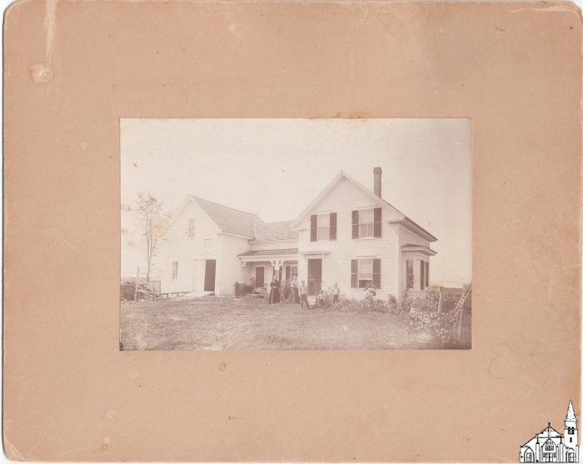
Charlotte Miles' Place [1904-1910] (OBJ.O.2004.56.5)
Farmhouse in Argyle said to be owned by Charlotte D. Howard Miles (1850-1923), the widow of Captain Charles Miles (1845-1901). Records show that she bought the Barrows lot (two lots north of the Sanborn lot) in 1898 and defaulted on her mortgage in 1910, after which she moved to Bangor where she died 13 years later. The picture shows two woman as well as three boys in front. No indication who the photographer was, but probably it was A.F. Orr.

Slide 896
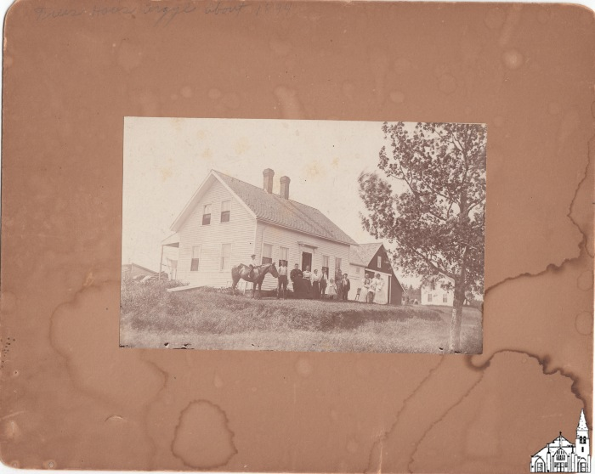
Freeze House [1896-1904] (OBJ.O.2004.56.6)
Photograph of what is described as the Freeze House in Argyle (ME) with family (and horse) in front. The exact location is not clear, but a comment on the back of a duplicate seems to suggest that the house in the back is the John Dow house. The lot to the north of John Dow's lot was in fact owned by William W. Freeze (1841-1913), a Civil War veteran and lumberman, so the photo may depict his house (although in that case the sunlight in the photo as indicated by the shadow of the chimneys seems to come too far from the north). According to the label on the back, the picture was taken by C. F. Rhodes.

Slide 897
Photo of a Logging Crew (1904-1921) (OBJ.O.2004.56.7)
Photograph of 25 men with logging equipment. Possibly taken by A. F. Orr.

Slide 898
Freese House [Interior Photograph] (OBJ.O.2004.57a)
A black and white photograph of the den in the Freese family home in Argyle, taken in the early 20th century, approx.

Slide 899
The Great Bangor Fire [Poem by John F. Young] (OBJ.O.2004.60)
A poem by John F. Young of Old Town, ME commemmorating the April 30, 1911 Great Fire of Bangor. Printed on yellow paper in two columns and priced at "10 Cents per Copy," it was apparently intended for local sale and distribution. Date of composition and date of printing not known.

Slide 900
Argyle Town Expenses (OBJ.O.2004.61)
A handwritten account book for the town of Argyle, ME.

Slide 901
Elevation Map [1880s] (OBJ.O.2005.19)
A fold-out elevation map of the river and area around PCF Mill (Penobscot Chemical Fiber Co., founded 1882), created in the late 1880s for use in the construction industry.

Slide 902
Old Town Fire Alarm Chart (OBJ.O.2005.58)
Adware. Old Town Fire Alarm Chart branded for Forest K. Moors, Insurance Service on Stillwater Avenue.

Slide 903
St. James Choir at Kukunsook Landing [1891] (OBJ.O.2005.60)
Two sepia photographs of a group of men and youths identified as members of the St. James Choir at Kukunsook Landing on Pushaw Lake. One of the men is identified as G.T.S. An article in the Penobscot Times (January 5, 2006, p.9) clarifies that this refers to George T. Sewall (1844-1909). The same article also identifies most of the others on the photos, including George's nephew James W. Sewall Jr. (1884-1946), and puts a date (1891) on the photo.

Slide 904
Dr. James C. Bradbury [Photograph] (OBJ.O.2005.61a)
A black and white headshot of Dr. James C. Bradbury, taken in the mid-19th century by M. L. Averill, Photographer, Old Town, ME. Dr. Bradbury was born in Buxton, ME on March 5, 1806. He graduated Bowdoin Medical School in 1829 and practiced medicine in Old Town, ME for 35 years. He died on October 3, 1865. His colleagues at the Maine Medical Association wrote a glowing biographical sketch of his life and achievements following his death.

Slide 905
Mrs. Dr. James Bradbury [Photograph] (OBJ.O.2005.61b)
A black and white headshot of the wife of Dr. James C. Bradbury, taken in the mid-19th century by M. L. Averill, Photographer, Old Town, ME. Little biographical information about her is available. She was born Eliza W. Smith, from Warren, ME. She and Bradbury married in fall of 1837.

Slide 906
Dr. Benjamin F. Small [Photograph] (OBJ.O.2005.62a)
A sepia headshot by M. L. Averill, Photographer, Old Town, ME. The subject is identified as Doctor Benjamin F. Small. Date of creation unknown; likely mid-19th century.

Slide 907
Mrs. Dr. Benjamin F. Small [Photograph] (OBJ.O.2005.62b)
A sepia headshot by M. L. Averill, Photographer, Old Town, ME. The subject is identified as the wife of Doctor Benjamin F. Small. Date of creation unknown; likely mid-19th century.

Slide 908
Dr. Sam Bradbury [photograph] (OBJ.O.2005.63)
A sepia headshot photograph by M. L. Averill, Photographer, Oldtown, ME, likely taken in the mid-19th century. The subject is identified as Dr. Sam Bradbury. Sam Bradbury was a relative of Dr. James C. Bradbury, also photographed by M. L. Averill, likely around the same time. This is probably James' nephew Sam rather than his brother Sam -- all three men attended Bowdoin Medical School and the class list of 1850 notes James C. Bradbury was instructor to Samuel Bradbury at that time, reinforcing the apparent age gap in the photographs. If this is indeed Dr. Samuel Bradbury, James C. Bradbury's nephew, then his parents were Samuel Crocket Bradbury (James' brother) and Miranda Page Bradbury. This Samuel Bradbury was born July 21, 1829 in Bangor, ME and died March 23, 1894 in Old Town, ME.

Slide 909
Alice Chapman [1877-1885] (OBJ.O.2005.64)
A black and white headshot photograph of a woman identified as Alice Chapman. According to its caption, the photo was taken by A. B. Carr, who was active in Old Town from about 1877 until before 1885.

Slide 910
Dr. A. P. Folsom [Photograph] (OBJ.O.2005.65)
A sepia photograph taken by Dewey's Gallery, 47 North St., Pittsfield, Mass, likely around the mid-19th century. The subject is identified as Dr. A. P. Fulsom. He is seated in semi-profile with both hands in his lap and wears a three-piece suit with pocket watch chain visible and bowtie. Dr. A. P. Folsom was the brother of Major M. M. Folsom. Both were from Old Town, ME.

Slide 911
Ira Davies [Photograph] (OBJ.O.2005.66)
A black and white headshot phototgraph taken, almost certainly in 1864, by G. H. Loomis, photographer, No. 7 Tremont Row, Boston. On the back of the photo is a bank check stamp on which Loomis rubber stamped his name and the date Nov 28, 1864. The subject is identified as Ira Davies. Davies wears a coat with large metal buttons which may be part of an army uniform.

Slide 912
Mary Edgerly [Photograph, c.1870] (OBJ.O.2005.67)
A Carte de Visite for a woman identified as Mary Edgerly. Photo taken by F. M. Hardy, photographer, Kenduskeag Block, Bangor, ME. Most likely, this was Mary O. Edgerly (1850-1897), a half-sister of Hannah Jane Edgerly, the wife of Melville M. Folsom of Old Town. Mary lived in Old Town as well.

Slide 913
Thomas O'Connor [Photograph] (OBJ.O.2005.78a)
A sepia headshot photograph, taken around 1900, by Modern Studio, 119 Center St., Old Town, ME. The subject is identified as Thomas O'Connor.

Slide 914
Thomas O'Connor [Photograph] (OBJ.O.2005.78b)
A black and white photograph, taken around 1900, by The Ramsdell Studio, Bangor, ME. The subject is identified as Thomas O'Connor.

Slide 915
Thomas O'Connor and Two Others [Photograph] (OBJ.O.2005.78c)
A black and white photograph, taken around 1900, by Howe, Old Town, ME. The subjects are three men, two standing and one seated. The seated individual is identified as Thomas O'Connor.

Slide 916
Anna Stevens O'Connor [Photograph] (OBJ.O.2005.78d)
A sepia photograph taken, likely around the turn of the 20th century, by Howe of Old Town, ME. The subject is identified as Anna Stevens O'Connor. She is shown from the waist up and leaning on an intricately woven wicker chair. She has on an embroidered coat with flared collar, gloves, and a hat with feathers.

Slide 917
Thomas O'Connor [Photograph] (OBJ.O.2005.78e)
A black and white photograph taken, likely around 1900, by an unidentified photographer out of Old Town, ME. The subject is identified as Thomas O'Connor.

Slide 918
O'Connor Woman, Unidentified [Photograph] (OBJ.O.2005.78f)
A black and white headshot photograph taken, likely around 1900, by The International Photo Co., R. M. Howe, No. 113 Main Street, Old Town, ME. The suject is an unidentified woman related to the O'Connor family, who donated this picture.

Slide 919
Old Toll Bridge [Postcard] (OBJ.O.2006.02)
A color postcard glued to a faux wooden frame, making only the front visible. It depicts a line drawing of a covered wooden bridge. A caption reads, "Old Toll Bridge, Oldtown, Me."

Slide 920
Brown Leather Wallet (OBJ.O.2006.12)
A brown leather wallet with metal button clasp with stylized flower design. Interior contains clasped compartment for coins and sleeve for bills. Age and connection to Old Town unclear.

Slide 921
Wilford Louis Spruce [Photograph] (OBJ.O.2007.02)
A black and white studio photograph taken around 1912-13 by A. F. Orr of Old Town, ME. The subject is Wilford Louis Spence as a very young child. Spence was a lifelong resident of Milford and would be the town's Postmaster from 1942-1970, having been named Acting Postmaster in 1940. In the fashion of the time, the toddler in the photograph wears a genderless white gown trimmed in eyelet lace and buttoned leather booties.

Slide 922
Tintype Photograph of Seated Woman (OBJ.O.2010.10)
Donated by Lois Buzzell, this original tintype depicts an unidentified female family relative posed in a seated position. She props her left arm on a fringed, cushioned arm rest, with her right hand in her lap and looks forward with no expression. Her dark hair is done in ringlets and topped with a bow. She also wears pearl-drop earrings and a choker as accessories as well as a large white bow on the front of her dress. The dress appears mid-to-late 19th century in cut, with wide sleeves, lace cuffs and collar, a buttoned bodice, and two-tiered full skirt with possible bustle and bow in the back. The fabric is plaid, which was popular dress material in the 1860s when tintypes were also much in use so may date the photo to that decade, though tintypes continued to be used into the early 20th century and the dress could be older or a fashion revival, so the date of origin is indeterminate. The Buzzell family are longtime Mainers, many of whom live or have lived in Old Town and Milford, though it's unknown whether the woman in this photo did.

Slide 923
Omega Pocket Watch with Leather Wristband (OBJ.O.2010.16)
A nickel-finish Omega pocket watch housed in a brown leather wristband. Per the branding on its face, the watch was retailed by Levy Hermanos (The Levy Brothers' jewelry and watch company, established in Manila, Philippines in 1873 and incorporated internationally in 1920) through La Estrella del Norte, the name of their firm and original store. Though exact date of manufacture could not be determined, it was likely made in the 1910s-1920s. Gift of Gene Abbott, resident of Old Town and Milford.

Slide 924
Eagle Padlock with Key (OBJ.O.2010.17a)
A brass padlock with key. Stamped Eagle Lock Co., Terryville, CT, U.S.A. on the shackle. Eagle Lock Co. was established in 1833 and active until the 1960s. This lock likely dates to the early 20th century. Gift of Gene Abbott, resident of Old Town and Milford.

Slide 925
Y & T Padlock with Key (OBJ.O.2010.17b)
A brass padlock with key. Stamped Yale & Towne Mfg. Co., Stamford, Conn., U.S.A. on the shackle. Stamped Y & T inside a club-shape, inside a circle on the body. Head of matching key is shaped like a club. Yale & Towne was established in 1868 by Linus Yale, the inventor of the tumbler lock, and Henry Towne. The firm was headquartered in Stamford, CT from 1869 to 1948, placing the manufacture of this lock in that timespan. Gift of Gene Abbott, resident of Old Town and Milford.

Slide 926
The Old Town Jaycees Present... [1950s?] (OBJ.O.2010.19a)
A stapled pamphlet. The cover features a map of Maine with an arrow pointing at Old Town, as well as images of hunters aiming rifles from behind cover at a game bird, rabbit, and bear. The title reads, "The Old Town Jaycees Present Old Town State of Maine (The Pine Tree State) The Hunting Center of the Northeast." The booklet contains ads for local businesses of interest to hunters, some creative writing by state and local leaders on the subject of hunting, and on the innermost pages a two-page spread showing a count of deer killed by county in 1952 across Maine, with Penobscot leading the list by a wide margin. Includes short pieces of creative writing by Burton M. Cross (Governor of Maine 1952-1955), B. W. Spencer (Secretary of the Old Town Chamber of Commerce), Bill Geagan (Bangor Commercial Radio Station WLBZ and author of Nature I Loved), and Bob Edge (Outdoors Editor, American Broadcasting Company, Associate Editor, "Sports Afield"), among others. 28 pages.

Slide 927
Milford Houses [2 Photos] (OBJ.O.2011.03)
Two black and white photo prints. One is apparently a picture of a framed black and white picture, the other may be an original print. Both depict large houses with light-colored wooden siding in Milford, ME. Age of the pictures and houses unclear.

Slide 928
Store Ledger [1871-72] (OBJ.O.2011.06)
A longhand store ledger documenting customers, purchases, and payments from 1871-1872. A bookplate notes that it was presented to Old Town Library by Mrs. Francis Clukey. The library gifted it to Old Town Museum in 2011. The name of the business that made this ledger is not noted, but the products sold (e.g. sugar, cod, oil) appear to be groceries.

Slide 929
OTHS Basketball Team [1910] (OBJ.O.2011.2)
Photo of OTHS Basketball team for the season 1910-11. Six players (Lewis Miller, Lawrence Curran, Fred Hutchinson, Rosco Martin, High Gibbons and one unknown) and coach (James Hamlin).

Slide 930
Stillwater Covered Bridge (OBJ.O.2016.8)
Postcard by the American Art Post Card Co. (Brookline, MA) with photo of the old covered bridge over the Stillwater River. Probably taken in the 1940s

Slide 931
Center Street (OBJ.O.2016.9)
Postcard 1396 by the American Art Post Card Co. (Boston, MA) depicting Center Street with a view on the bridge. Depicts Monhigan Market on left, which was on Center Street until 1941.

Slide 932
Decorative frame (OBJ.S.1981.11a)
Decorative multi-layered wooden frame with non-wood finish of white material with wood-imitation top layer. Decorations at the corner.

Slide 933
Bussell - Hand-colored Photo of Camden coast (OBJ.S.1981.11b)
Hand-colored photograph of a view of the Maine coast at Camden. The back has a printed label with the text "This Picture is a Camden Water Color from the Potter Studio, Camden, Maine. Duplicates can be obtained by ordering Number 388a", with the number hand-written. The name Potter Studio refers to a photography studio owned and operated by Jay Potter and his wife for most of the first half of the 20th century. It went by the name of Potter Studio from about 1924 until the death of Jay Potter in 1962. Hand-colored photographs (using water-color in this case) were popular in the 1920s and 1930s, before color photography became affordable.

Slide 934
Frame with Two Photos (OBJ.S.1989.153a)
Art Deco inspired single layer frame with stylized relief on front and black finish. Displays one photo (OBJ.S.1989.153.b) with another underneath (OBJ.S.1989.153.c). Glass plate cover and paperboard back with text in pencil referring to the photo on top.

Slide 935
Old Man with Toddler (OBJ.S.1989.153b)
Photo of old man with toddler on his lap. Title on the back of rebound book on the couch reads "History of Lincoln, Maine," which most likely is short for "History of the Town of Lincoln, Penobscot County, Maine, 1822–1928," the only book-length account of the history of Lincoln. This book was authored by D.W. Fellows and published in 1929. Thus, the photo was most likely taken after that date. In fact, on the basis of the wallpaper and curtain design, it seems likely that the photo considerably postdates WW II. Text on the back of the frame (OBJ.S.1989.153a) says "Capt. Lenfest. Civil War. Went West". Surely this is a reference to Charles W. Lenfest (1841-1919) of Milford, who was promoted to Captain during the Civil War and moved to Anola, MI after the war and to whom Clifton was related by marriage. Clearly, however, the man depicted in the photo cannot be Capt. Lenfest. Connection to Old Town area unclear.

Slide 936
Young Woman with Baby (OBJ.S.1989.153c)
Photo of young woman with hat and pleated skirt holding a baby. No further information available. Based on the characteristics of the photo and the fashion style of woman and baby, the shot seems to have been taken in the 1930s. Connection to Old Town area unclear.

Slide 937
Sachem [1956] (RSC.N.2007.1)
Sachem OTHS Yearbook for the year 1956 (volume 61).

Slide 938
Sachem [1928] (RSC.N.2012.2)
Sachem OTHS Yearbook for 1928 in fair condition.

Slide 939
Class of 1928 [Reunion] (RSC.N.2012.3)
Two newspaper clippings and one address list (in duplicate) related to reunions of the OTHS Class of 1928.

Slide 940
PCF Bangor Daily Supplement [1966] (RSC.N.2021.2)
Fourteen-page advertorial for the Penobscot Chemical Fibre Company included with the weekend edition of the Bangor Daily News of March 26-27, 1966.

Slide 941
Old Town Souvenirs [1906] (RSC.N.2023.10)
pp. 35-38 of original edition of Old Town and its Environs (1906).

Slide 942
Sketches of Old Town [1881] (RSC.N.2023.15)
Copy of the 1881 edition of Norton's Sketches of Old Town.

